Slide 1
Emphasizing Human Progress
Allan Rossman
Department of Statistics
Cal Poly – San Luis Obispo
arossman@calpoly.edu
https://askgoodquestions.blog

Slide 2
Outline
Background
  Quotes, questions, inspirations
Graphs (lots of graphs)
Take-home message
Class examples
Conclusion
  Criticisms, resources, quote

Slide 3
Quote
“How can we soundly appraise the state of the world? The answer is to count. … A quantitative mindset, despite its nerdy aura, is in fact the morally enlightened one, because it treats every human life as having equal value rather than privileging the people who are closest to us or most photogenic.” ‒ Steven Pinker

Slide 4
Question A
In the last 20 years, the proportion of the world population living in extreme poverty has …?
  Almost doubled
  Remained more or less the same
  Almost halved

Slide 5
Question B
What percent of the world’s 1-year-old children today have been vaccinated against some disease?
  20 percent
  50 percent
  80 percent

Slide 6
Question C
Worldwide, 30-year-old men have spent 10 years in school, on average. How many years have women of the same age spent in school, on average?
  9 years
  6 years
  3 years

Slide 7
Another quote
“Over the past twenty years, the proportion of the global population living in extreme poverty has halved. This is absolutely revolutionary. I consider it to be the most important change that has happened in the world in my lifetime.” ‒ Hans Rosling

Slide 8
Question A
In the last 20 years, the proportion of the world population living in extreme poverty has …?
  Almost doubled
  Remained more or less the same
  Almost halved

Slide 9
Question B
What percent of the world’s 1-year-old children today have been vaccinated against some disease?
  20 percent
  50 percent
  80 percent

Slide 10
Question C
Worldwide, 30-year-old men have spent 10 years in school, on average. How many years have women of the same age spent in school, on average?
  9 years
  6 years
  3 years

Slide 11
A third quote and a conundrum
“Here is a shocker: The world has made spectacular progress in every single measure of human well-being.
Here is a second shocker: Almost no one knows about it.” ‒ Pinker

Slide 12
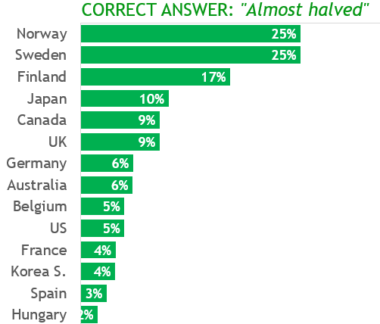
Question A (poverty)

Slide 13
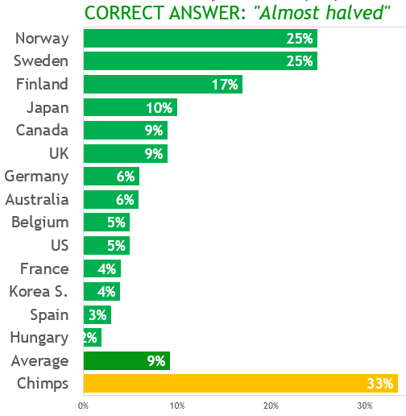
Question A (poverty)

Slide 14
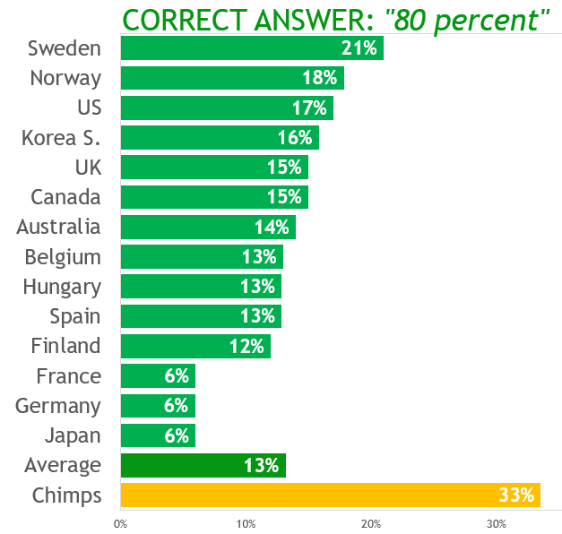
Question B (vaccinations)

Slide 15
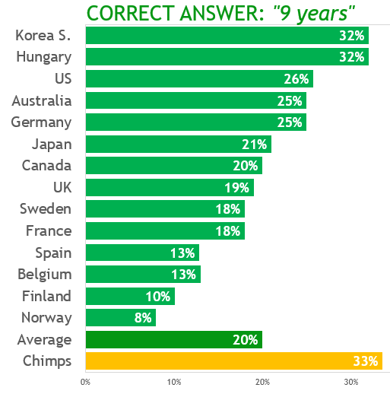
Question C (schooling)

Slide 16
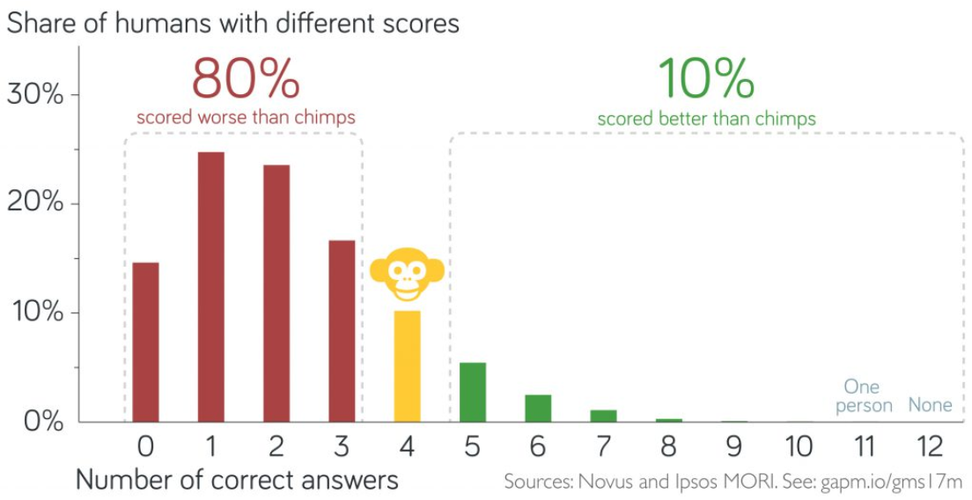
Worse than ignorance

Slide 17


Inspirations for this talk

Slide 18
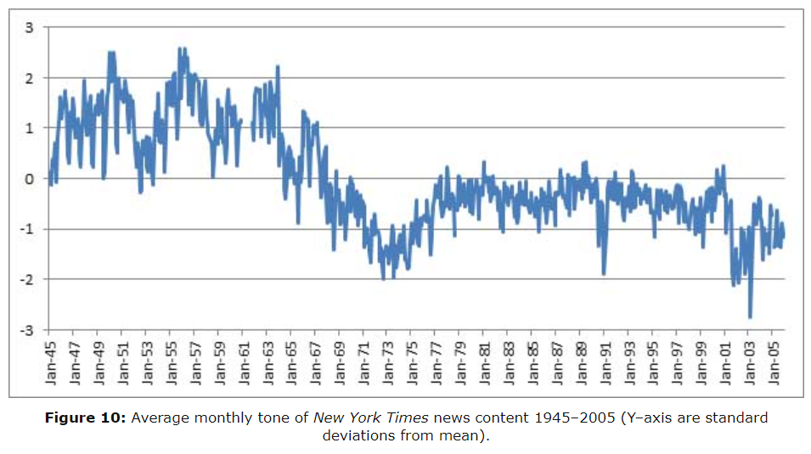
Sentiment analysis of news (Leetaru)

Slide 19
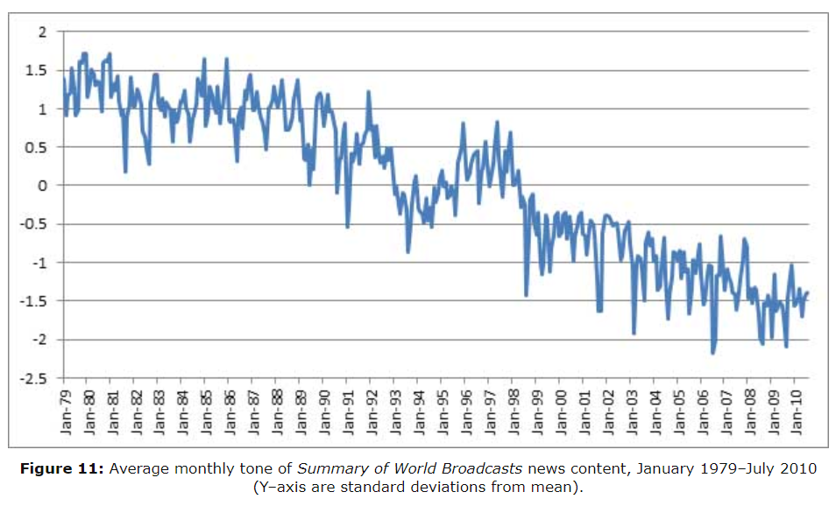
Sentiment analysis of news (Leetaru)

Slide 20
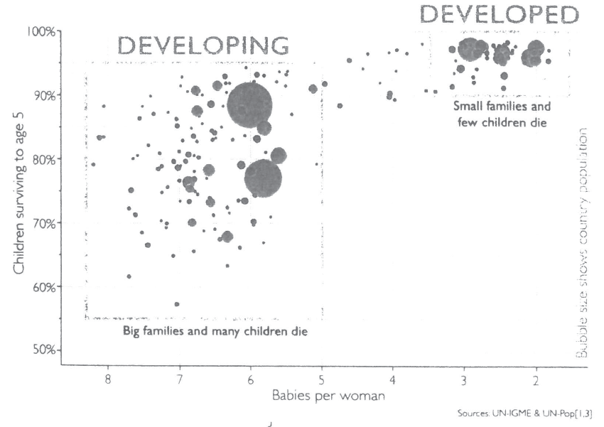
Developed vs. developing countries

Slide 21
Developed vs. developing countries
1965

Slide 22
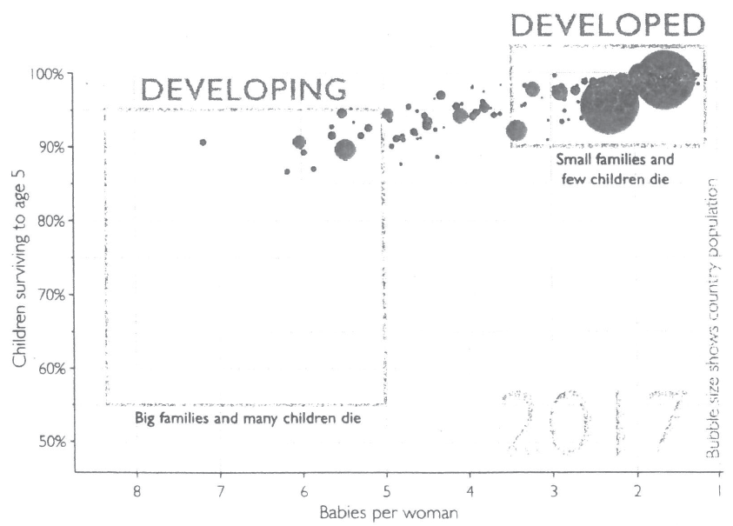
Developed vs. developing countries
2017

Slide 23
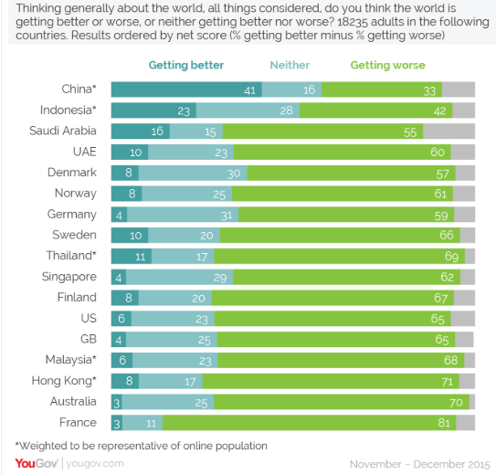
Perception: World is getting worse

Slide 24
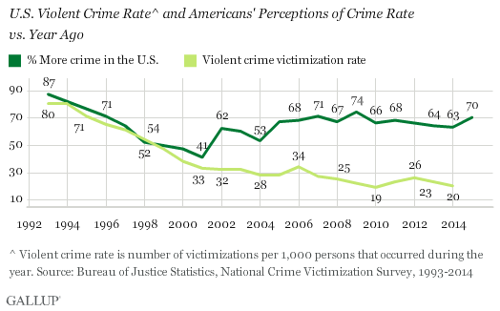
Crime rate: Perception vs. actual

Slide 25
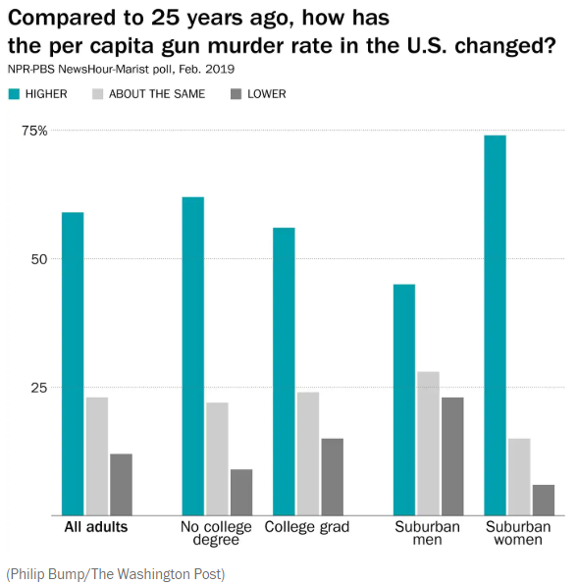
Gun murder rate: perception

Slide 26
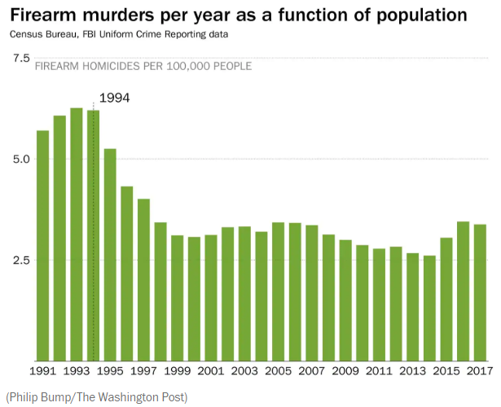
Gun murder rate: actual

Slide 27
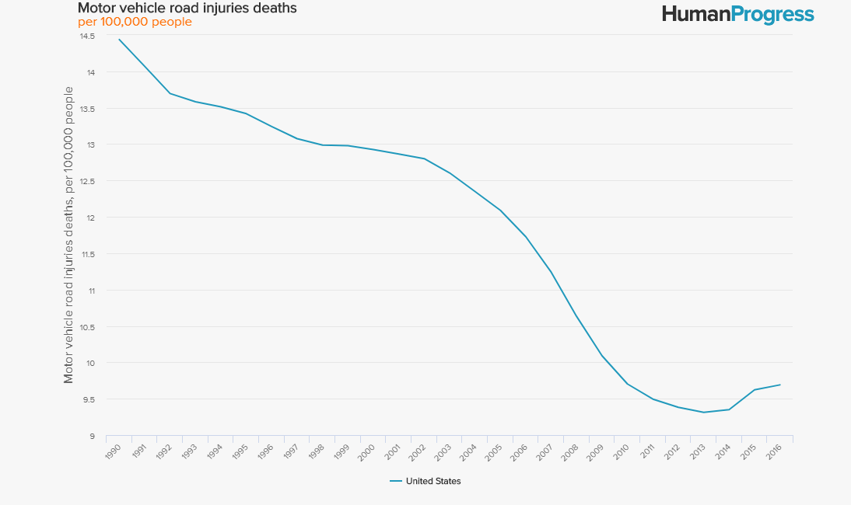
Motor vehicle road injuries, deaths

Slide 28
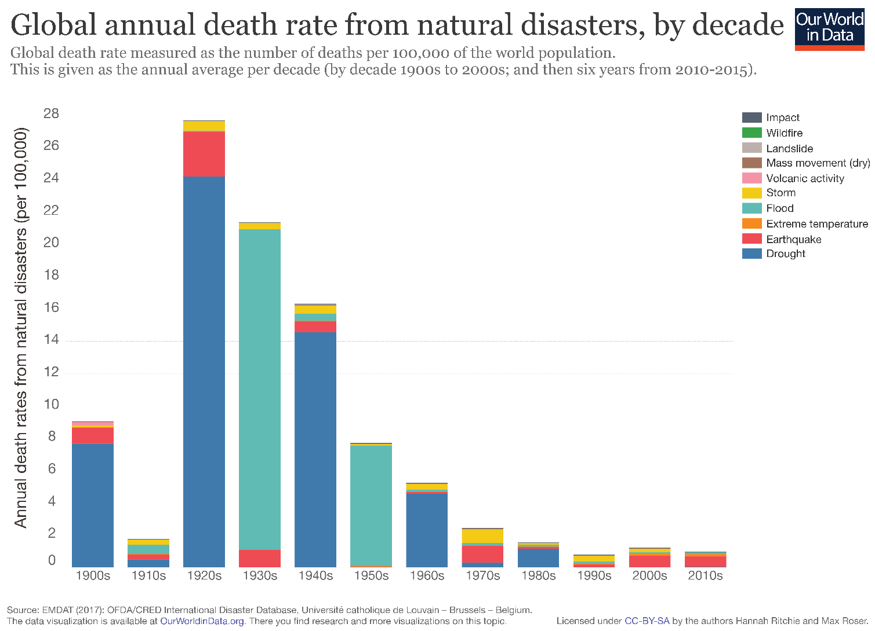
Natural disaster deaths

Slide 29
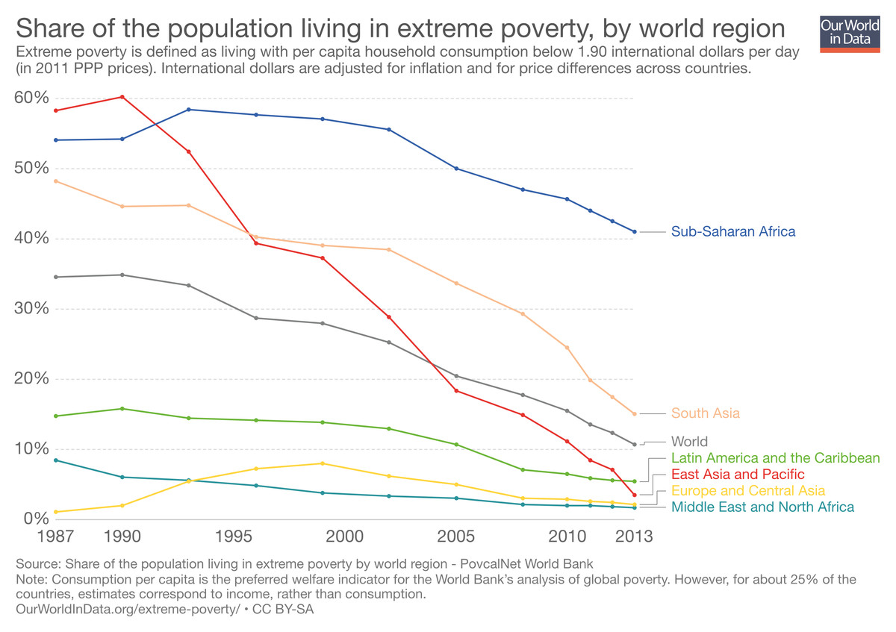
Extreme poverty

Slide 30
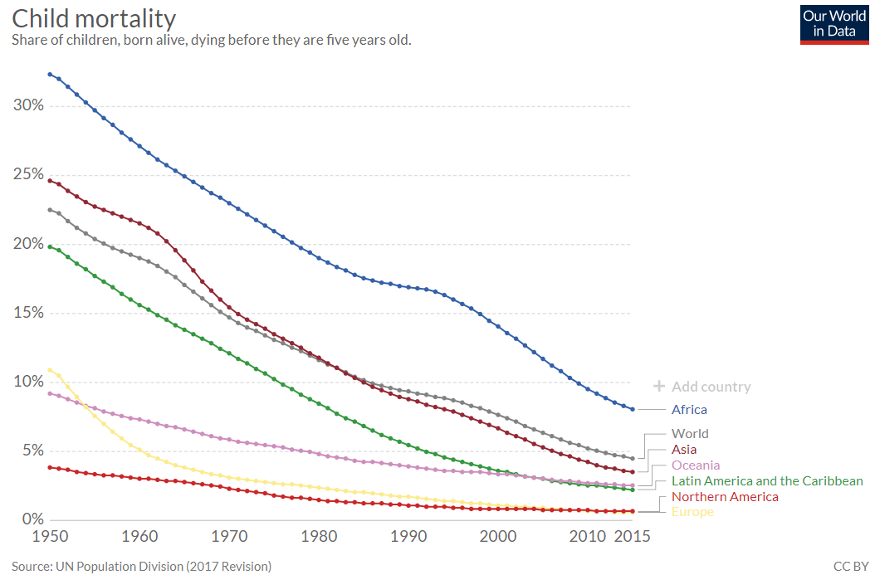
Child mortality

Slide 31
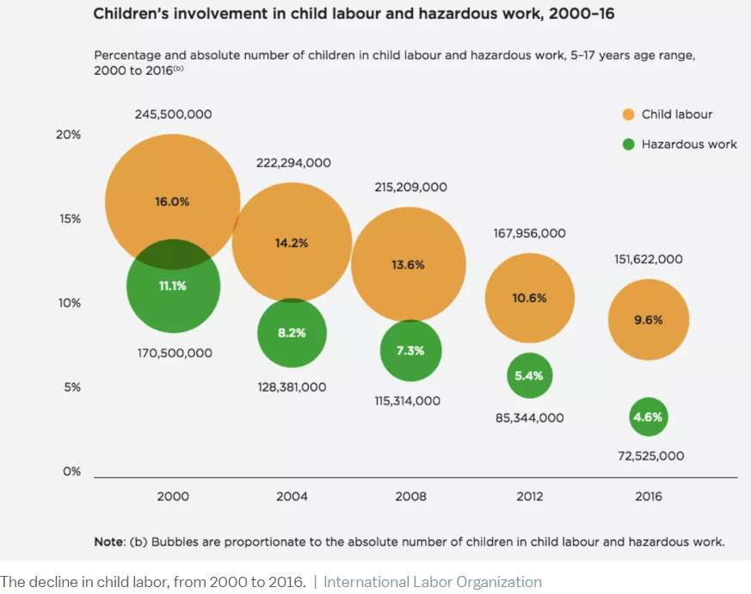
Child labor

Slide 32
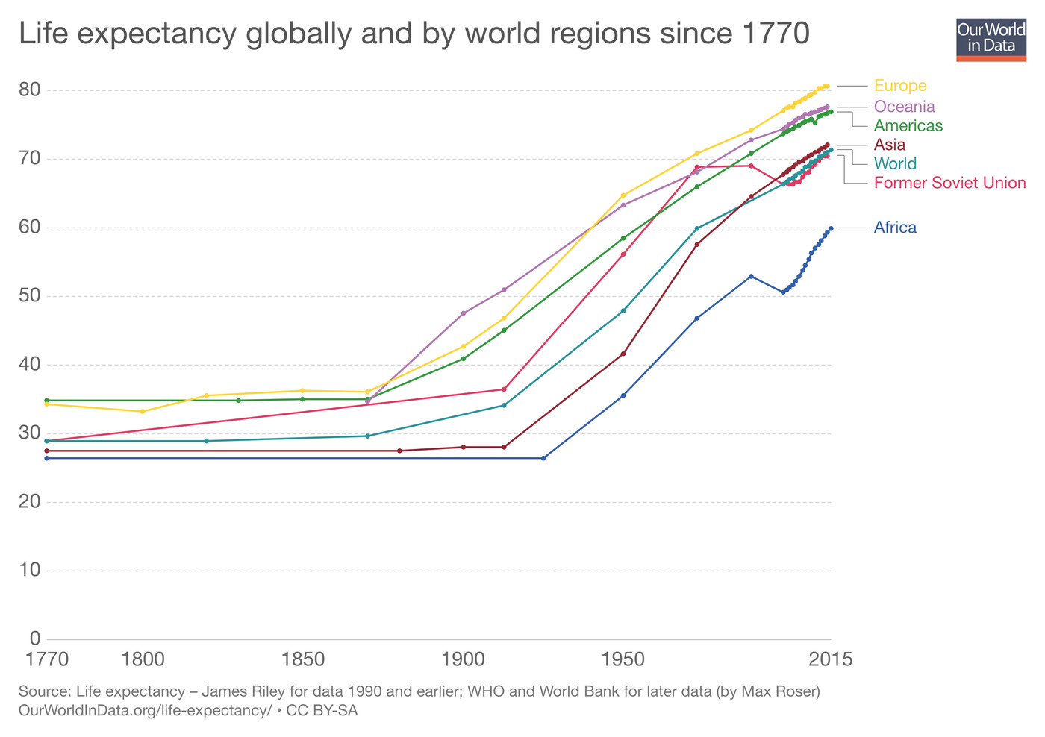
Life expectancy

Slide 33
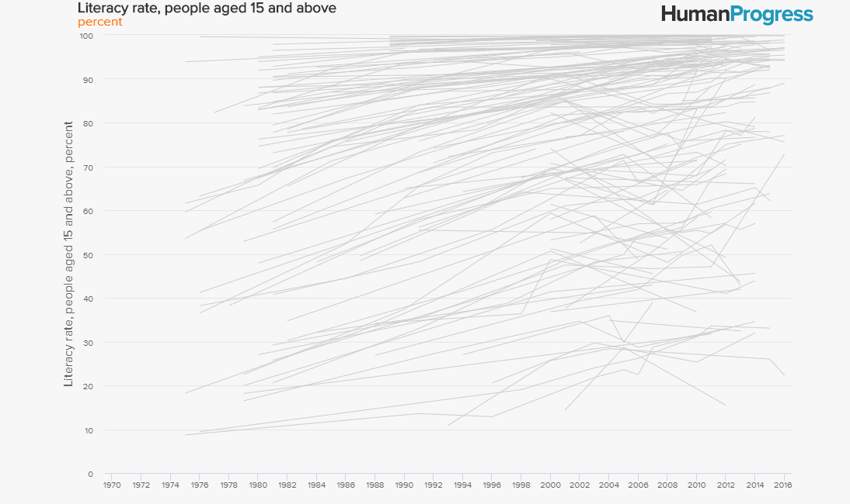
Literacy

Slide 34
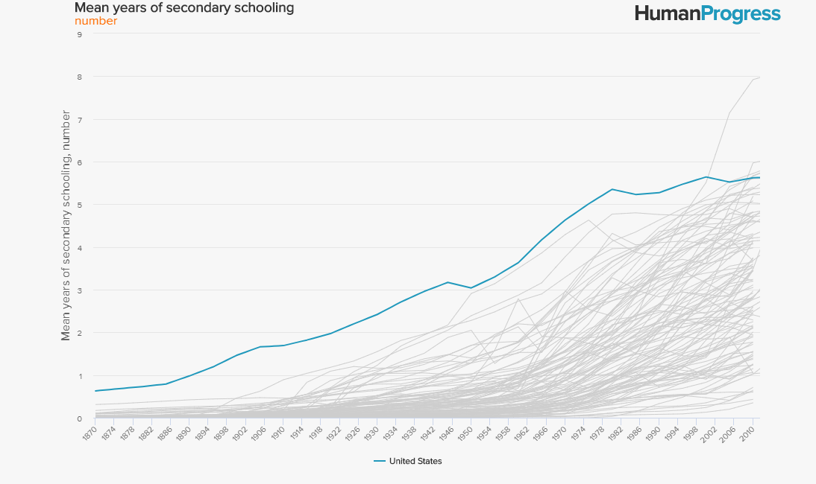
Secondary schooling

Slide 35
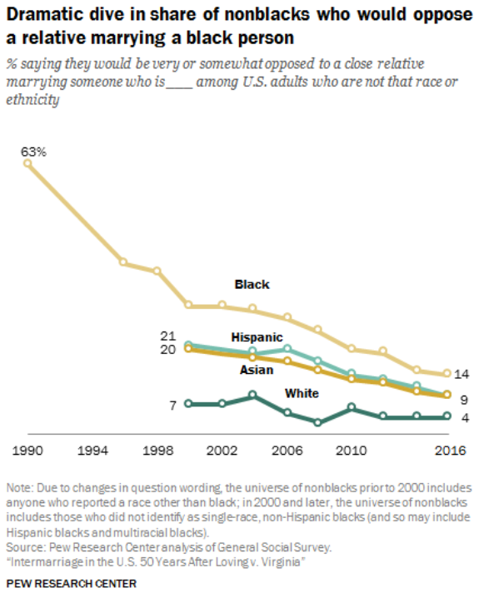
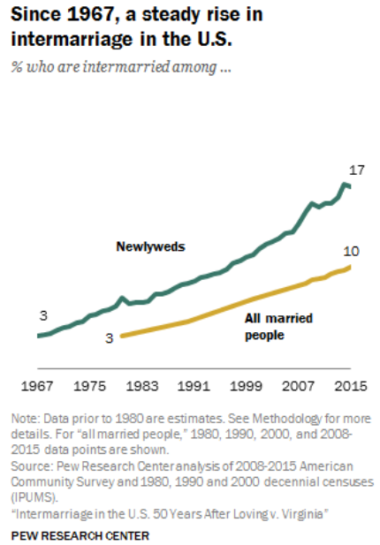
Inter-racial marriage

Slide 36
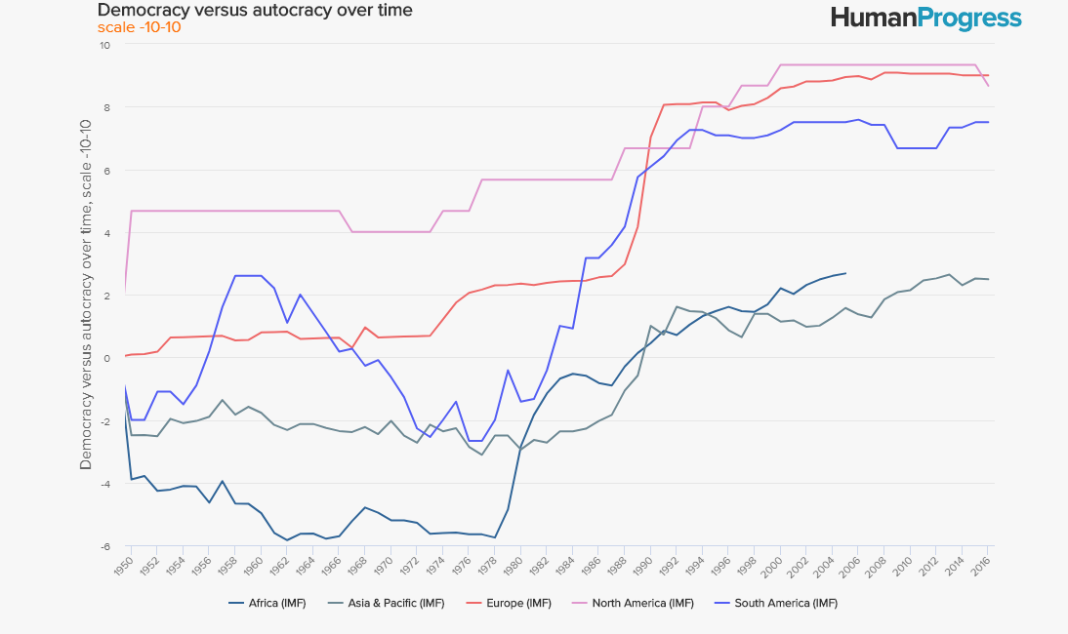
Democracy vs. autocracy

Slide 37
Take-home message
Statistics teachers can use data, examples, activities, and assignments that help to make students aware of human progress.

Slide 38
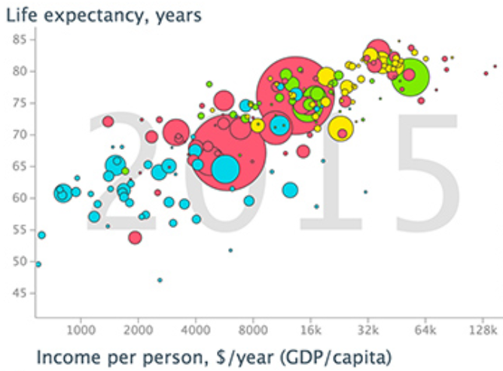
Example 1: Health vs. wealth
Students watch Rosling’s video on “200 countries, 200 years in 4 minutes”

Slide 39
Example 1: Health vs. wealth
Identify the observational units in this graph.
Identify all of the variables in this graph.
Classify each variable as categorical or numerical.
Describe the association between income per person and life expectancy.
Describe what the graph reveals about any relationship between regions of the world and health/wealth.

Slide 40
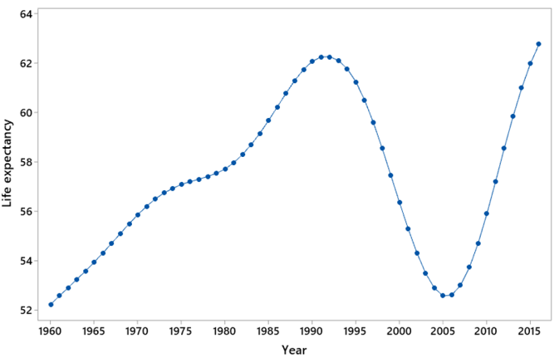
Example 2: Life expectancy in …
Describe what this graph reveals.
Make an educated guess for the country.

Slide 41
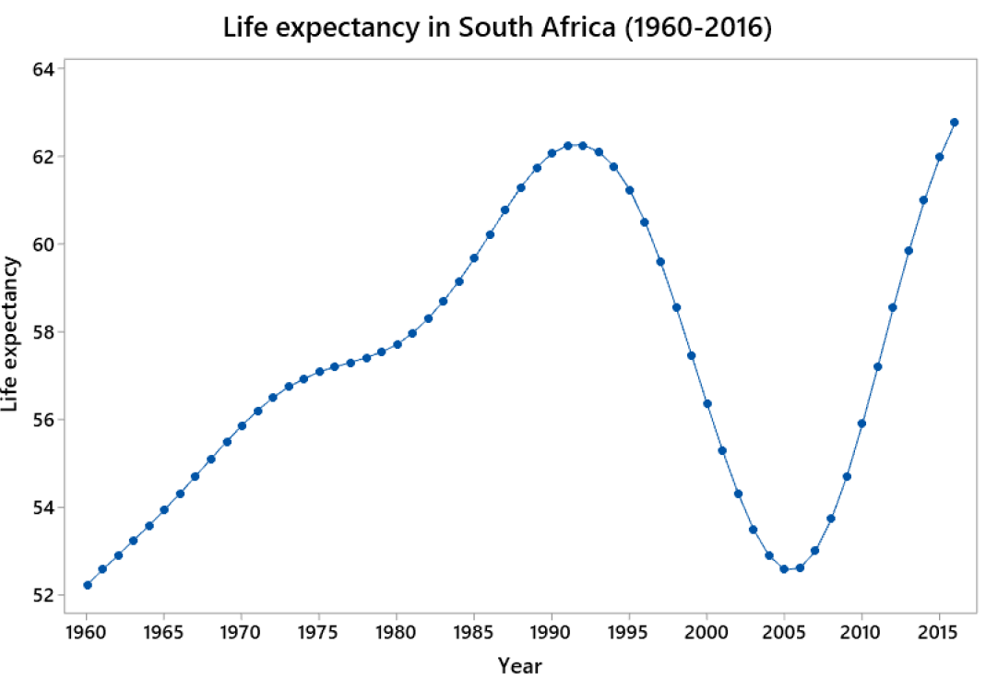
Example 2: Life expectancy in …
Explain what happened in the 1990s.

Slide 42
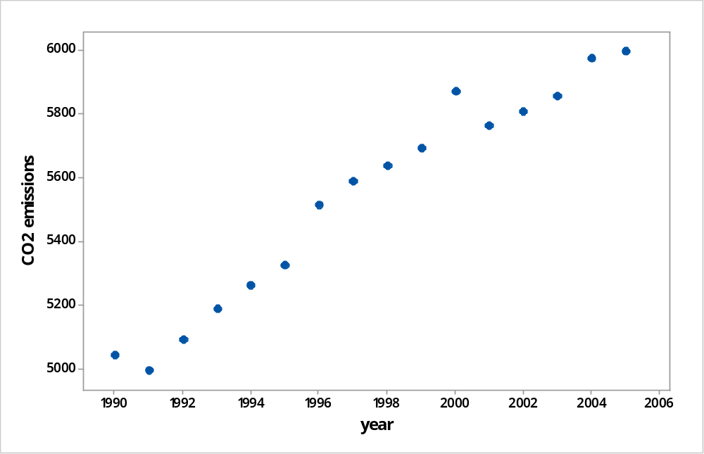
Example 3: CO2 emissions
Energy-related CO2 emissions (in millions of metric tons) in the U.S. from 1990-2005
Source: https://www.eia.gov/environment/emissions/carbon/

Slide 43
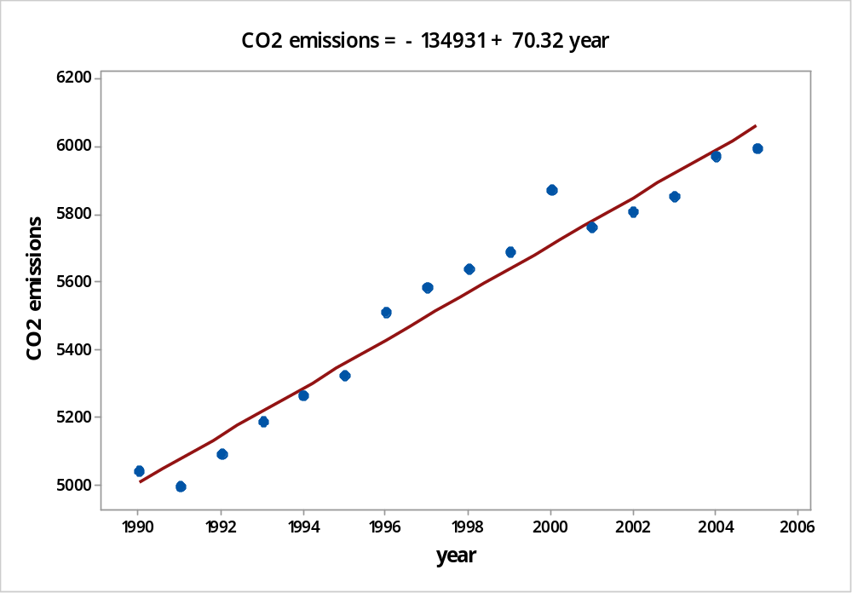
Example 3: CO2 emissions
Describe what graph reveals.
Determine least squares line.

Slide 44
Example 3: CO2 emissions
Interpret the slope coefficient of the line.
Use the line to predict CO2 emissions for the year 2016.
Predicted CO2 emissions in year 2016
= -134,931 + 70.32×2016 ≈ 6834 mmt
Actual CO2 emissions in year 2016: 5170 mmt
Determine percentage error of the prediction
(6834 – 5170) / 5170 × 100% ≈ 32.2%

Slide 45
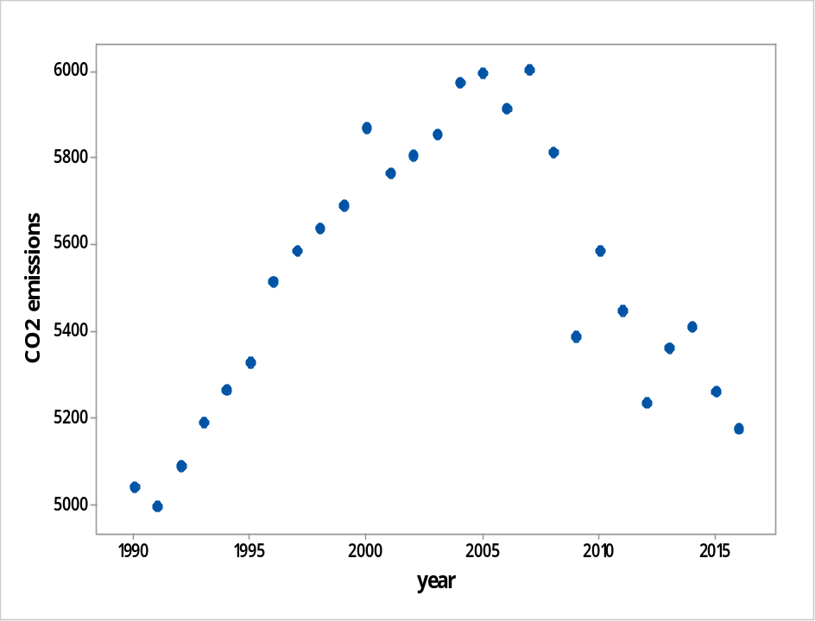
Example 3: CO2 emissions
What went wrong??
Beware of extrapolation

Slide 46
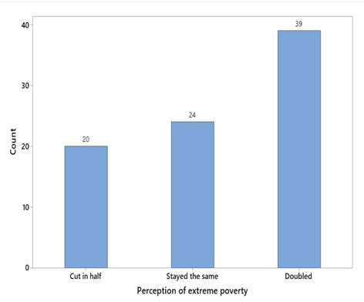
Example 4: Global poverty question
Data from a recent class of mine (n = 83)

Slide 47
Example 4: Global poverty question
Do the sample data provide strong evidence that less than one-third of all students at the university would answer correctly (i.e., that students do worse than chimpanzees would)?
Simulation-based inference

Slide 48
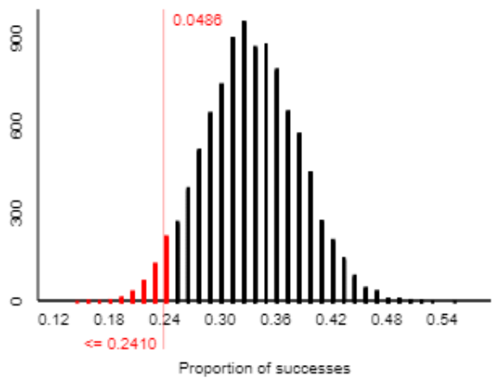
Example 4: Global poverty question
Moderately strong evidence (p-value ≈ .0486) that less than one-third would answer correctly

Slide 49
Example 5: Global poverty question
U.S. survey: 59% of 1005 answered “doubled”
Estimate the proportion of all U.S. adults who would answer “doubled” with 95% confidence
.59 ± .030: (.560, .620)
Interpret this interval.

Slide 50
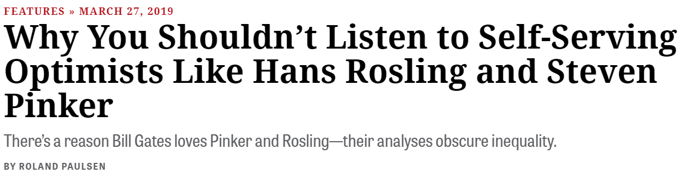

Criticisms
inthesetimes.com
The Chronicle Review

Slide 51
Disclaimer
I also believe that:
Enormous progress remains to be made.
Statistics teachers should also present data, examples, activities, and assignments that expose problems, inequity, and injustice.
  Students can be motivated to address societal challenges by studying such examples.

Slide 52
For more information
Steven Pinker, Enlightenment Now
Hans Rosling, Factfulness
www.gapminder.org
ourworldindata.org
humanprogress.org

Slide 53
One more quote
“If you could choose a moment in history to be born, and you didn’t know ahead of time who you were going to be, you’d choose now.
Because the world has never been less violent, healthier, better educated, more tolerant, with more opportunity for more people, and more connected than it is today.”

Slide 54
One more quote
“If you could choose a moment in history to be born, and you didn’t know ahead of time who you were going to be, you’d choose now.
Because the world has never been less violent, healthier, better educated, more tolerant, with more opportunity for more people, and more connected than it is today.”
‒ President Barack Obama, July 20, 2016

Slide 55
Thanks!
Shameless plug for my new blog about teaching introductory statistics: askgoodquestions.blog
  These slides can be found there
Contact me with questions and comments: arossman@calpoly.edu

