Slide 1
Teaching Introductory Statistics: Implementing GAISE Recommendations
Allan Rossman
Department of Statistics
Cal Poly – San Luis Obispo
arossman@calpoly.edu
https://askgoodquestions.blog

Slide 2
Overview
Please play the role of student today
  Engage with activities
  Try to experience from students’ perspective
    Well-behaved student, not problem student!
Also keep your instructor hat on
  Feel free to ask questions throughout
Thanks for coming
  Time is our most precious asset

Slide 3
Introductions
Name, school
How would you describe your comfort level with teaching statistics?
  1: Terrified, feel like I know nothing!
  2: Some comfort, but lots to learn
  3: Fairly comfortable, but still a ways to go
  4: Quite comfortable, always looking for new ideas
  5: I know everything, just here to stir up trouble!

Slide 4
GAISE
Guidelines for Assessment and Instruction in Statistics Education
Recommendations for teaching introductory statistics at college level
  Comparable guidelines at PreK-12 level
Developed by American Statistical Association
  Originally in 2005, revised in 2016
www.amstat.org/education/gaise

Slide 5
GAISE recommendations
Teach statistical thinking.
Focus on conceptual understanding.
Integrate real data with a context and purpose.
Foster active learning.
Use technology to explore concepts and analyze data.
Use assessments to improve and evaluate student learning.

Slide 6
New emphases in GAISE revision
Teach statistical thinking
  Teach statistics as investigative process of problem-solving and decision-making
  Give students experience with multivariable thinking

Slide 7
Goals for introductory students
Become critical consumers.
Be able to apply investigative process.
Produce and interpret results of graphical displays and numerical summaries.
Recognize and explain fundamental role of variability.
Recognize and explain central role of randomness in designing studies and drawing conclusions.

Slide 8
Goals for introductory students (cont)
Gain experience with statistical models, including multivariable ones.
Demonstrate understanding of, and ability to apply, statistical inference in variety of settings.
Interpret and draw conclusions from standard output of statistical software.
Demonstrate awareness of ethical issues associated with sound statistical practice.

Slide 9

Frank Sinatra
What’s the secret to being a successful singer?
  “Sing Good Songs”
9

Slide 10
My similarly succinct suggestion
What’s the secret to being an effective teacher?
  “Ask Good Questions”
10

Slide 11
What kinds/purposes of questions?
Guide students to develop their understanding and skills
  Formative assessment
  Learning activities
Assess what students have learned
  Summative assessment
  Quiz/exam questions
11

Slide 12
Descriptive statistics
I suspect that when I moved from PA to CA, the average IQ dropped in both states!
  Is this possible?
  What would have to be true (in principle) for this to happen?
Yes, if (my IQ > average IQ in PA)
and (my IQ < average IQ in CA)

Slide 13
Descriptive statistics
Suppose that Abby records the ages of customers at The Avenue (on-campus snack bar) from 11am-2pm today, while Mary records ages of customers at McDonald’s (near freeway).
Who will have the larger standard deviation of customer ages: Abby or Mary? Explain.

Slide 14
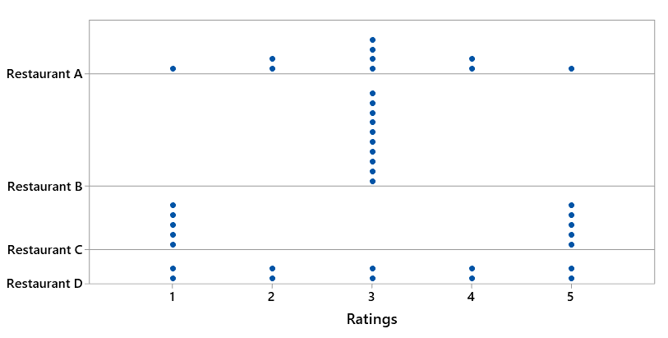
Descriptive statistics
Arrange the four restaurants in order from smallest SD of ratings to largest SD of ratings

Slide 15
Descriptive statistics
Example (adapted from Jay Lehmann):
Which would be larger – the mean weight of 10 randomly selected people or the mean weight of 1000 randomly selected cats? Explain briefly.
Which would be larger – the standard deviation of the weights of 1000 randomly selected people or the standard deviation of the weights of 10 randomly selected cats? Explain briefly.

Slide 16
Descriptive statistics
Many of my students think that larger sample size produces smaller SD
Do not realize that SD of the sample mean (or sample proportion) gets smaller as sample size increases
Advice: When you talk about SD, always emphasize SD of what

Slide 17
Descriptive statistics
Exam scores have mean 70, SD 8
  Arturo’s score is 75
  Bella’s score is 1.5 SDs above Arturo’s
What is Bella’s score on the exam?
  Concept: Measuring distance as number of SDs away from something
  Not necessarily away from mean

Slide 18
Descriptive statistics
Suppose that every student in our class scored 5 points lower on the second exam than on the first exam.
What would be the value of the correlation coefficient between exam1 score and exam2 score?
  Options: -5, -1, -0.5, 0, 0.5, 1, 5

Slide 19
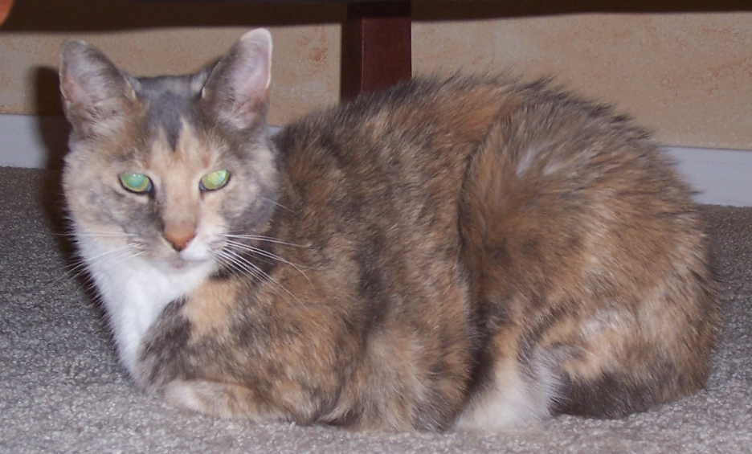
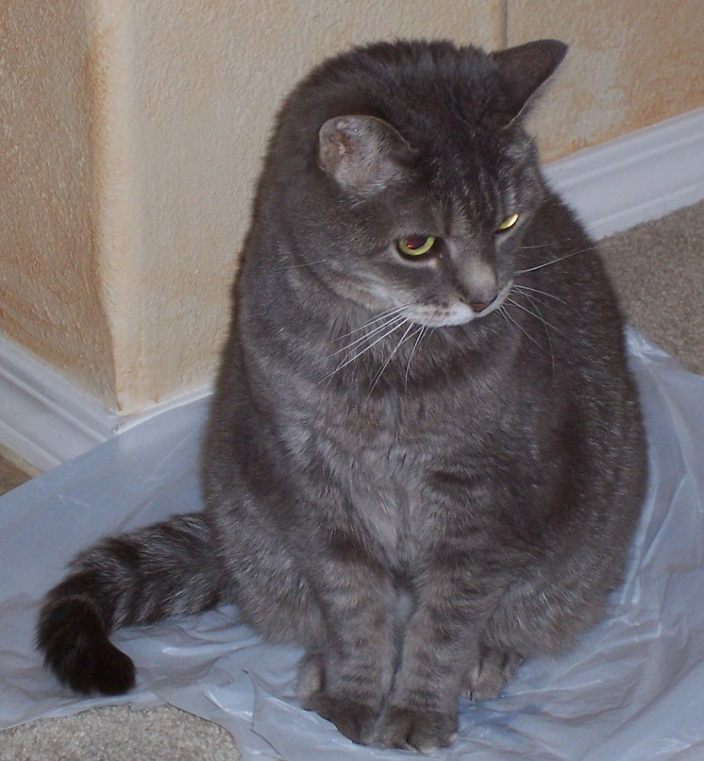
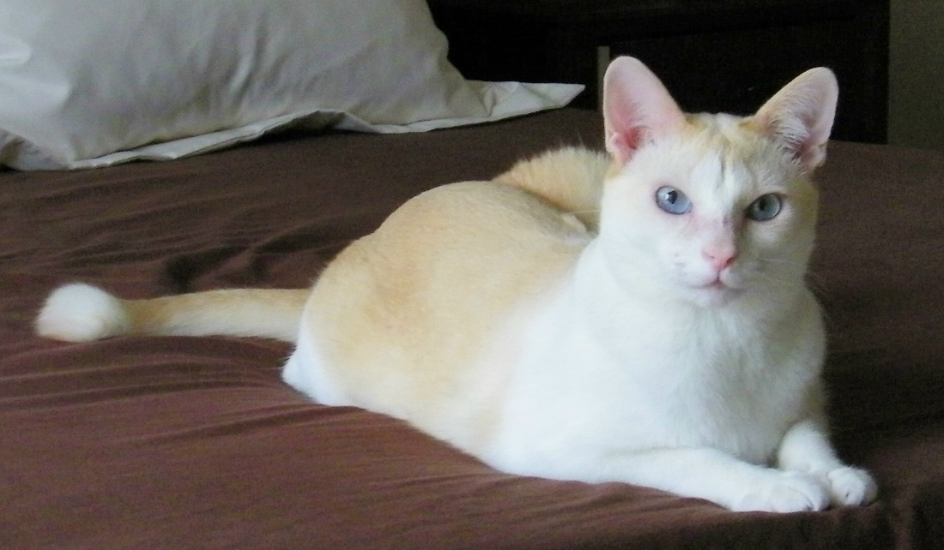
My cats

Slide 20
“Ask Good Questions” blog
Ideas, examples, activities, assessments and advice for teaching introductory statistics
Two goals
  Practical, for direct use with students
  Thought-provoking, for discussion with peers
One post/essay per week
  Published on Mondays at 11am ET, 8am PT
  2000-3000 words per essay
  34 so far, 18 (at least) more to come

Slide 21
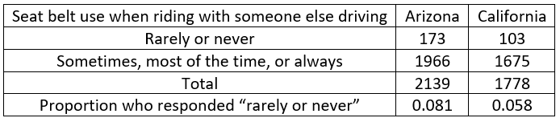
A recent post: A pervasive pet peeve
2017 Youth Risky Behavior Surveillance Survey
Were Arizona youths 2.3% more likely to respond “rarely or never” than California youths?
No! The Arizona percentage was 2.3 percentage points higher than California’s.

Slide 22
A recent post: A pervasive pet peeve
2017 Youth Risky Behavior Surveillance Survey
Percentage difference:
(.081-.058)/.058 × 100% ≈ 39.6%
Arizona youths were 39.6% more likely than California youths to respond “rarely or never”

Slide 23
A recent post: A pervasive pet peeve
2017 Youth Risky Behavior Surveillance Survey
Relative risk: .081/.058 ≈ 1.396
Arizona youths were 1.396 times more likely than California youths to respond “rarely or never”
% difference = (relative risk – 1) × 100%

Slide 24
A recent post: A pervasive pet peeve
Potential title: A persnickety post that preaches about a pervasive, persistent, and pernicious pet peeve concerning percentages (60% P-words)
Actual title: A pervasive pet peeve (75%)
So, is this a 15% increase in % of P-words?
  No, that’s the pet peeve!

Slide 25
“Ask Good Questions” blog
Sign up to receive weekly email messages containing post
Peruse annotated list of posts
Post #1 answers ten questions
https://askgoodquestions.blog/posts

Slide 26
Let’s get started!

