Slide 1
Revealing Human Progress
Allan Rossman
Department of Statistics
Cal Poly – San Luis Obispo
arossman@calpoly.edu
https://askgoodquestions.blog
@allanjrossman

Slide 2
Outline
Introduction
  Quotes, questions, big reveal
Data and graphs (lots!)
  Human progress, perception vs. reality
My request
Class examples
Conclusion
  Disclaimer, criticisms, final quote

Slide 3
Quote 1: Quantitative mindset
“How can we soundly appraise the state of the world? The answer is to count. … A quantitative mindset, despite its nerdy aura, is in fact the morally enlightened one, because it treats every human life as having equal value rather than privileging the people who are closest to us or most photogenic.” ‒ Steven Pinker

Slide 4
Question A
In the last 20 years, the proportion of the world population living in extreme poverty has …?
  Almost doubled
  Remained more or less the same
  Almost halved

Slide 5
Question B
What percent of the world’s 1-year-old children today have been vaccinated against some disease?
  20 percent
  50 percent
  80 percent

Slide 6
Question C
Worldwide, 30-year-old men have spent 10 years in school, on average. How many years have women of the same age spent in school, on average?
  9 years
  6 years
  3 years

Slide 7
Quote 2: Most important change
“Over the past twenty years, the proportion of the global population living in extreme poverty has halved. This is absolutely revolutionary. I consider it to be the most important change that has happened in the world in my lifetime.” ‒ Hans Rosling

Slide 8
Question A
In the last 20 years, the proportion of the world population living in extreme poverty has …?
  Almost doubled
  Remained more or less the same
  Almost halved

Slide 9
Question B
What percent of the world’s 1-year-old children today have been vaccinated against some disease?
  20 percent
  50 percent
  80 percent

Slide 10
Question C
Worldwide, 30-year-old men have spent 10 years in school, on average. How many years have women of the same age spent in school, on average?
  9 years
  6 years
  3 years

Slide 11
Quote 3: The big reveal!
“Here is a shocker: The world has made spectacular progress in every single measure of human well-being.
Here is a second shocker: Almost no one knows about it.” ‒ Pinker

Slide 12
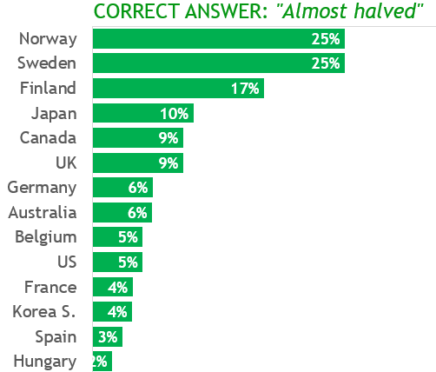
Question A (poverty)

Slide 13
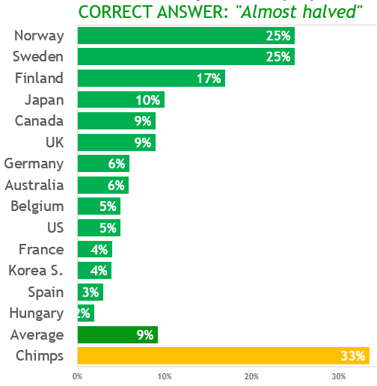
Question A (poverty)

Slide 14
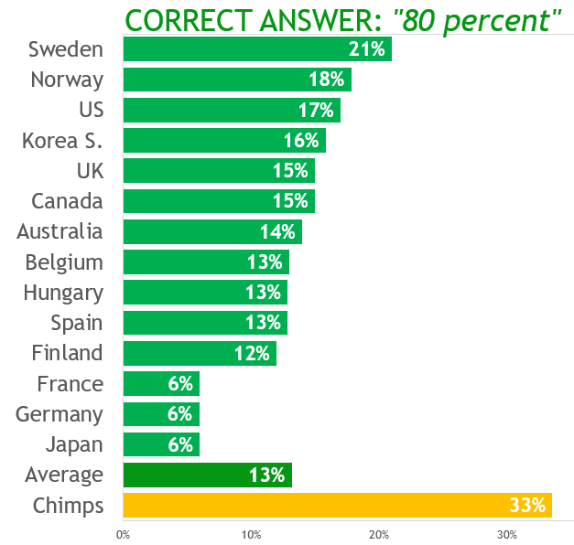
Question B (vaccinations)

Slide 15
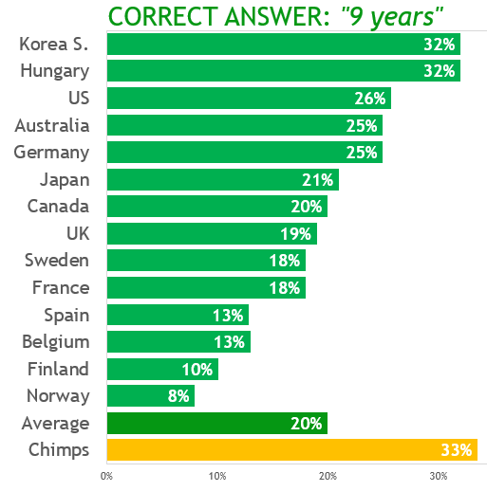
Question C (schooling)

Slide 16
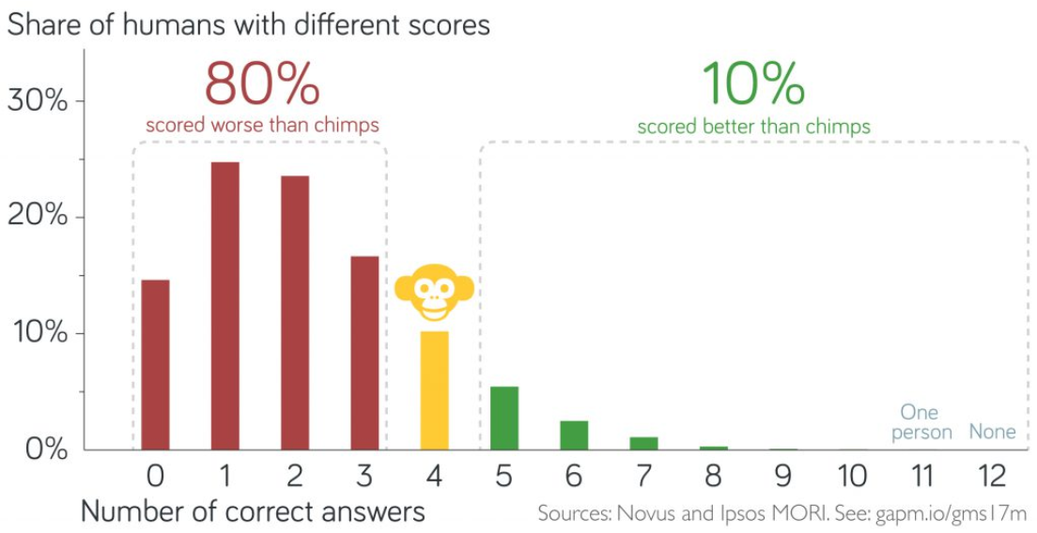
Worse than ignorance

Slide 17
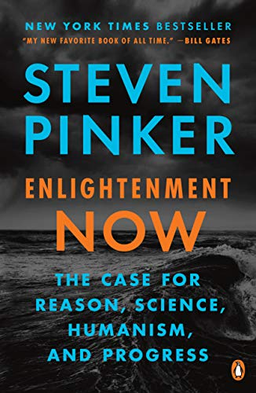

Inspirations for this talk

Slide 18
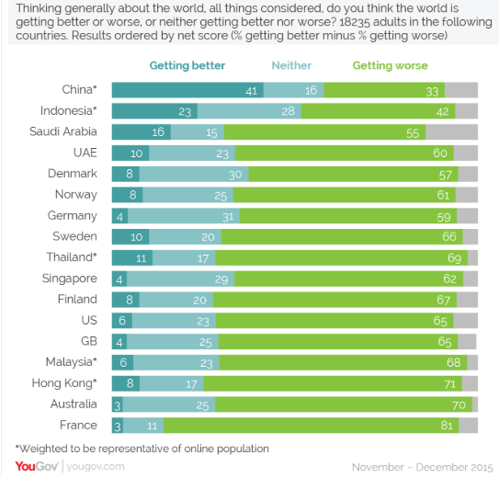
Perception: World is getting worse

Slide 19
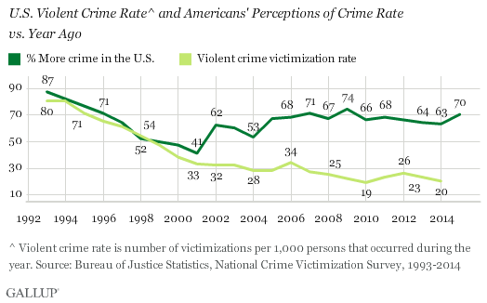
Crime rate: Perception vs. actual

Slide 20
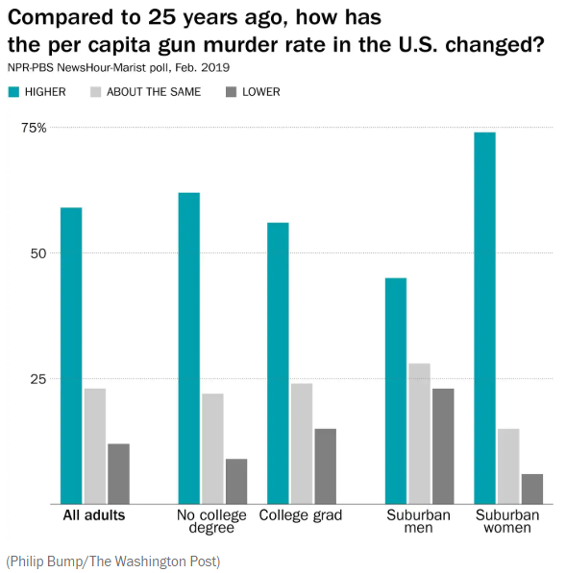
Gun murder rate: perception

Slide 21
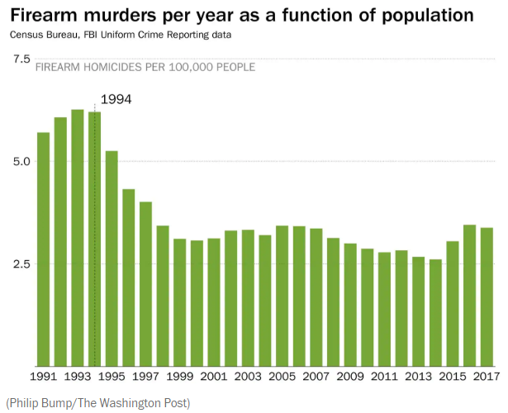
Gun murder rate: actual

Slide 22
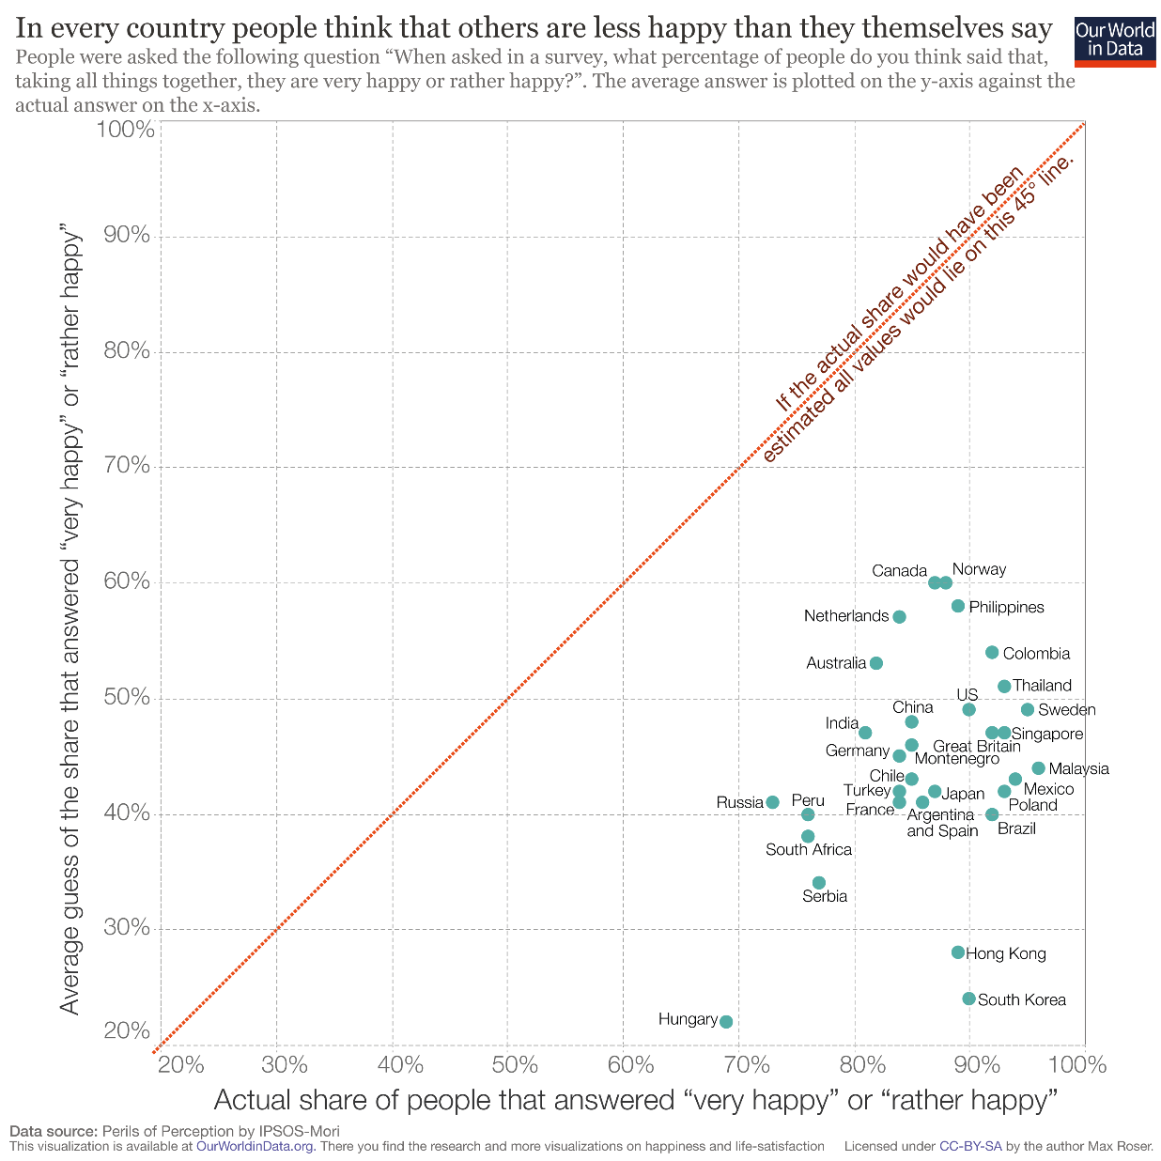
Perceived happiness of others

Slide 23
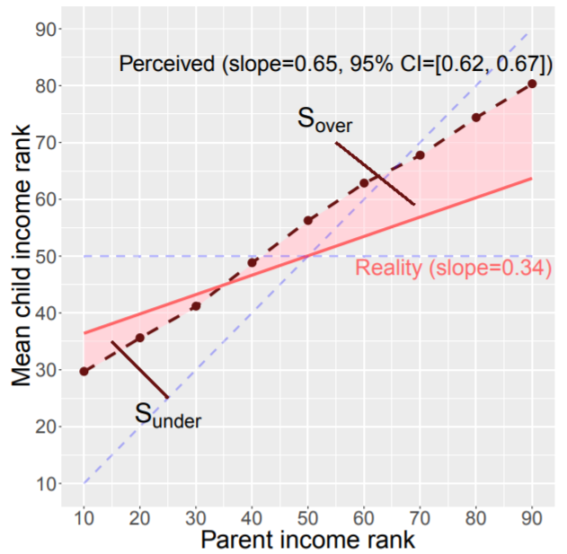
Intergenerational income mobility
Cheng and Wen (2019, PNAS)

Slide 24
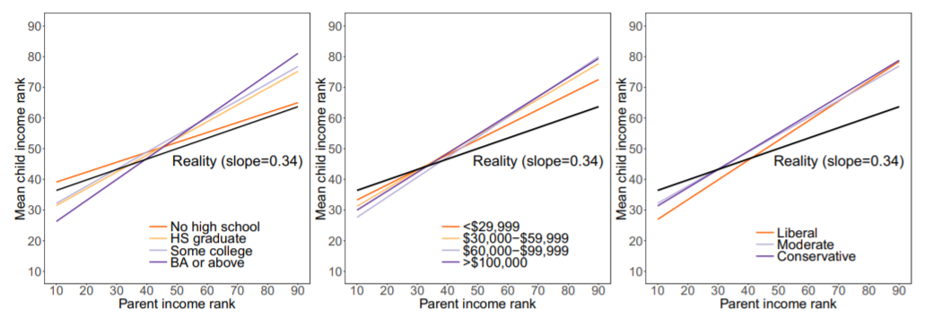
Intergenerational income mobility
Cheng and Wen (2019, PNAS)

Slide 25
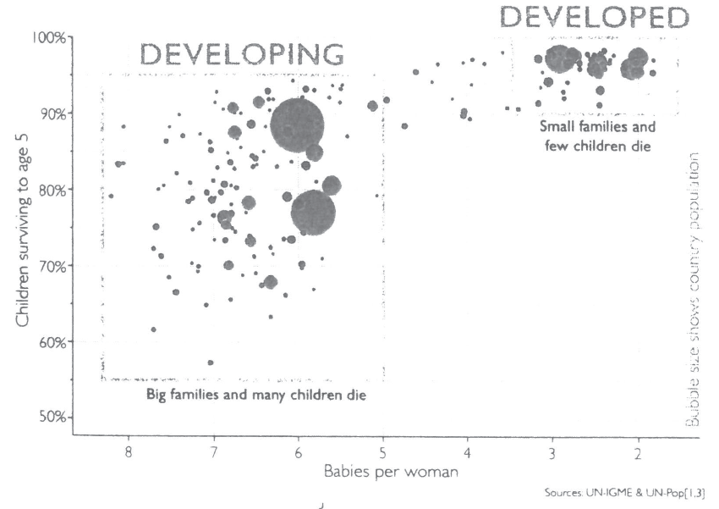
Gap instinct (Rosling)

Slide 26
Gap instinct (Rosling)
1965

Slide 27
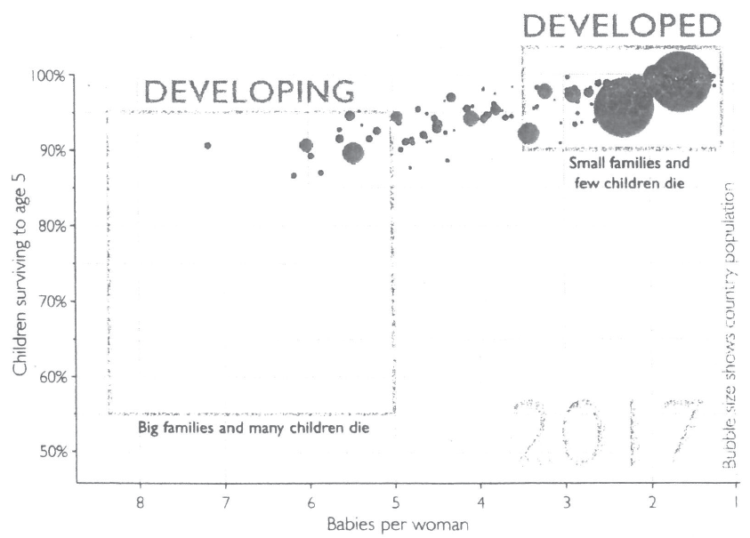
Gap instinct (Rosling)
2017

Slide 28
Data and graphs (lots!)
First: what’s going down?
Then: what’s going up?

Slide 29
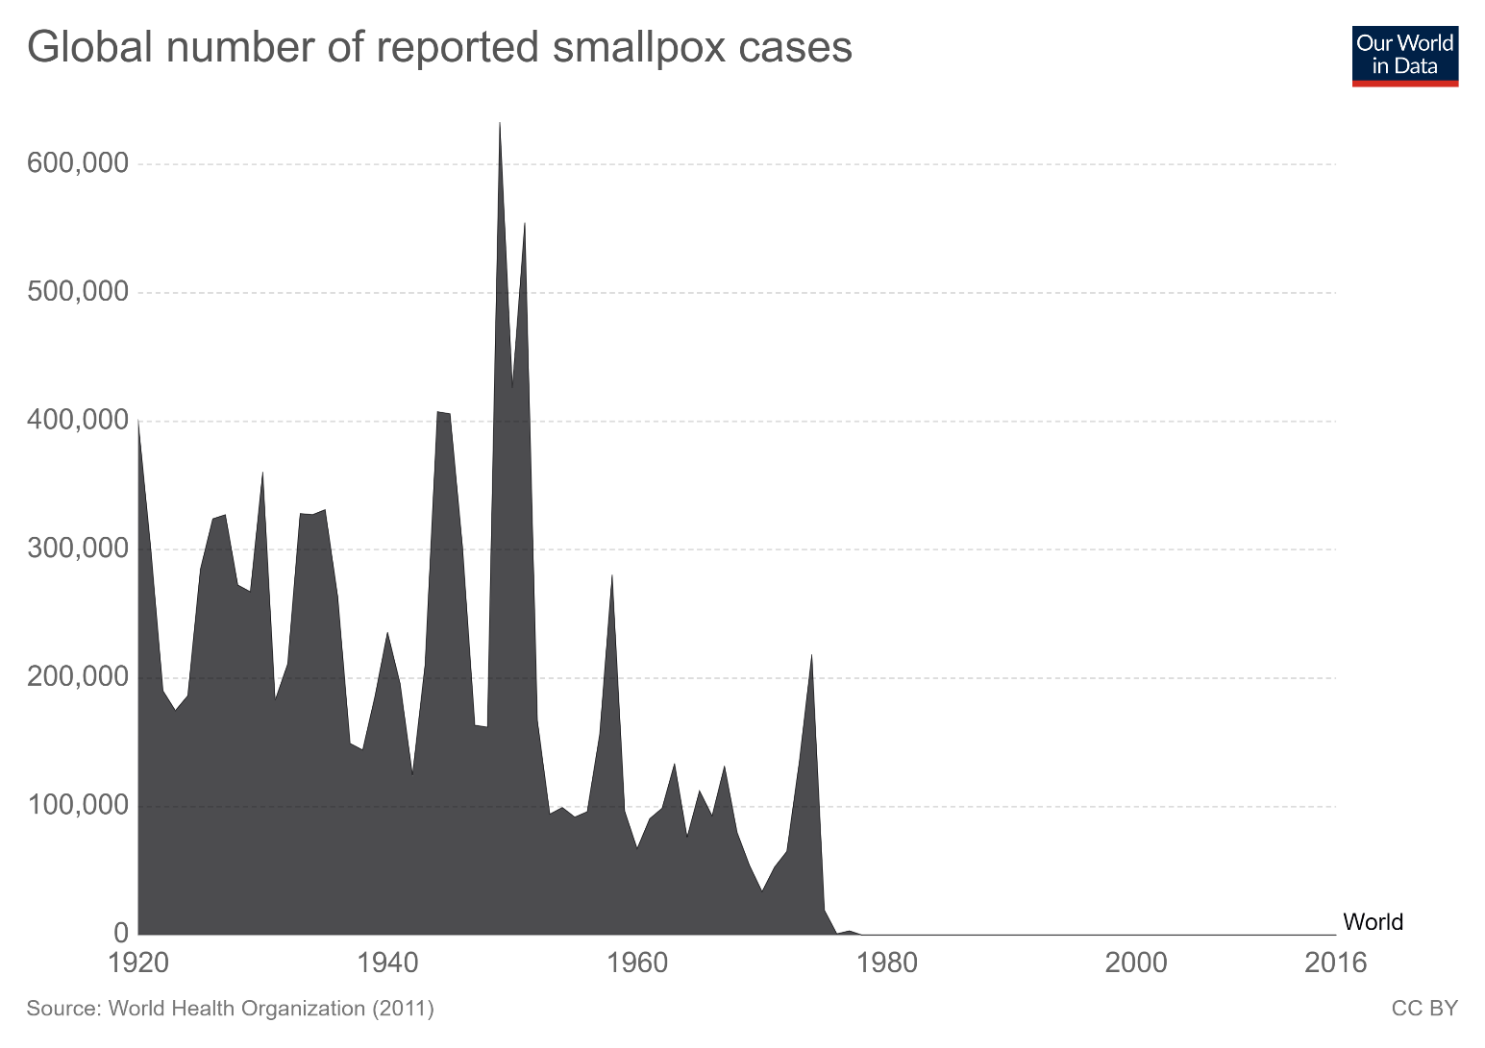
Smallpox: eradicated

Slide 30
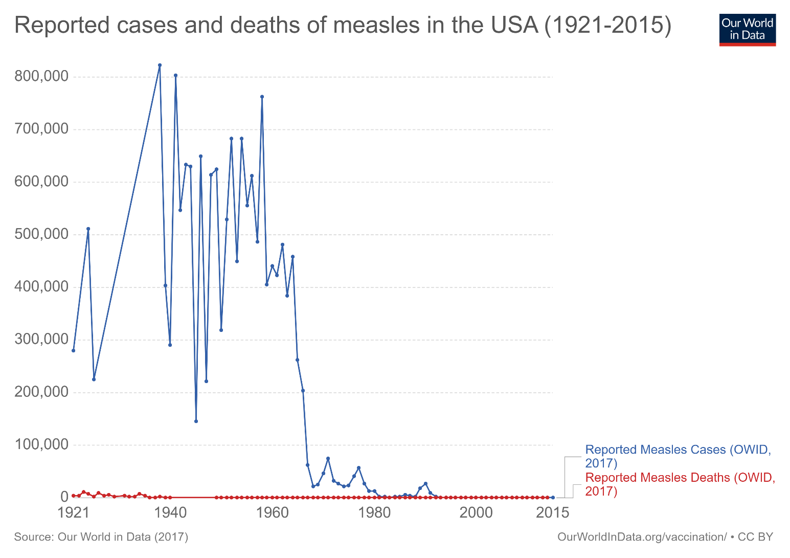
Measles cases, U.S.

Slide 31
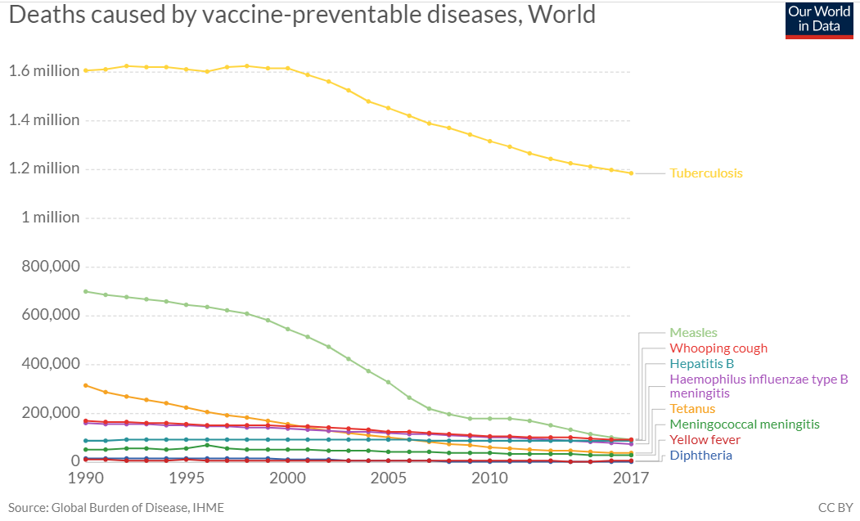
Vaccine-preventable deaths

Slide 32
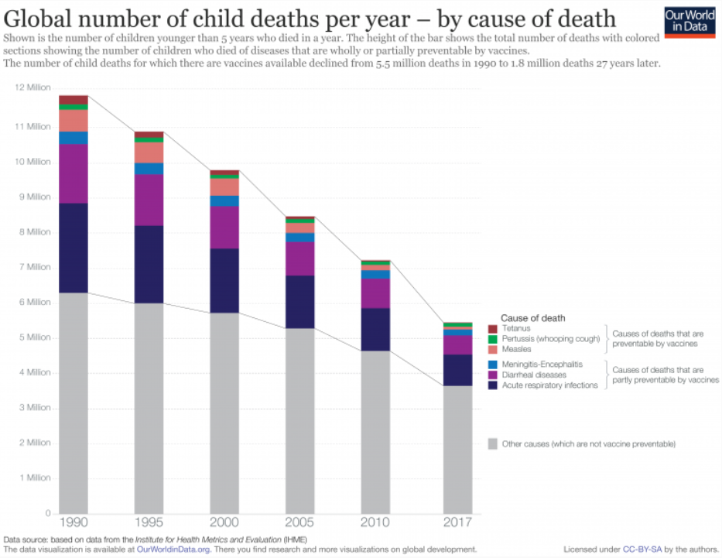
Child deaths

Slide 33
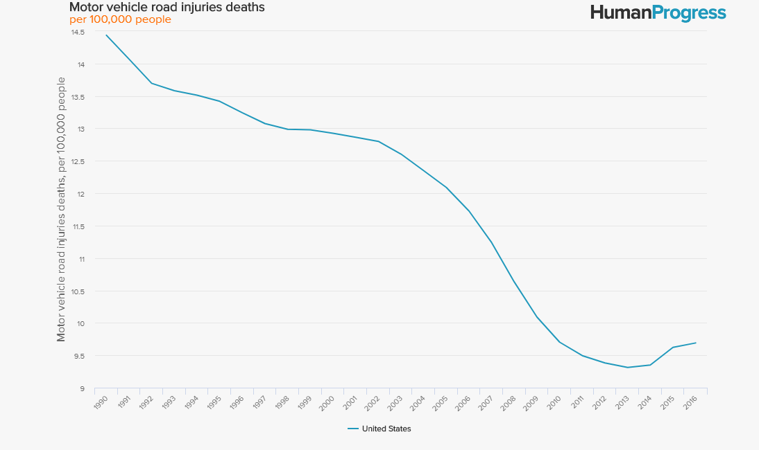
Motor vehicle injuries, deaths, U.S.

Slide 34
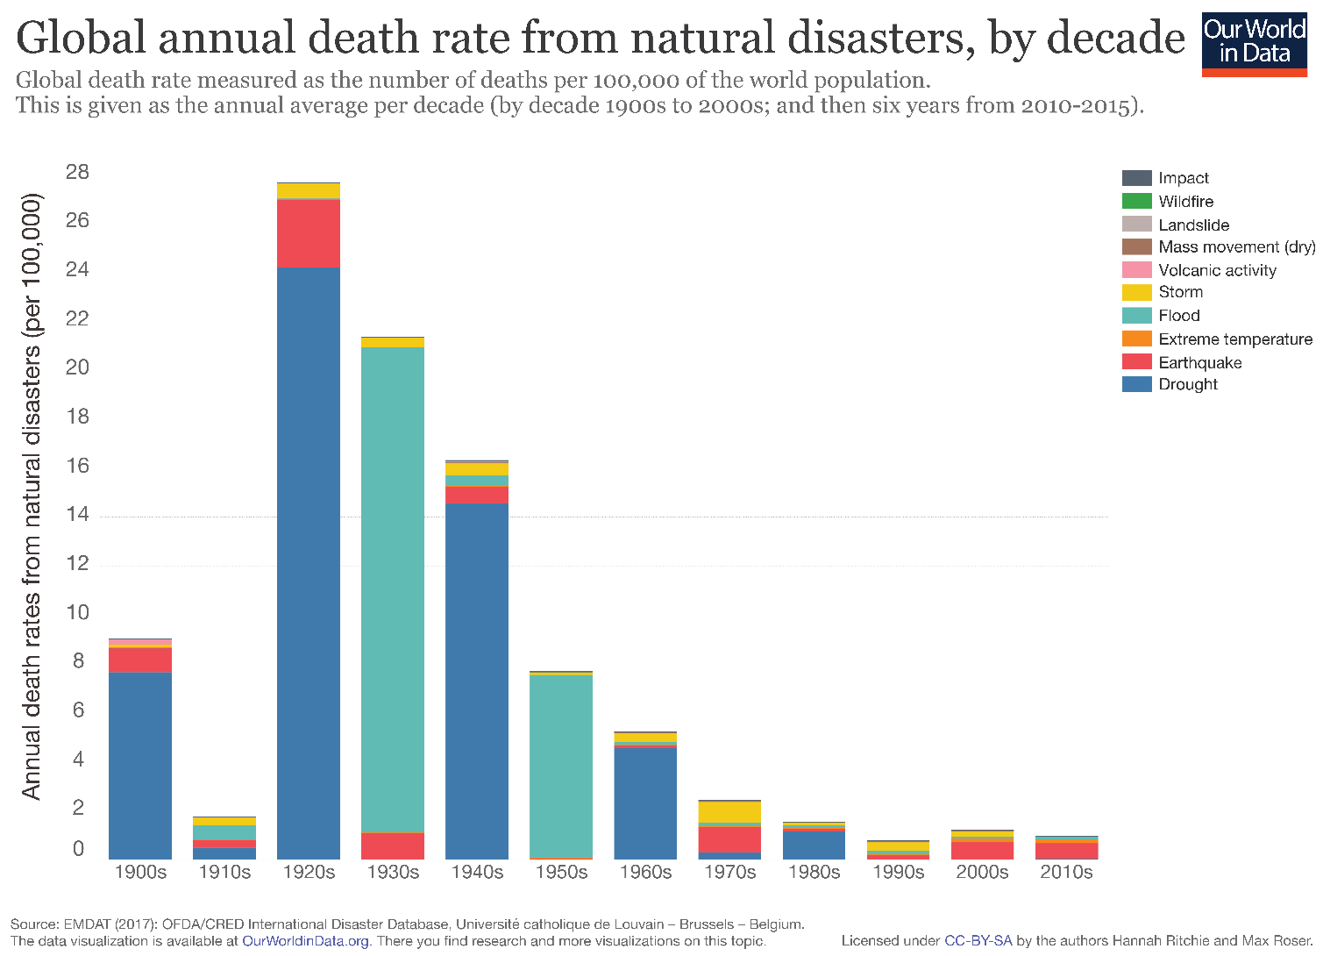
Natural disaster deaths

Slide 35
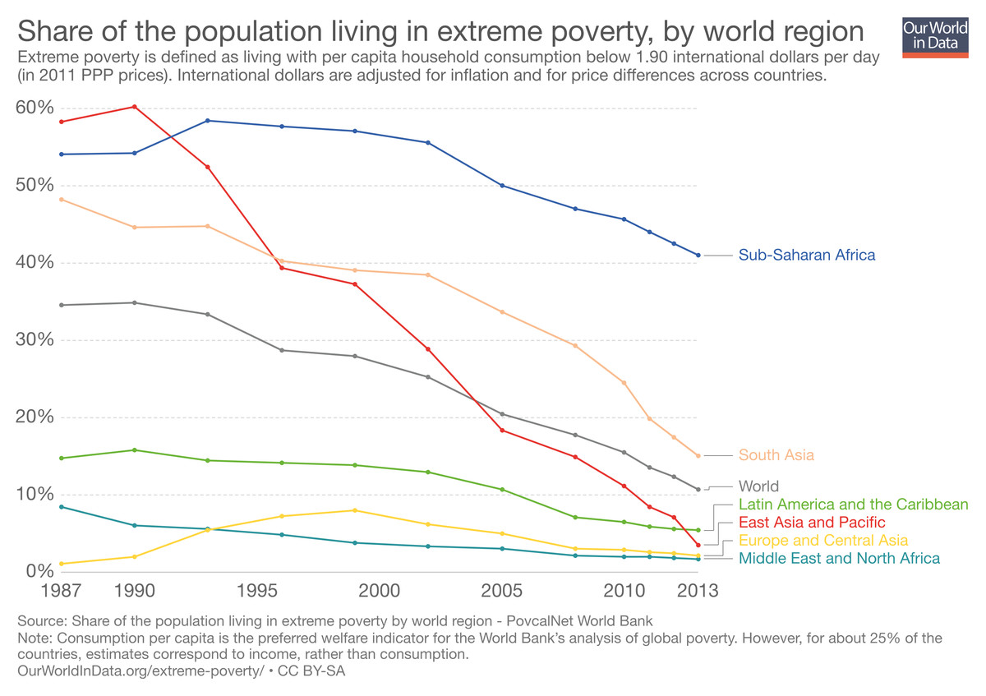
Extreme poverty

Slide 36
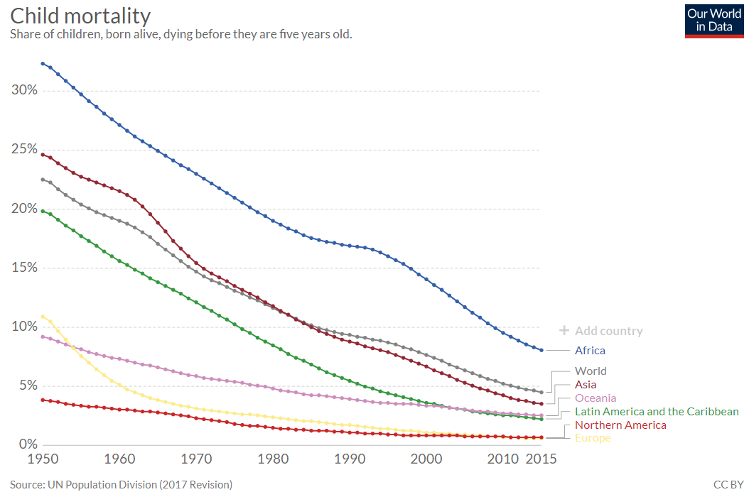
Child mortality

Slide 37
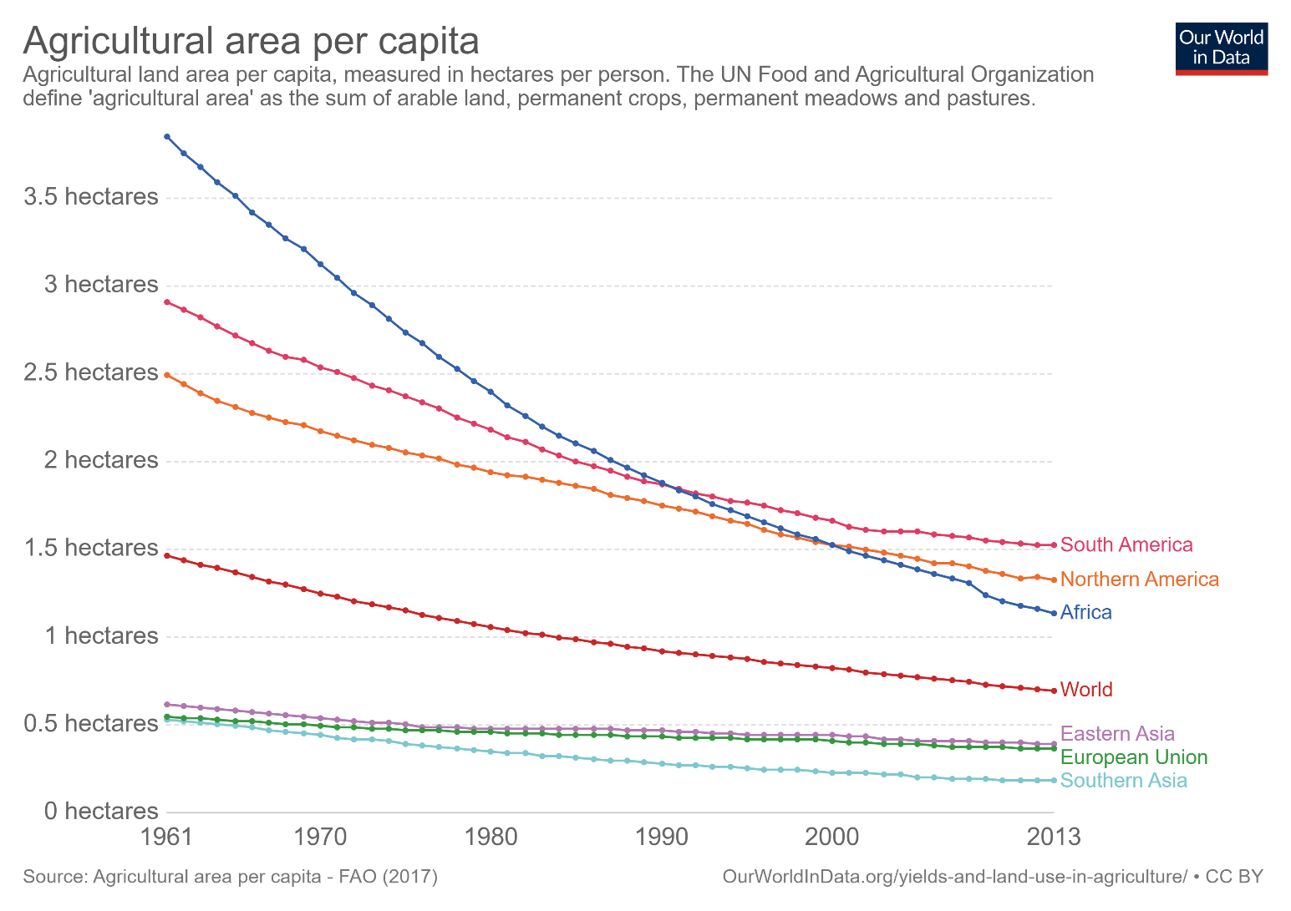
Agricultural land use

Slide 38
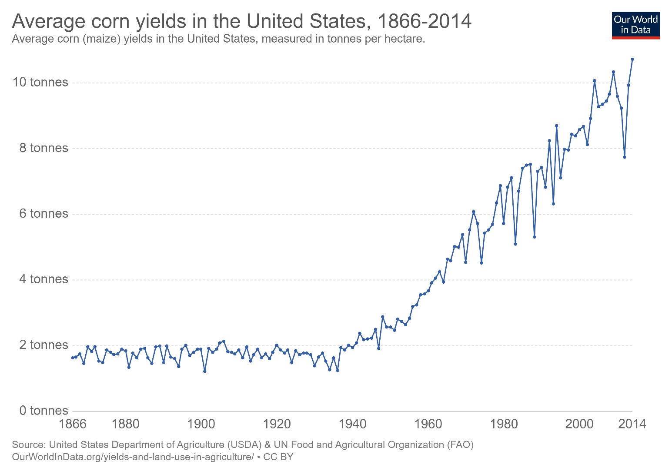
Crop yields

Slide 39
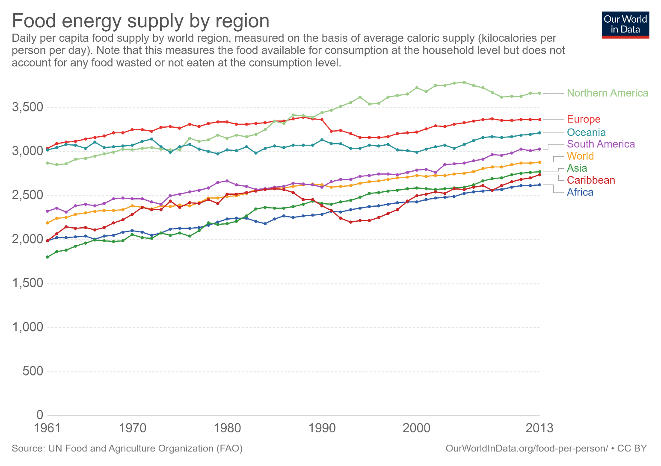
Food energy supply

Slide 40
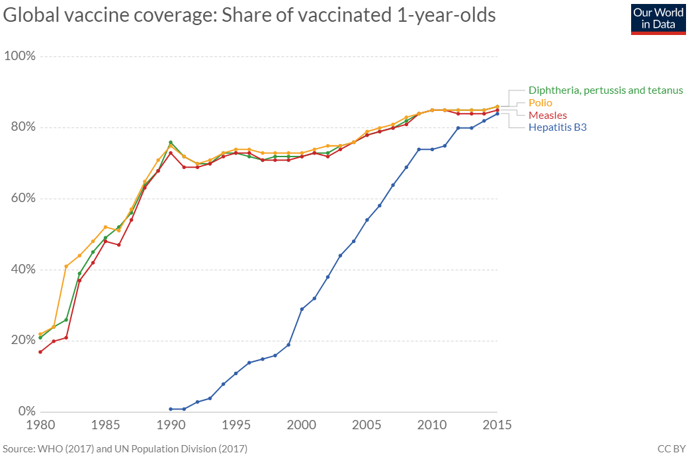
Vaccine rates

Slide 41
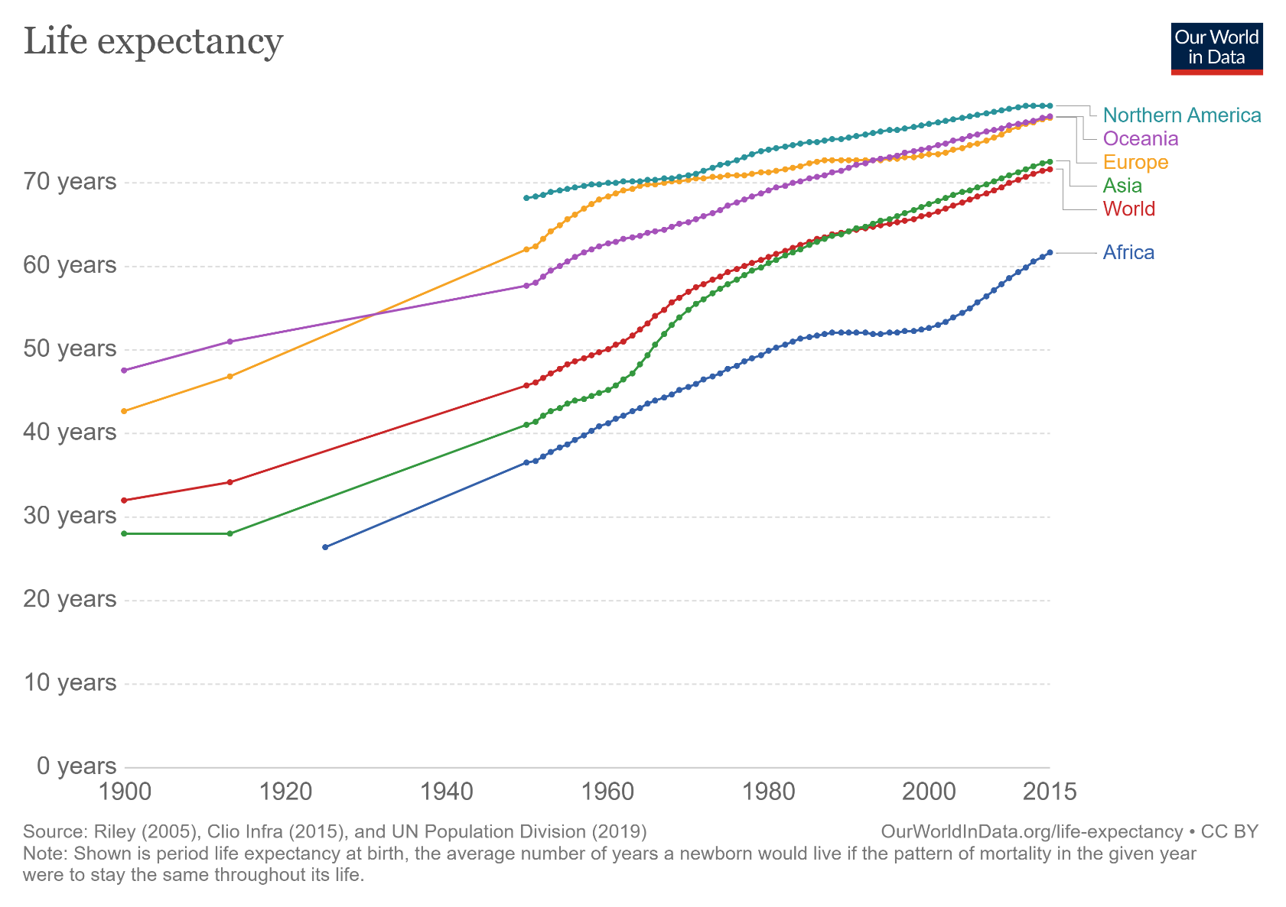
Life expectancy

Slide 42
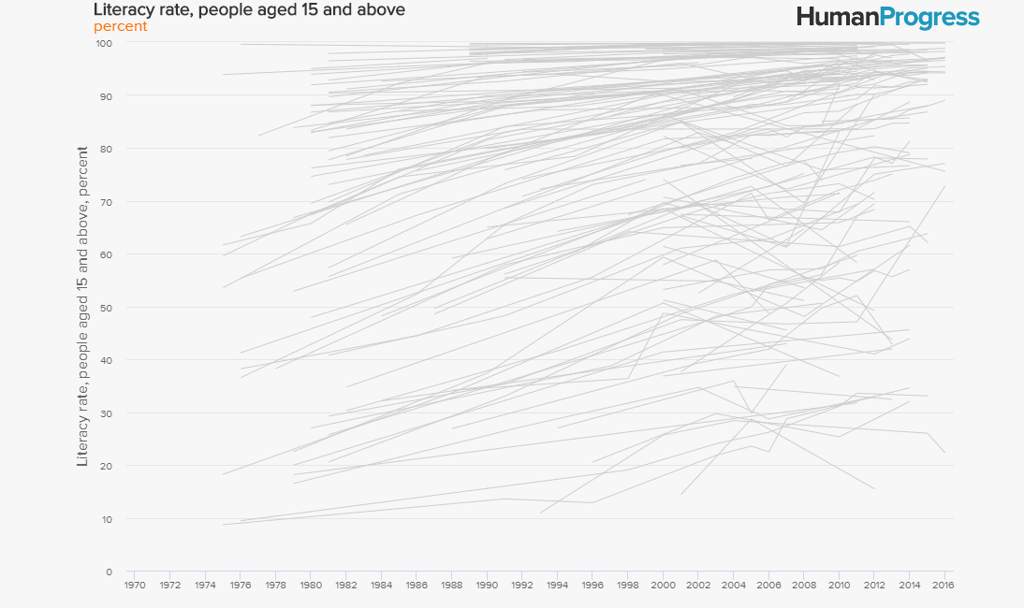
Literacy

Slide 43
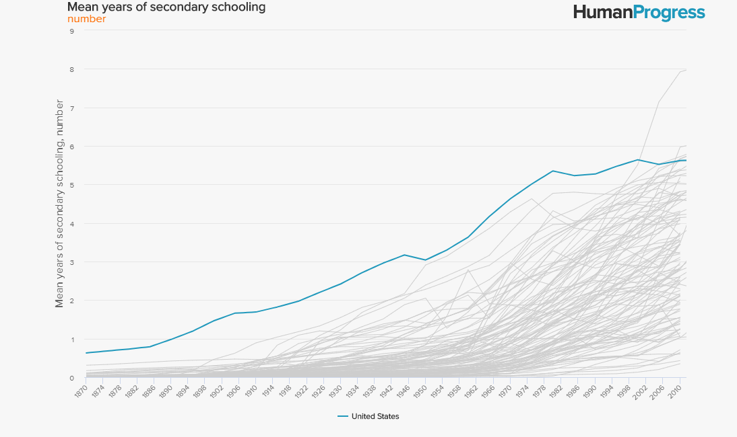
Secondary schooling

Slide 44
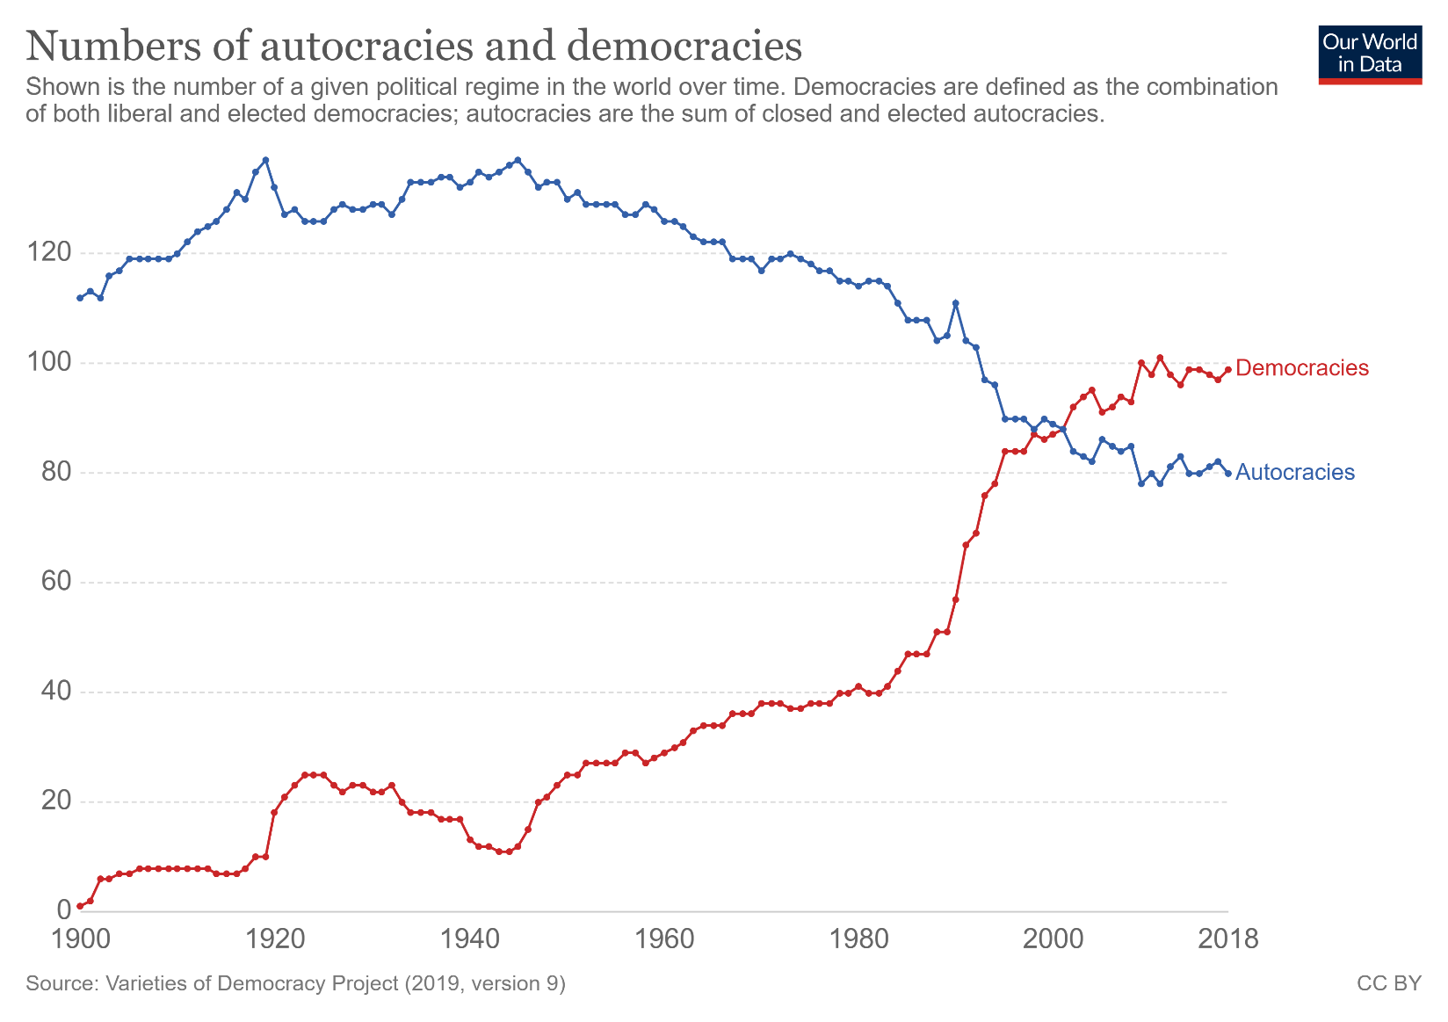
Democracy vs. autocracy

Slide 45
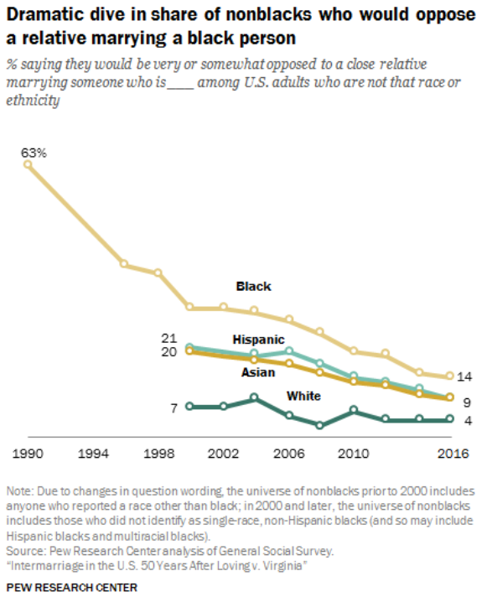
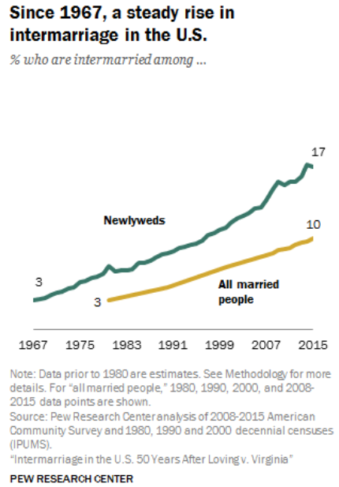
Inter-racial marriage, U.S.

Slide 46
Please forgive a prideful side comment
Statistics and statisticians deserve some of the credit for these advances
  Public health
  Agriculture
Old-fashioned, 20th-century statistics
  Experimental design
  Clinical trials
  Statistical inference

Slide 47
My request
Use data, examples, activities, and assignments that make students aware of human progress.

Slide 48
Quote 4: Fact-based worldview
“When we have a fact-based worldview, we can see that the world is not as bad as it seems – and we can see what we have to do to keep making it better.”
– Rosling

Slide 49
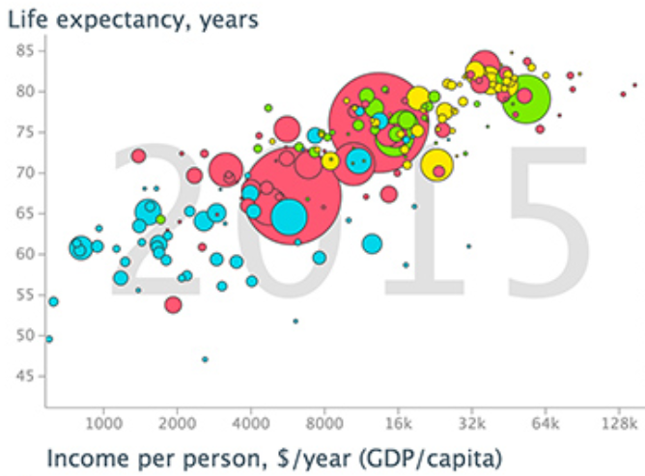
Example 1: Health vs. wealth

Slide 50
Example 1: Health vs. wealth
Identify the observational units in this graph.
Identify all of the variables in this graph.
Classify each variable as categorical or numerical.
Describe the association between income per person and life expectancy.
Describe what the graph reveals about any relationship between regions of the world and health/wealth.

Slide 51
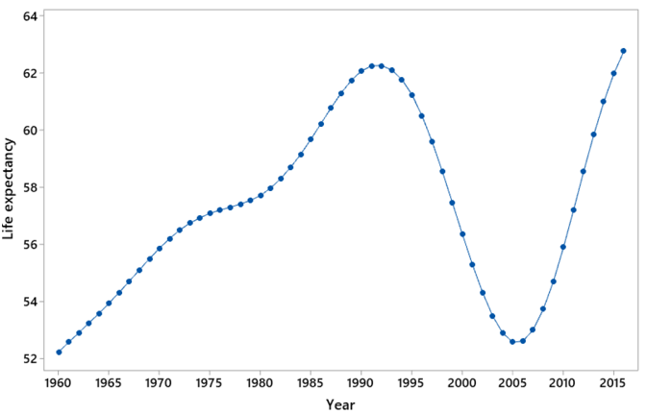
Example 2: Life expectancy in …
Describe what this graph reveals.
Make an educated guess for the country.

Slide 52
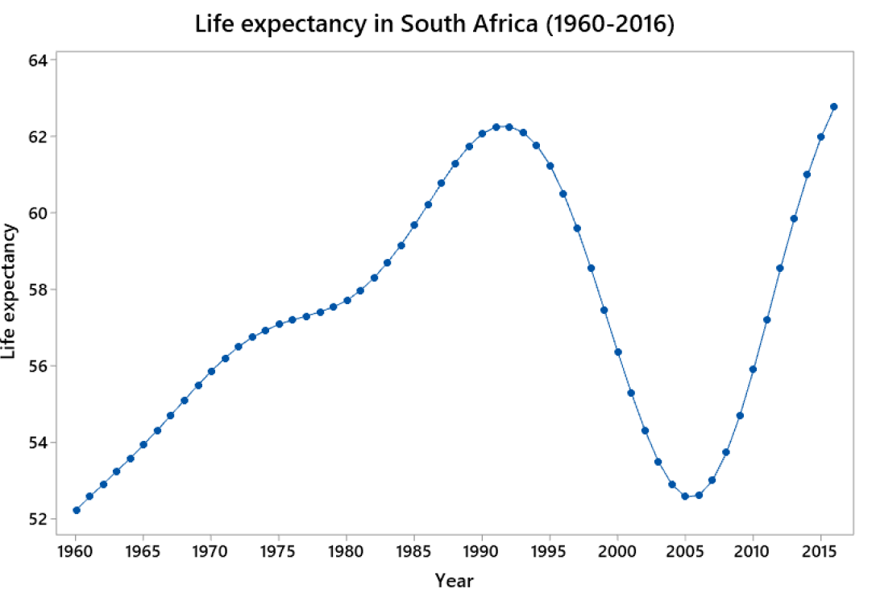
Example 2: Life expectancy in …
Explain what happened in the 1990s.

Slide 53
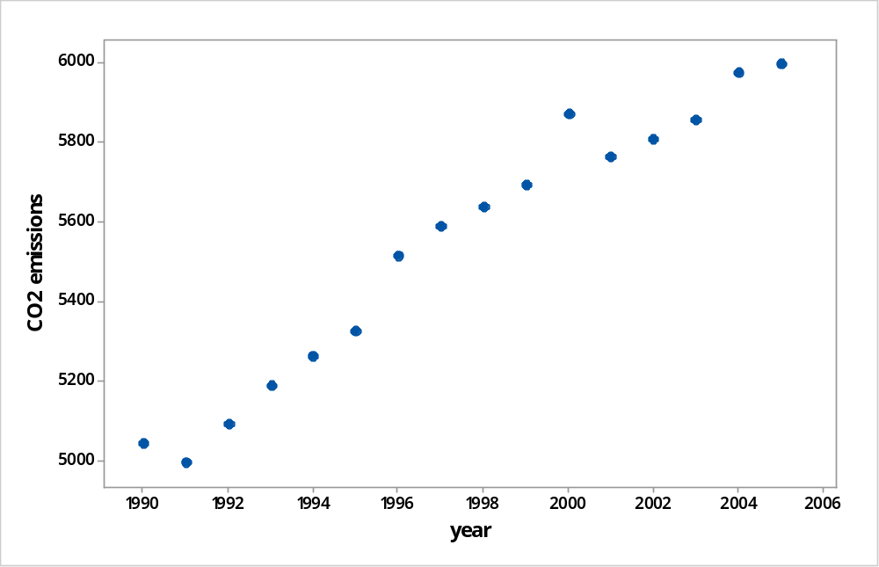
Example 3: CO2 emissions
Energy-related CO2 emissions (in millions of metric tons) in the U.S. from 1990-2005
Source: https://www.eia.gov/environment/emissions/carbon/

Slide 54
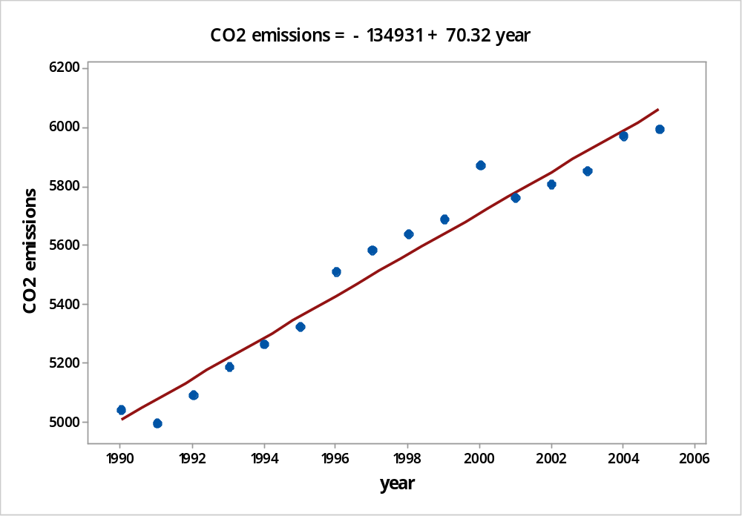
Example 3: CO2 emissions
Describe what graph reveals.
Determine least squares line.

Slide 55
Example 3: CO2 emissions
Interpret the slope coefficient of the line.
Use the line to predict CO2 emissions for the year 2016.
Predicted CO2 emissions in year 2016
= -134,931 + 70.32×2016 ≈ 6834 mmt
Actual CO2 emissions in year 2016: 5170 mmt
Determine percentage error of the prediction
(6834 – 5170) / 5170 × 100% ≈ 32.2%

Slide 56
Example 3: CO2 emissions
What went wrong??

Slide 57
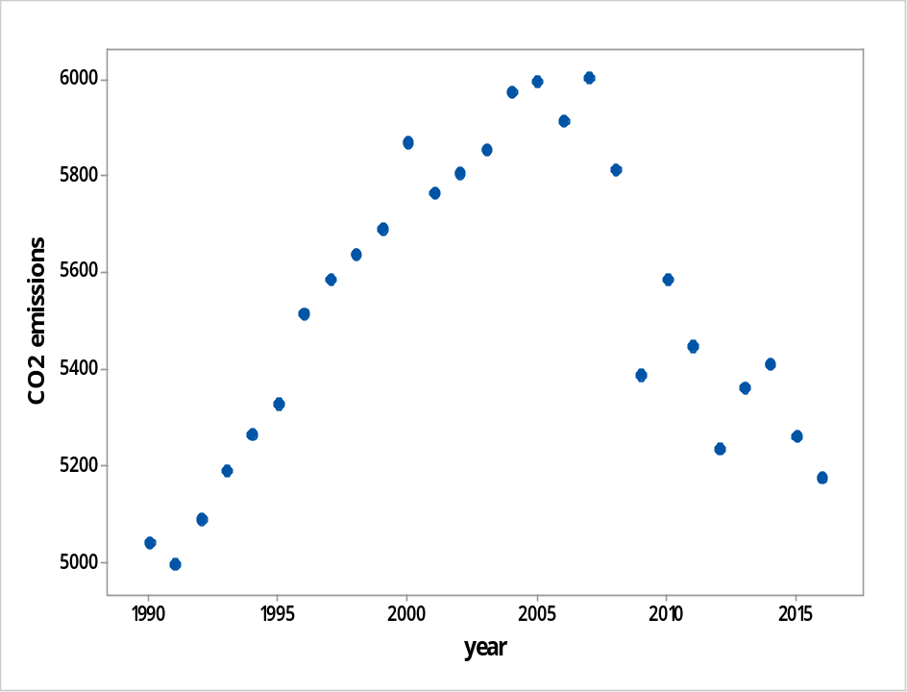
Example 3: CO2 emissions
What went wrong??
Beware of extrapolation!

Slide 58
Example 4: Extreme poverty rate
1990: 35.9%
2015: 10.0%
  Source: World Bank Development Research Group
Did the percentage who lived in extreme poverty decline by 25.9% over this period?
No! The percentage declined by 25.9 percentage points, which is different from a 25.9 percent decline.

Slide 59
Example 4: Extreme poverty rate
Percentage change = (new – old) / old × 100%
(.100 - .359) / .359 × 100%
= -.259 / .359 × 100%
= .721 × 100%
= 72.1% decrease

Slide 60
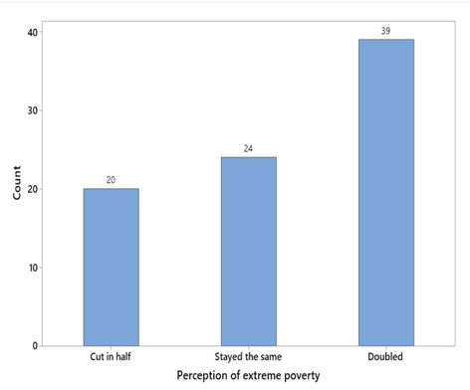
Example 5: Global poverty question
Data from a recent class of mine (n = 83):

Slide 61
Example 5: Global poverty question
Do the sample data provide strong evidence that less than one-third of all students at the university would answer correctly (i.e., that students do worse than chimpanzees would)?
Simulation-based inference

Slide 62
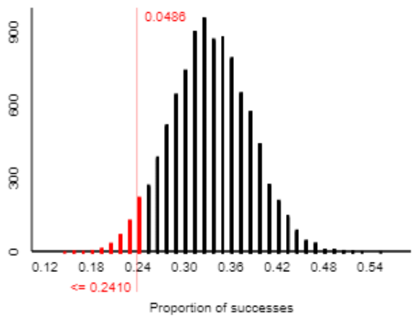
Example 5: Global poverty question
Moderately strong evidence (p-value ≈ .0486) that less than one-third would answer correctly

Slide 63
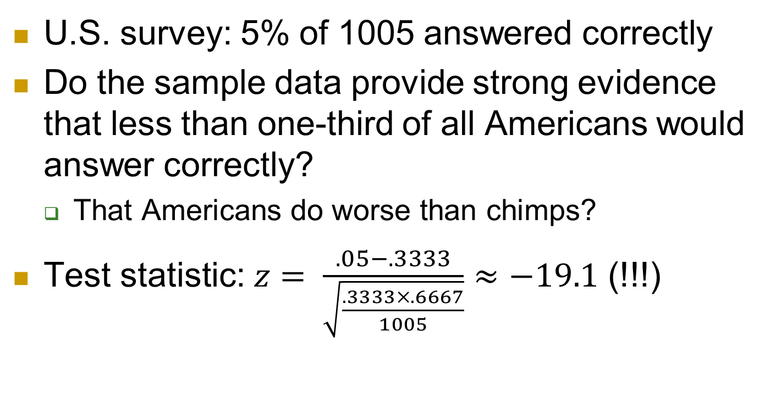
Example 6: Global poverty question
U.S. survey: 5% of 1005 answered correctly
Do the sample data provide strong evidence that less than one-third of all Americans would answer correctly?
  That Americans do worse than chimps?
Test statistic: $z= \frac{.05−.3333}{\sqrt{\frac{.3333×.6667}{1005}}}$ $≈−19.1$ (!!!)

Slide 64
Example 6: Global poverty question
Interpret this z-statistic.
  The sample proportion who answered correctly (5%) is 19.1 standard deviations away from the hypothesize value of one-third.
Determine the p-value.
  Very close to zero
State your conclusion.
  Overwhelming evidence that Americans do worse than random guessing on this question

Slide 65
Example 7: Global poverty question
U.S. survey: 59% of 1005 answered “doubled”
Estimate the proportion of all U.S. adults who would answer “doubled” with 95% confidence
.59 ± .030: (.560, .620)
Interpret this interval.
  We are 95% confident that between 56% and 62% of all U.S. adults would give the most wrong answer to this question.

Slide 66
Student projects
Select topic, data, countries, time period, …
Explore the data
Pose questions
Write report

Slide 67
For more information/data
www.gapminder.org
ourworldindata.org
humanprogress.org
www.worlddata.io/
https://data.worldbank.org/
informationisbeautiful.net/beautifulnews/
www.toddrjones.com/data-visualization

Slide 68
Disclaimer
I also believe that:
Enormous progress remains to be made.
Teachers should also present data, examples, activities, and assignments that expose problems and inequities.
  Students can be motivated to address societal challenges by such exposure.

Slide 69
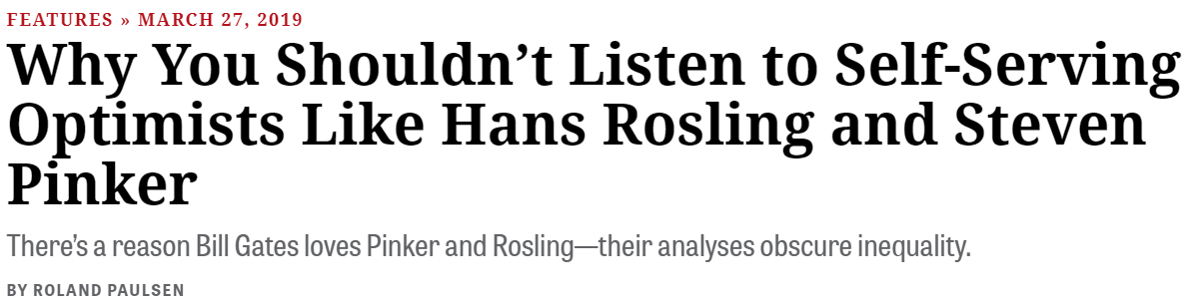
Criticisms
inthesetimes.com

Slide 70

Criticisms
inthesetimes.com
The Chronicle Review

Slide 71
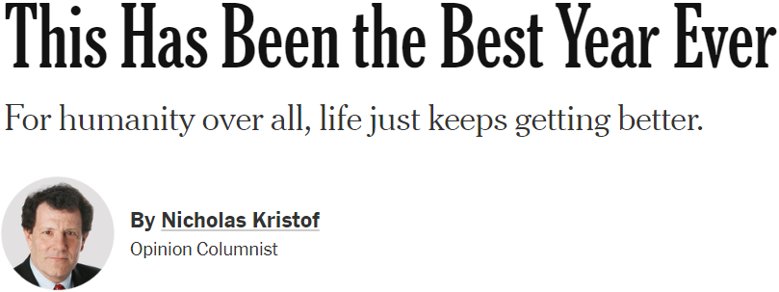
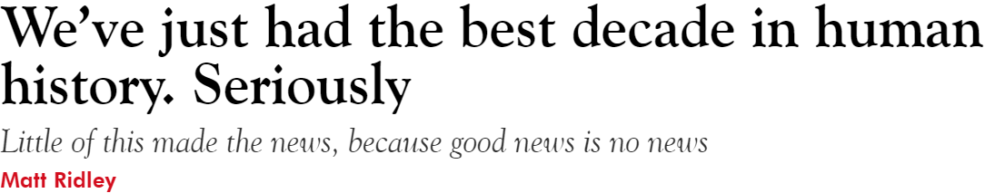
End-of-year/decade
Nicholas Kristof, New York Times
Matt Ridley, The Spectator (UK)

Slide 72
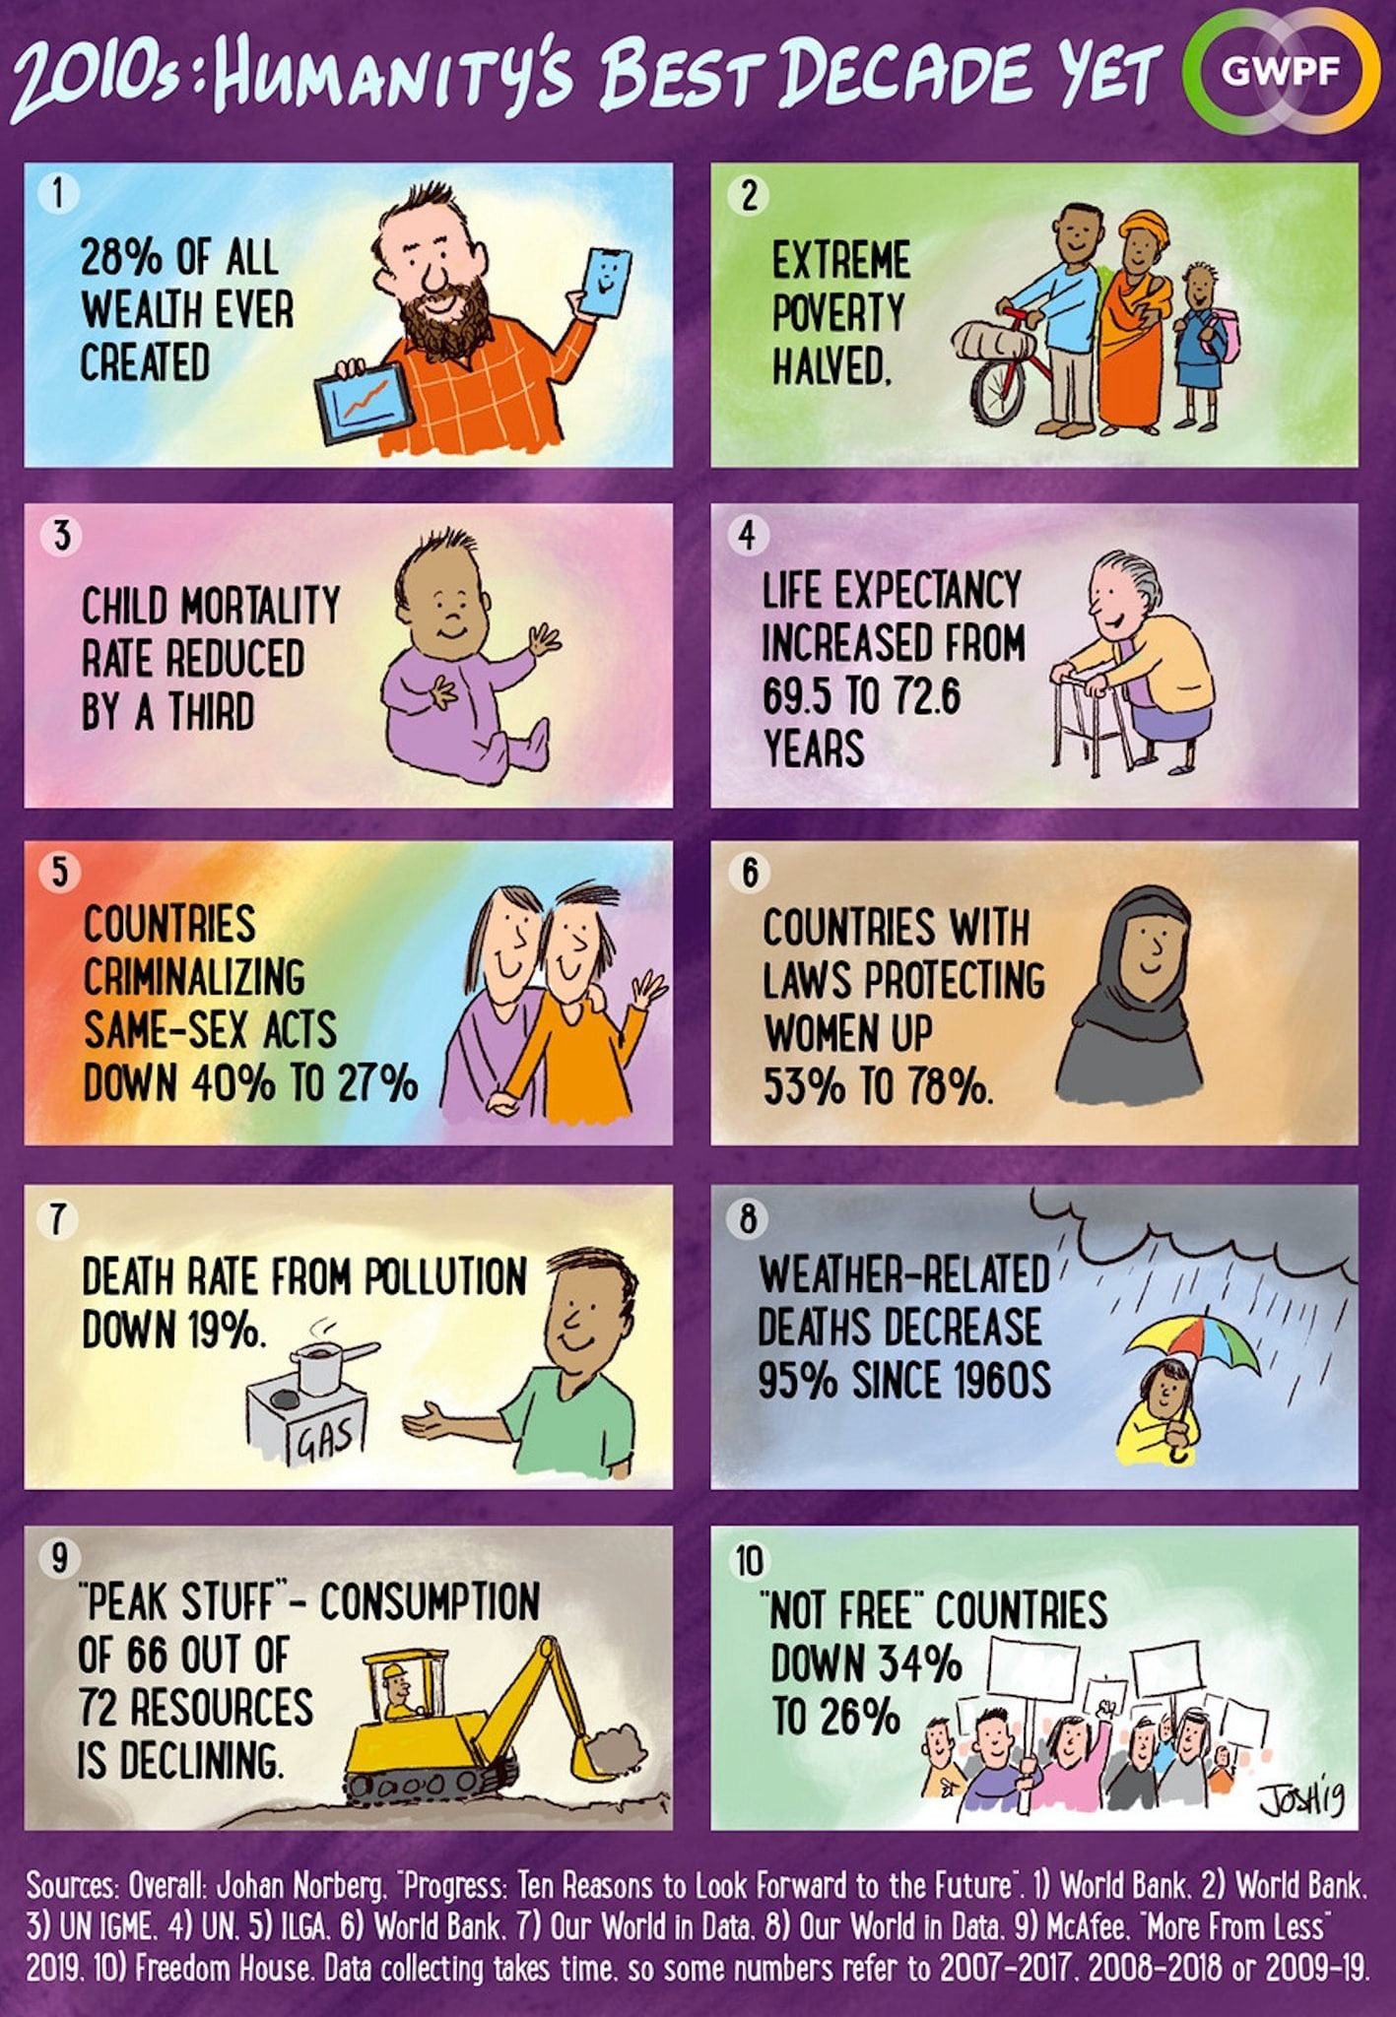
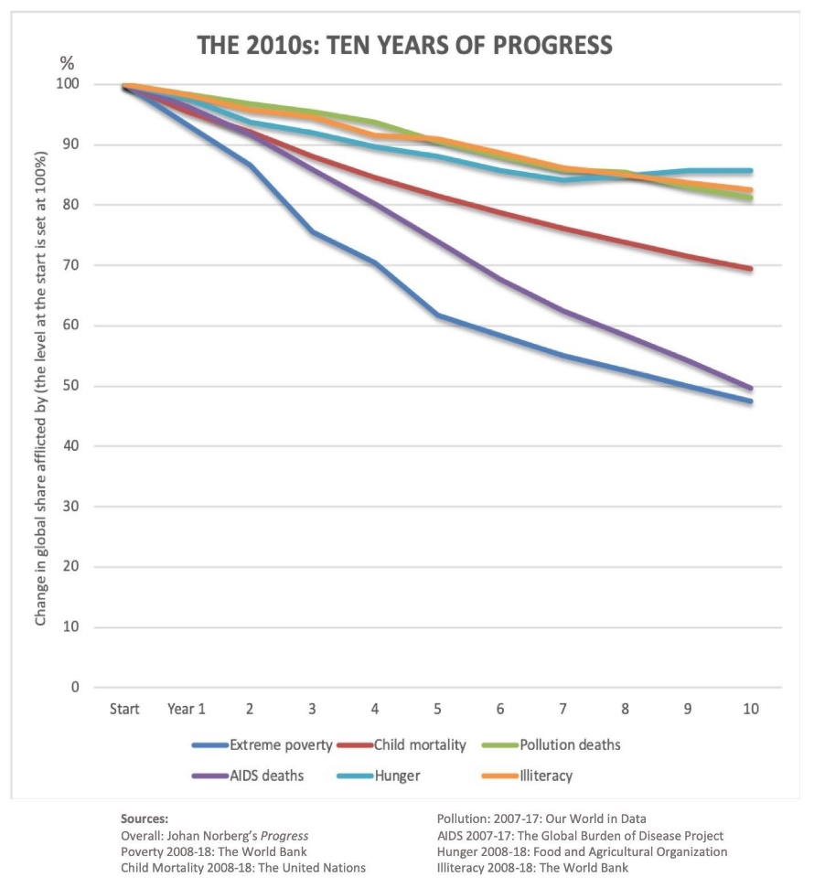
End-of-year/decade
Johan Norberg

Slide 73
Quote 5: When would you choose?
“If you could choose a moment in history to be born, and you didn’t know ahead of time who you were going to be, you’d choose now.
Because the world has never been less violent, healthier, better educated, more tolerant, with more opportunity for more people, and more connected than it is today.”
‒ President Barack Obama, July 20, 2016

Slide 74
Thanks!
Shameless plug for my weekly blog about teaching introductory statistics: askgoodquestions.blog
  These slides are under “Presentations”
Contact me with questions and comments: arossman@calpoly.edu

