Slide 1
Teaching Introductory Statistics: Ask Good Questions
Allan J. Rossman
Department of Statistics
Cal Poly – San Luis Obispo
Email: arossman@calpoly.edu
Twitter: @allanjrossman
Blog: https://askgoodquestions.blog

Slide 2
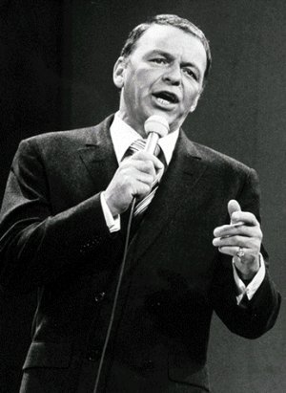
Frank Sinatra
What’s the secret to being a successful singer?
  “Sing Good Songs”
2

Slide 3
My similarly succinct suggestion
What’s the secret to being an effective teacher?
  “Ask Good Questions”
3

Slide 4
What kinds/purposes of questions?
Guide students to develop their understanding and skills
  Formative assessment
  Learning activities
Assess what students have learned
  Summative assessment
  Quiz/exam questions
4

Slide 5
Topics of questions in this presentation
Statistical thinking
Descriptive statistics
Sampling and experimentation
Probability
Simulation-based inference
Confidence intervals
Hypothesis tests

Slide 6
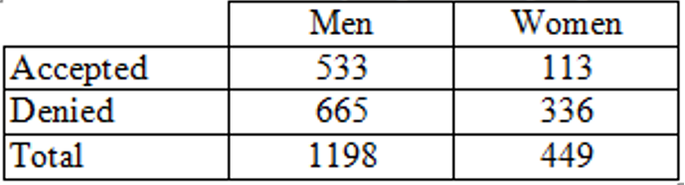
Statistical thinking
Example: Sex discrimination?
Men: 533/1198 ≈ .445 were accepted
Women: 113/449 ≈ .252 were accepted
Does this provide evidence of discrimination against women?

Slide 7
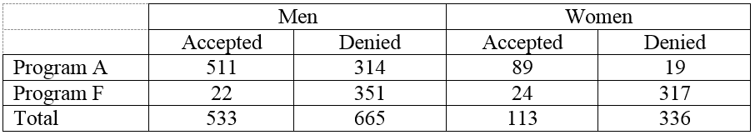
Statistical thinking
Program A
  Men: 511/825 ≈ .619
  Women: 89/108 ≈ .824
Program F:
  Men: 22/373 ≈ .059
  Women: 24/341 ≈ .070

Slide 8
Statistical thinking
Describe and explain the oddity, using the data given
Most men apply to the easy program to get in; most women apply to the hard program to get in
Multivariable thinking
  Simpson’s paradox

Slide 9
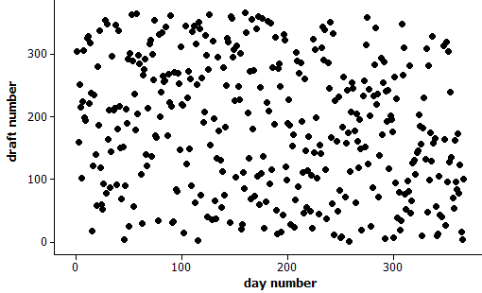
Statistical thinking
Example: 1970 Draft Lottery
Any reason to doubt randomness?
Calculate median draft number for each month

Slide 10
Statistical thinking
Calculate median draft number for each month
Jan 211 Jul 188
Feb 210 Aug 145
Mar 256 Sep 168
Apr 225 Oct 201
May 226 Nov 131.5
Jun 207.5 Dec 100
Do you see a pattern/trend?

Slide 11
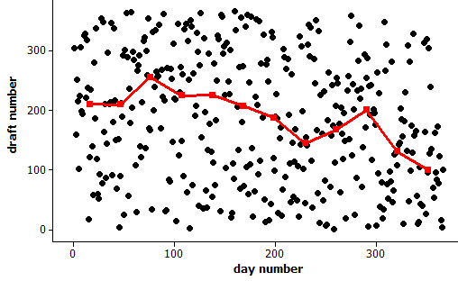
Statistical thinking
Example: 1970 Draft Lottery
Any reason to doubt randomness?

Slide 12
Statistical thinking
How often would such an extreme outcome occur with a truly random lottery?

Slide 13
Statistical thinking
How often would such an extreme outcome occur with a truly random lottery?
What statistic might you use to determine “extreme”-ness?

Slide 14
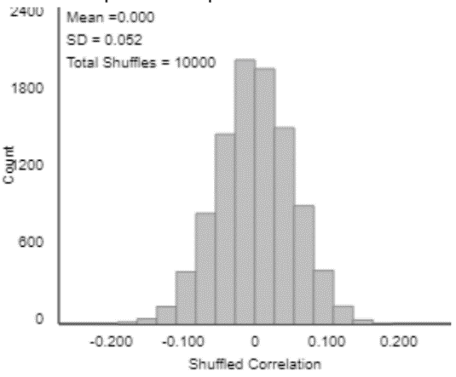
Statistical thinking
How often would such an extreme outcome occur with a truly random lottery?
What statistic might you use to determine “extreme”-ness?
  Correlation ≈ -0.226

Slide 15
Descriptive statistics
I suspect that when I flew from CA to GA, the average IQ dropped in both states!
  Is this possible?
  What would have to be true (in principle) for this to happen?
Yes, if (my IQ > average IQ in CA)
and (my IQ < average IQ in GA)

Slide 16
Descriptive statistics
Suppose that Abby records the ages of customers at The Avenue (on-campus snack bar) from 11am-2pm today, while Mary records ages of customers at McDonald’s (near freeway).
Who will have the larger standard deviation of customer ages: Abby or Mary? Explain.

Slide 17
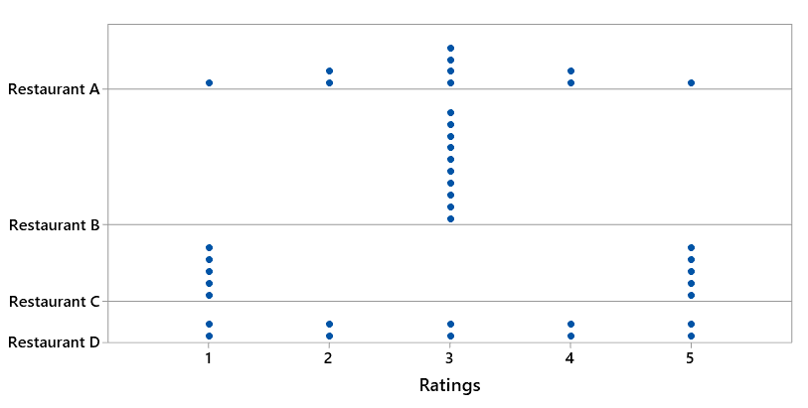
Descriptive statistics
Arrange the four restaurants in order from smallest SD of ratings to largest SD of ratings

Slide 18
Descriptive statistics
Example (adapted from Jay Lehmann):
Which would be larger – the mean weight of 10 randomly selected people or the mean weight of 1000 randomly selected cats? Explain briefly.
Which would be larger – the standard deviation of the weights of 1000 randomly selected people or the standard deviation of the weights of 10 randomly selected cats? Explain briefly.

Slide 19
Descriptive statistics
Many of my students think that larger sample size produces smaller SD
Do not realize that SD of the sample mean (or sample proportion) gets smaller as sample size increases
Advice: When you talk about SD, always emphasize SD of what

Slide 20
Descriptive statistics
Exam scores have mean 70, SD 8
  Arturo’s score is 75
  Bella’s score is 1.5 SDs above Arturo’s.
What is Bella’s score on the exam? Show your work.
  Concept: Measuring distance as number of SDs away from something
  Not necessarily away from mean

Slide 21
Descriptive statistics
Suppose that every student in our class scored 5 points lower on the second exam than on the first exam.
What would be the value of the correlation coefficient between (exam1 score) and (exam2 score)?
  Options: -5, -1, -0.5, 0, 0.5, 1, 5

Slide 22
Sampling and experimentation
Example: Gettysburg Address
Select a sample of 10 words from the population of 268 words in the Gettysburg Address. (Just circle 10 words.)
  Record the length (# of letters) of each word.
  Calculate average length for your sample.
  Produce graph of sample averages.
Is this a reasonable sampling method for estimating average word length in population?

Slide 23
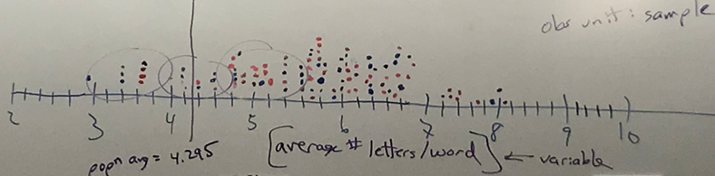
Sampling and experimentation
How does this graph indicate sampling bias?
Would closing eyes and pointing be unbiased?

Slide 24
Sampling and experimentation
Example: Mandela’s age
  Group 1: Nelson Mandela was the first president of South Africa following apartheid.
    Do you think he was older or younger than 16 years old when he died?
    Make a guess for how old he was when he died.
  Group 2: Nelson Mandela was the first president of South Africa following apartheid.
    Do you think he was older or younger than 160 years old when he died?
    Make a guess for how old he was when he died.

Slide 25
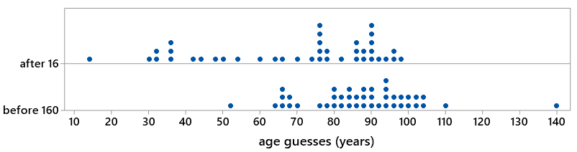
Sampling and experimentation
Example: Mandela’s age
t = -4.17; p-value ≈ .0000
Very strong evidence for anchoring effect

Slide 26
Sampling and experimentation
Random sampling and random assignment are different tools with different purposes
Random sampling
  Goal: Select representative sample
  Benefit: Generalize results
Random assignment
  Goal: Produce similar groups
  Benefit: Draw cause-effect conclusions

Slide 27
Probability
2018 General Social Survey
  47% had a pet dog
  25% had a pet cat
Does it follow that 72% (which is 47% + 25%) had a pet dog or a pet cat?
  What would be required for this to happen?
No!
  Would require that no households have both

Slide 28
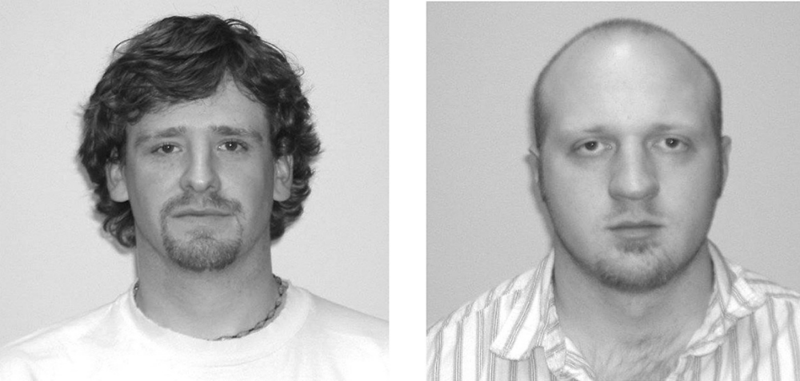
Simulation-based inference
Example: Facial prototyping
Do people tend to associate names with faces?
Who is on the left: Bob or Tim?

Slide 29
Simulation-based inference
Example: Facial prototyping (cont)
36 of 46 students put Tim on the left
  What are two possible explanations for our observed sample result?
  Which explanation can we investigate/model? How?
  How often would such an extreme sample result occur by chance alone (if there were no facial prototyping)?
  Have students flip coins to investigate

Slide 30
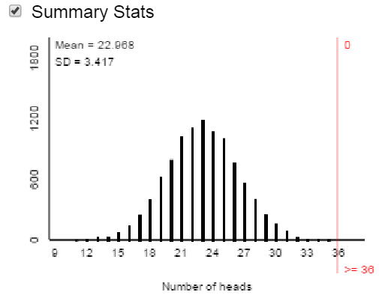
Simulation-based inference
Facial prototyping: 10,000 simulated samples of 46 students
Very strong evidence: people have a genuine tendency to put Tim on left

Slide 31
Confidence intervals
What does 95% confidence mean?
Simulation:
www.rossmanchance.com/applets
(Simulating confidence intervals)

Slide 32
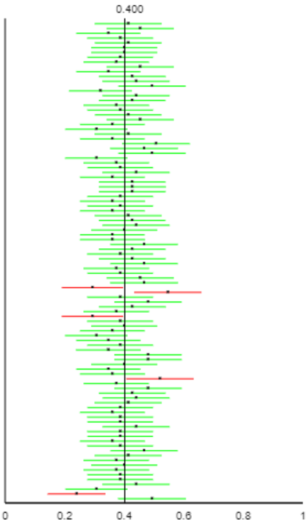
Confidence intervals
What does 95% confidence mean?
Simulation:

Slide 33
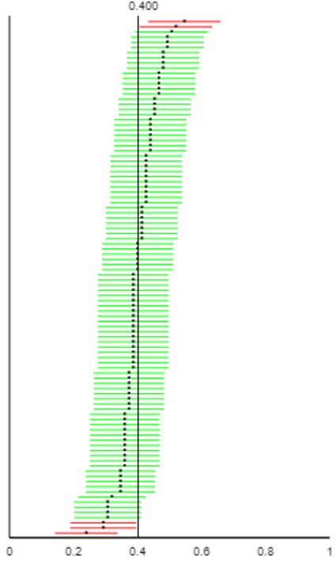
Confidence intervals
What does 95% confidence mean?
Simulation:

Slide 34
Confidence intervals
What would change (two things) if the confidence level was increased or decreased?
Predict,
then test

Slide 35
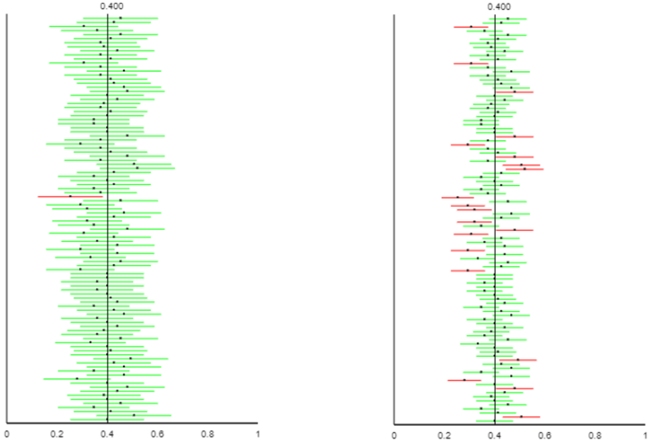
Confidence intervals
What would change (two things) if the confidence level was increased or decreased?
Predict,
then test
99% (left)
80% (right)

Slide 36
Confidence intervals
What would change if the sample size was increased?
Predict,
then test

Slide 37
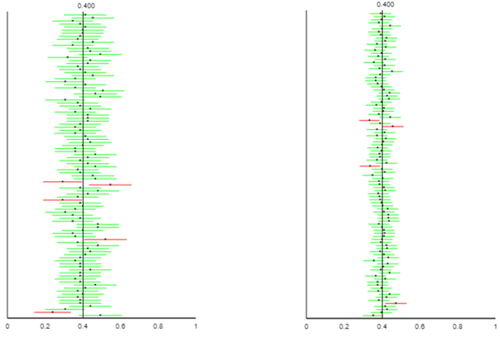
Confidence intervals
What would change if the sample size was increased?
Predict,
then test
Smaller n (left)
Larger n (right)

Slide 38
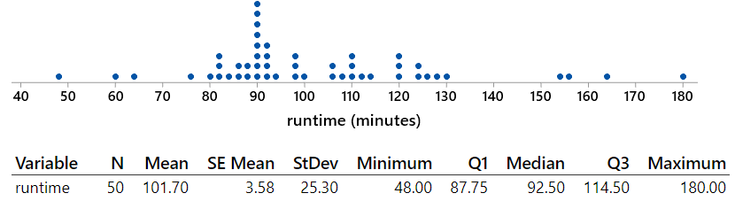
Confidence intervals
Random sample of 50 movies in “thriller” category from IMDb database

Slide 39
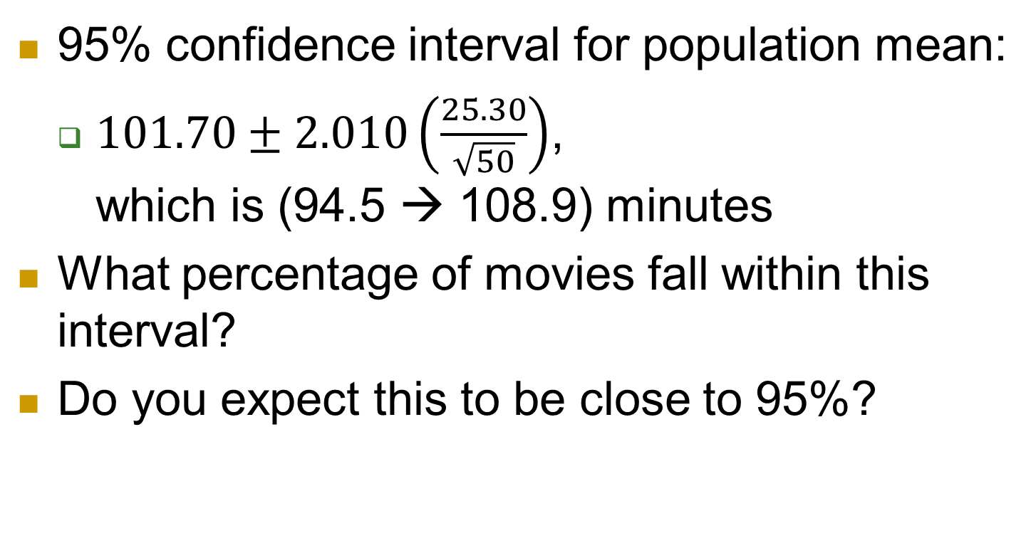
Confidence intervals
95% confidence interval for population mean:
  $101.70±2.010\left(\frac{25.30}{\sqrt{50}}\right)$, which is (94.5 → 108.9) minutes
What percentage of movies fall within this interval?
Do you expect this to be close to 95%?

Slide 40
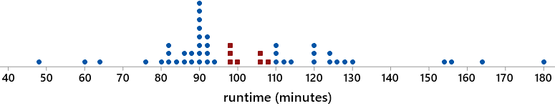
Confidence intervals
7 of 50 movies (14%) fall within this interval
CI estimates popn mean, not individual values
Many students misunderstand this
  Much more important than confidence level

Slide 41
Confidence intervals
Suppose that an alien lands on earth and sets out to estimate the proportion of human beings who are female
The alien took a good statistics course on its home planet and knows to take a sample, produce a confidence interval
Sample: the 2020 U.S. Senate, which has 26 women (the most ever!) and 74 men

Slide 42
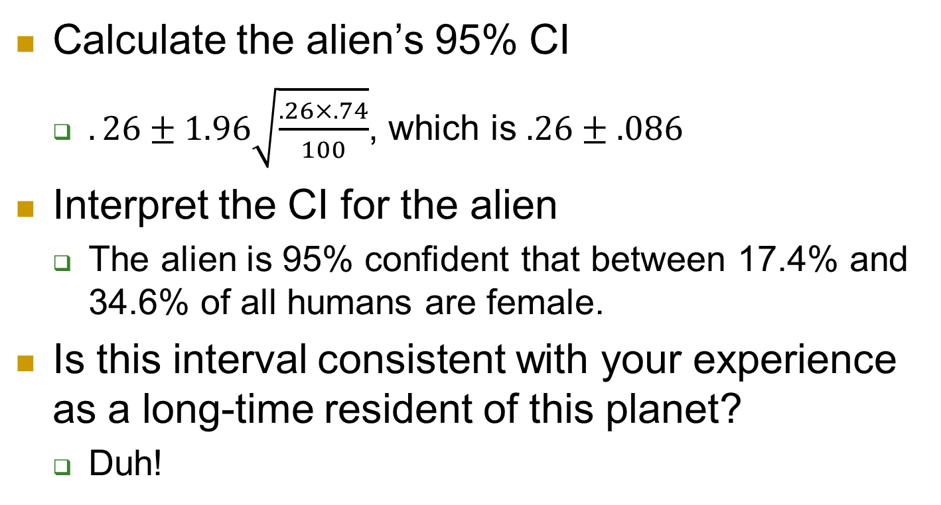
Confidence intervals
Calculate the alien’s 95% CI
  $.26±1.96\sqrt{\frac{.26×.74}{100}}$, which is $.26±.086$
Interpret the CI for the alien
  The alien is 95% confident that between 17.4% and 34.6% of all humans are female.
Is this interval consistent with your experience as a long-time resident of this planet?
  Duh!

Slide 43
Confidence intervals
Is the problem that 5% of all 95% CIs fail to capture actual value of population parameter?
  No!
Then what went wrong???
  Biased sampling method!
If the alien was only interested in estimating the proportion of 2020 U.S. Senators who are female, would this 95% CI make sense?
  No, exactly 26% of senators in 2020 are female!

Slide 44
Intervals and tests
Survey of 47,000 U.S. households in 2006 found that 32.4% had a pet cat
Does this provide very strong evidence that the population proportion with a cat is different from one-third?
Does this provide strong evidence that the population proportion with a cat is very different from one-third?

Slide 45
Intervals and tests
Does this provide very strong evidence that the population proportion with a cat is different from one-third?
  Yes! Test stat z ≈ -4.29, p-value ≈ .00002
Does this provide strong evidence that the population proportion with a cat is very different from one-third?
  No! 99.9% CI: (.317 → .331)

Slide 46
Intervals and tests
Hypothesis test and confidence interval give consistent results
  Value one-third is rejected, does not appear in CI
Statistical significance is different from practical importance
  Especially relevant with large sample sizes

Slide 47
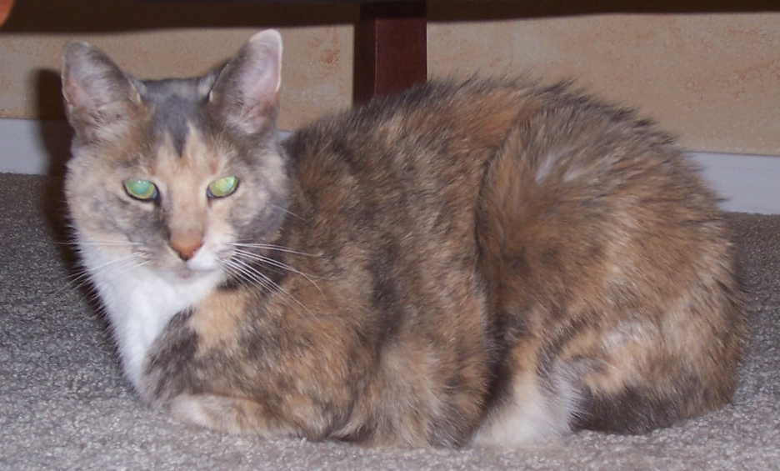
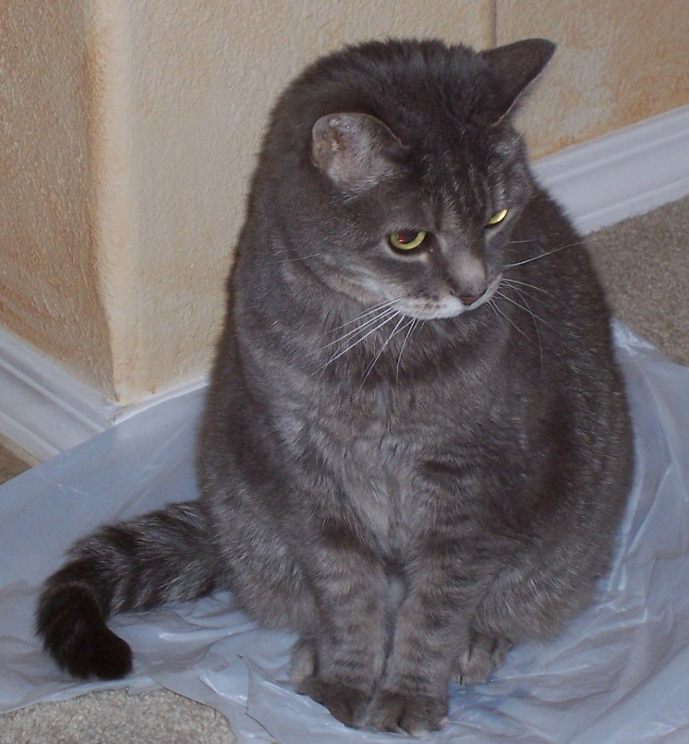
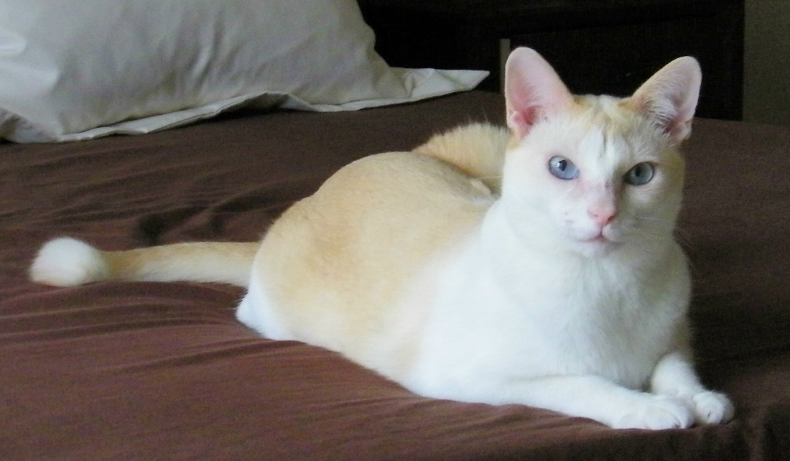
My cats

Slide 48
“Ask Good Questions” blog
Ideas, examples, activities, assessments and advice for teaching introductory statistics
  Practical, for direct use with students
  Thought-provoking, for discussion with peers
  Conversational tone, with attempts at humor
One post/essay per week
  Published on Mondays at 11am ET, 8am PT
  1500-3000 words per essay
  31 so far, 21 (at least) more to come

Slide 49
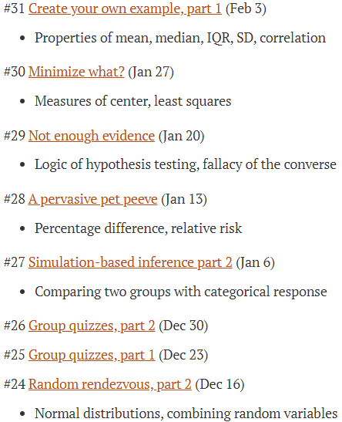
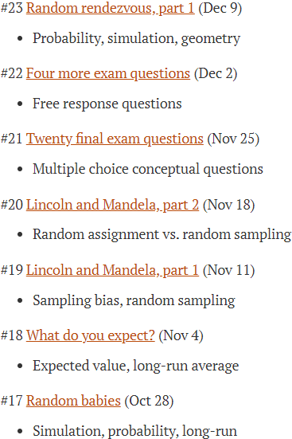
“Ask Good Questions” blog

Slide 50
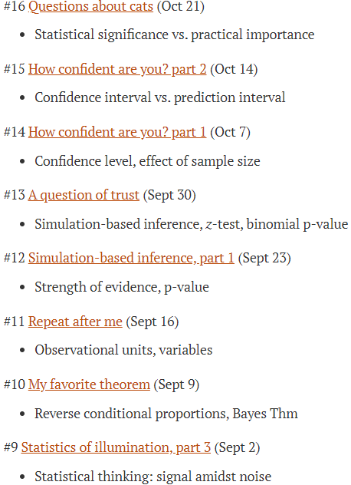
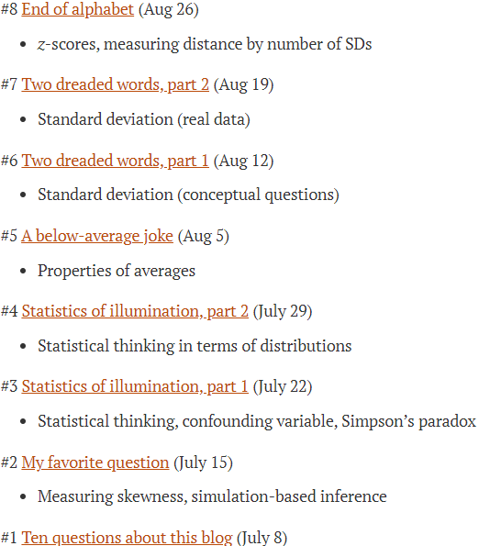
“Ask Good Questions” blog

Slide 51
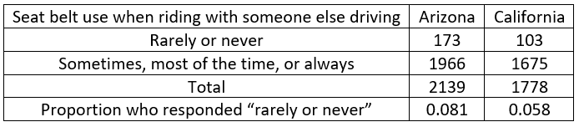
Recent post: A pervasive pet peeve
2017 Youth Risky Behavior Surveillance Survey
Were Arizona youths 2.3% more likely to respond “rarely or never” than California youths?
No! The Arizona percentage was 2.3 percentage points higher than California’s.

Slide 52
Recent post: A pervasive pet peeve
2017 Youth Risky Behavior Surveillance Survey
Percentage difference:
(.081-.058)/.058 × 100% ≈ 39.6%
Arizona youths were 39.6% more likely than California youths to respond “rarely or never”

Slide 53
Recent post: A pervasive pet peeve
2017 Youth Risky Behavior Surveillance Survey
Relative risk: .081/.058 ≈ 1.396
Arizona youths were 1.396 times more likely than California youths to respond “rarely or never”
% difference = (relative risk – 1) × 100%

Slide 54
Recent post: A pervasive pet peeve
Potential title: A persnickety post that preaches about a pervasive, persistent, and pernicious pet peeve concerning percentages (60% P-words)
Actual title: A pervasive pet peeve (75%)
So, is this a 15% increase in % of P-words?
  No, that’s the pet peeve!

Slide 55
“Ask Good Questions” blog
Sign up to receive weekly email messages containing post
Peruse annotated list of posts
https://askgoodquestions.blog/posts
Post #1 answers ten questions

Slide 56
Some final questions for you
Have you ever attended a presentation titled
  Ask Bad Questions?
Have you ever attended a presentation titled
  Don’t Ask Questions?
Of course not! So, …
  Why am I wasting your time with such obvious advice as “Ask Good Questions”??
56

Slide 57
Yeah, why am I wasting your time?
I respectfully suggest that the next time you (or I) feel compelled to invest our valuable time, thought, energy, and creativity on …
  Preparing crystal-clear lectures
  Writing lucid paragraphs of exposition
  Crafting beautiful presentations
57

Slide 58
What should we do?
58

Slide 59

What should we do?
59
Resist this temptation!

Slide 60
So, what do I suggest instead?
Instead we should invest these precious commodities (time, thought, energy, creativity) on
  Developing engaging classroom activities
  Preparing thought-provoking assignments
  Crafting effective assessment items
In other words, we should be sure to …
60

Slide 61
What’s the take-home message?
Ask Good Questions!
61

Slide 62
Thanks very much!
Please follow my weekly blog with many more examples and advice:
https://askgoodquestions.blog
Please contact me with questions and comments:
arossman@calpoly.edu

