Slide 1
Teaching Introductory Statistics: Top Thirteen Topics
Allan J. Rossman
Department of Statistics
Cal Poly – San Luis Obispo
Email: arossman@calpoly.edu
Twitter: @allanjrossman
Blog: https://askgoodquestions.blog

Slide 2
Disclaimers
I have no experience (yet) with online teaching, so I have no advice to offer
These 13 topics are all relevant but not specific to AP Statistics
These 13 topics describe little (if any) that you don’t already know

Slide 3
So why should you stay?
Food for thought about what to emphasize
Lots of examples for use with students
Photos of my cats at the end

Slide 4
Outline
Topic #1
Topic #2
Topic #3
Topic #4
Topic #5
Topic #6
Topic #7
Topic #8
Topic #9
Topic #10
Topic #11
Topic #12
Topic #13
Conclusion

Slide 5
Topic #1
Identifying observational units and variables points the way.

Slide 6
Topic #1
Kristen Gilbert was a nurse accused of murdering patients
18 months of hospital records were analyzed
  Gilbert worked on 257 shifts; a death occurred on 40 of these shifts
  Gilbert did not work on 1384 shifts; a death occurred on 34 of these shifts

Slide 7
Topic #1
What are the observational units?
What are the variables?
What type of variable is each – categorical or numerical?
Which is explanatory; which is response?

Slide 8
Topic #1
Observational units: shifts (not nurses, not patients, not deaths)
Explanatory variable: whether or not Gilbert worked on the shift (categorical, binary)
Response variable: whether or not a patient died on the shift (categorical, binary)

Slide 9
Topic #1
Answers to these questions point the way to
  What kind of graph(s) to produce
  What kind of statistic(s) to calculate
  What the relevant parameter(s) is/are
  What the appropriate inference procedure is

Slide 10
Topic #2
Proportional reasoning, and working with percentages, can be tricky but are crucial.

Slide 11
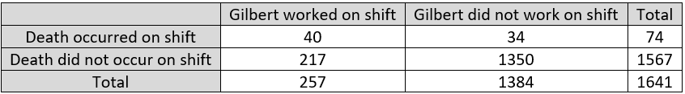
Topic #2
Is it reasonable to compare 40 versus 34? Explain.
Calculate the relevant proportions to be compared. Write a sentence comparing them.
How many times more likely was a death to occur on a Gilbert shift than a non-Gilbert shift?
Was death 13.1% more likely on a Gilbert shift?

Slide 12
Topic #2
Gilbert: 40/257 ≈ 0.156; non: 34/1384 ≈ 0.025
15.6% of Gilbert shifts had a death, compared to 2.5% of non-Gilbert shifts
0.156/0.025 ≈ 6.34, so a death was 6.34 times more likely on a Gilbert shift
Percentage difference is 534%, not 13.1%!

Slide 13
Topic #3
Averages reveal statistical tendencies.

Slide 14
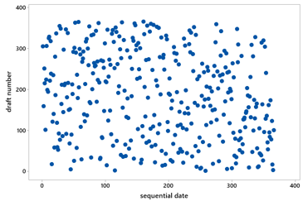
Topic #3
1970 draft lottery
Do you see any tendency in this graph?
Determine median draft number for each month

Slide 15
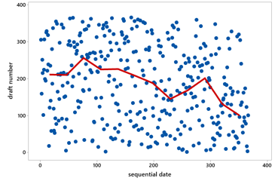
Topic #3
Determine median draft number for each month.
Do you see any tendency in this graph?

Slide 16
Topic #4
Variability, and distributional thinking, are fundamental.

Slide 17
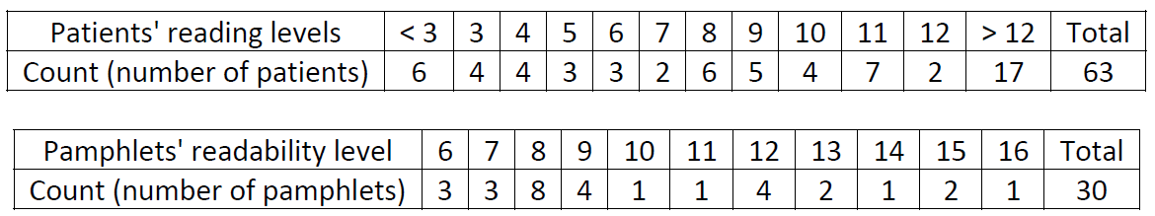
Topic #4
Readability of cancer pamphlets
Determine median for each distribution.
Do medians reveal that pamphlets are written at appropriate levels to be read by patients?

Slide 18
Topic #4
Median = 9 for both patients and pamphlets
  But this is not relevant to the question!
Need to compare distributions, not centers
  Many patients (17/63 ≈ 27%) have reading level below that of simplest pamphlet

Slide 19
Topic #5
Visual displays of data can be very illuminating.

Slide 20
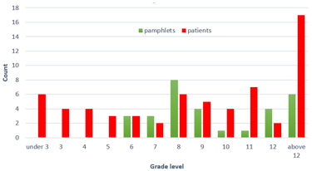
Topic #5

Slide 21
Topic #6
Association is not causation; always look for other sources of variability.

Slide 22
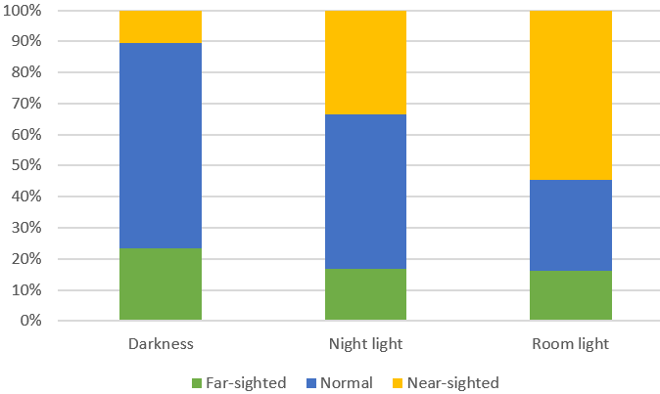
Topic #6
Study: eyesight and bedroom light before age 2
What are the variables? What type?
Describe association revealed by graph
Do data provide evidence that light in bedroom before age 2 causes near-sightedness?

Slide 23
Topic #6
Suggest confounding variable and explain how it provides alternative (to cause-and-effect) explanation for association
Parents’ eyesight is reasonable suggestion
  Near-sighted parents tend to have near-sighted children
  Near-sighted parents may tend to use more light in child’s bedroom

Slide 24
Topic #7
Randomized experiments, featuring random assignment to groups, allow for cause-and-effect conclusions.

Slide 25
Topic #7
Class activity
Group A
  Was Nelson Mandela younger or older than age 16 when he died?
  Make a guess for Nelson Mandela’s age at death
Group B
  Was Nelson Mandela younger or older than age 160 when he died?
  Make a guess for Nelson Mandela’s age at death

Slide 26
Topic #7
Is this an observational study or a randomized experiment?
Does this study make use of random sampling, random assignment, both, or neither?
What is the purpose of randomness?
If we find a significant difference in two groups,
  Can we draw cause-effect conclusion?
  Can we generalize to all students?

Slide 27
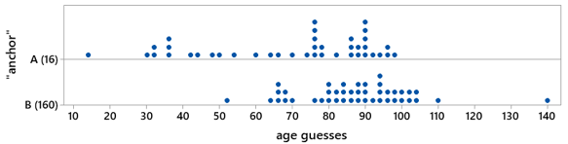
Topic #7
Recent class data

Slide 28
Topic #8
Random sampling allows for generalizing conclusions but can be very hard to achieve.

Slide 29
Topic #8
Will this result in random sample of students?
  Interview students that you approach in library
  Send email message to randomly selected addresses
Use class as sample of students from school
  Variable for which this is very biased method?
  Variable for which generalizing is probably okay?

Slide 30
Topic #8
Random sampling and random assignment are different tools with different purposes
Random sampling
  Goal: Select representative sample
  Benefit: Generalize results
Random assignment
  Goal: Produce similar groups
  Benefit: Draw cause-effect conclusions

Slide 31
Topic #9
Analyzing random phenomena requires studying long-run behavior.

Slide 32
Topic #9
“What would happen if you were to repeat this process forever and ever …” leads to
  Foundational topics in probability and statistics
  Lots of fun explorations to pursue
  Very challenging concepts to understand

Slide 33
Topic #9
Nate Silver: 28-29% chance for Trump in 2016
  Many people believe that Silver was very wrong because outcome felt so incredible to them
  Would obtaining HH in two coin tosses be incredible?
Randomness is hard
  Let’s embrace/practice humility

Slide 34
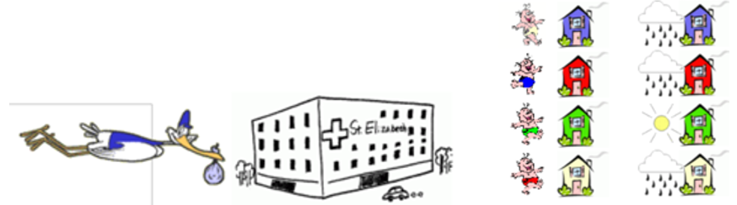
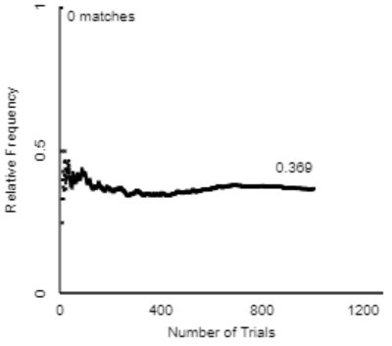
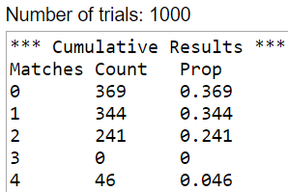
Topic #9
Random babies

Slide 35
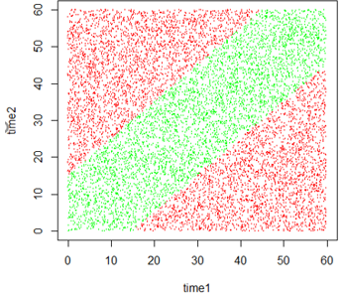
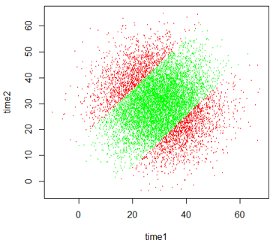
Topic #9
Random rendezvous
Two busy people agree to wait 15 minutes for the other to arrive at a restaurant
What is the probability that they meet?

Slide 36
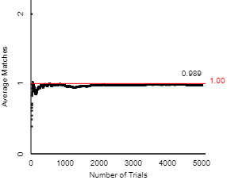
Topic #9
Expected value
Long-run average
Expected number of matches = 1
Pr(1 match) = 8/24

Slide 37
Topic #10
Sampling distributions lay the foundation for statistical inference.

Slide 38
Topic #10
Most challenging topic for introductory students?
  How the value of a sample statistic varies from sample to sample, if we were to repeatedly take random samples from a population
  I could have said: sampling distributions
    Shorthand is useful for those in the know, not for beginners
  I could have added: randomization distributions
    How the value of a statistic varies from randomization to randomization, if we were to repeatedly assign subjects randomly to groups

Slide 39
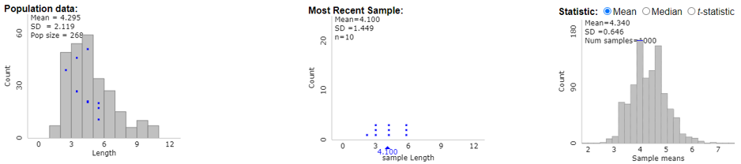
Topic #10
Three distributions to keep track of:
  Distribution of data values in population
  Distribution of data values in sample
  Distribution of sample statistic values across many samples
    Observational units have changed: samples

Slide 40
Topic #11
Confidence intervals estimate parameter with margin-of-error.

Slide 41
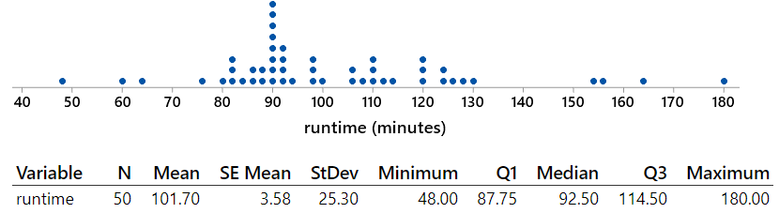
Topic #11
Random sample of 50 movies in “thriller” category from IMDb database

Slide 42
Topic #11
Determine a 95% confidence interval
What percentage of movies fall within CI?
Should this to be close to 95%? Explain.

Slide 43
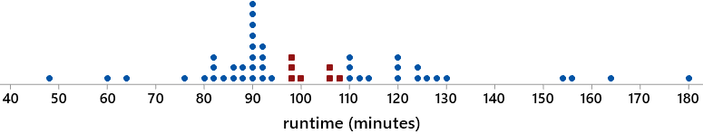
Topic #11
95% CI: (94.5 → 108.9) minutes
7 of 50 movies (14%) fall within this interval
CI estimates popn mean, not individual values
  Parameter is challenging for students

Slide 44
Topic #12
P-values indicate how surprising the sample result would be if a hypothesized model were true.

Slide 45
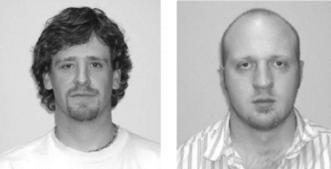
Topic #12
Facial prototyping: Do people tend to associate names with faces?
Who is on the left: Bob or Tim?

Slide 46
Topic #12
36 of 46 students put Tim on the left
  What are two possible explanations for our observed sample result?
  Which explanation can we investigate/model? How?
  How often would such an extreme sample result occur by chance alone (if there were no facial prototyping)?
  Flip coins to investigate

Slide 47
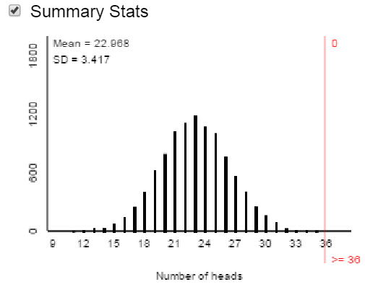
Topic #12
Facial prototyping: 10,000 simulated samples of 46 students
Very strong evidence that people have a genuine tendency to put Tim on left

Slide 48
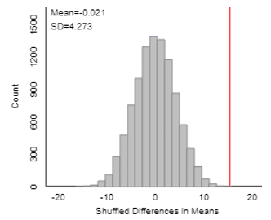

Topic #12
Anchoring effect: Mandela’s age
Conduct simulation analysis
Do the data provide strong evidence that the anchor number affects people’s responses?

Slide 49
Topic #13
Statistical inference does not reveal, or account for, everything of interest.

Slide 50
Topic #13
Suppose that an alien lands on earth and sets out to estimate the proportion of human beings who are female
The alien took a good statistics course on its home planet and knows to take a sample, produce a confidence interval
Sample: the 2020 U.S. Senate, which has 26 women (the most ever!) and 74 men

Slide 51
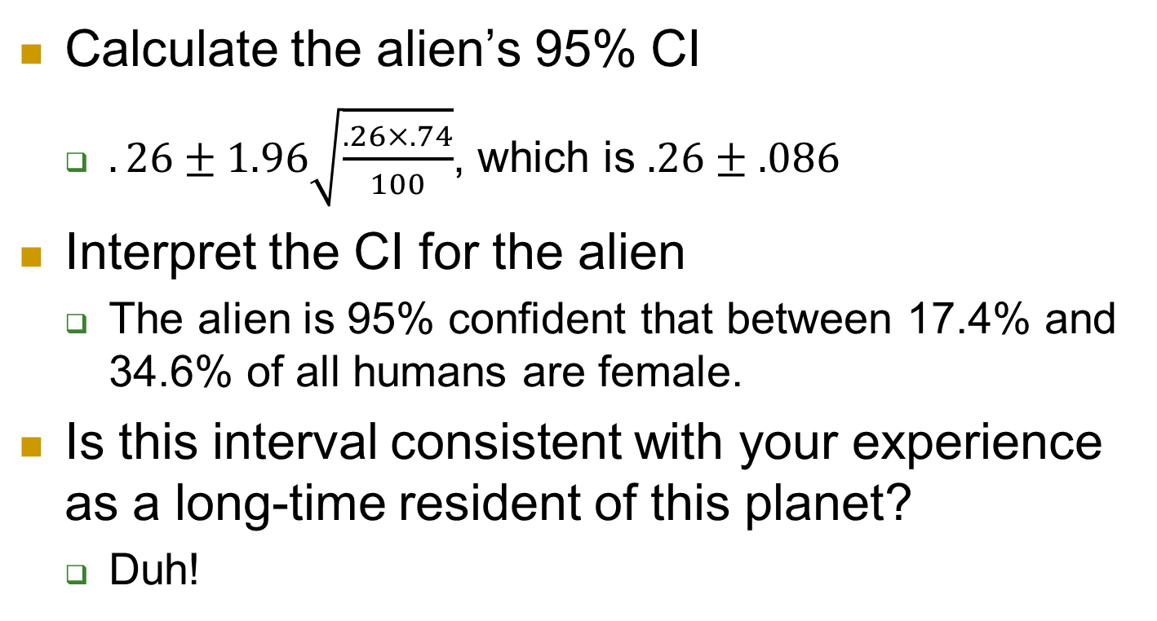
Topic #13
Calculate the alien’s 95% CI
  $.26±1.96\sqrt{\frac{.26×.74}{100}}$, which is $.26±.086$
Interpret the CI for the alien
  The alien is 95% confident that between 17.4% and 34.6% of all humans are female.
Is this interval consistent with your experience as a long-time resident of this planet?
  Duh!

Slide 52
Topic #13
Is the problem that 5% of all 95% CIs fail to capture actual value of population parameter?
  No!
Then what went wrong???
  Biased sampling method!
If the alien was only interested in estimating the proportion of 2020 U.S. Senators who are female, would this 95% CI make sense?
  No, exactly 26% of senators in 2020 are female!

Slide 53
Conclusion
My teaching philosophy:
Ask good questions

Slide 54
Conclusion
Everything presented here can be found in my weekly blog posts
https://askgoodquestions.blog
  Ideas, examples, activities, assessments, advice for teaching introductory statistics
  Aim to be practical, thought-provoking, fun
  52 posts from July 2019 – June 2020
    More than 123,000 words

Slide 55
Conclusion (Question 1 of 5)
I sometimes joke that when I moved from Pennsylvania to California, the average IQ dropped in both states!
Is this possible (in principle, anyway)?
What would have to be true for this to occur?
Yes, if (avg IQ in PA) < my IQ < (avg IQ in CA)

Slide 56
Conclusion (Question 2 of 5)
Exam scores have mean 70, SD 8
  Arturo’s score is 75
  Bella’s score is 1.5 SDs above Arturo’s
What is Bella’s score on the exam?
  Concept: Measuring distance as number of SDs away from something
  Not necessarily away from mean

Slide 57
Conclusion (Question 3 of 5)
Suppose that every student in our class scores 5 points lower on the second exam than on the first exam.
What would be the value of the correlation coefficient between (exam1 score) and (exam2 score)?
  Options: -5, -1, -0.5, 0, 0.5, 1, 5
  Correct: 1, common: -1, most discouraging: -5

Slide 58
Conclusion (Question 4 of 5)
2018 General Social Survey
  47% had a pet dog
  25% had a pet cat
Does it follow that 72% (which is 47% + 25%) had a pet dog or a pet cat?
  Under what circumstance would this be true?
Only true if no households have both

Slide 59
Conclusion (Question 5 of 5)
Which would be larger – the mean weight of 10 randomly selected people or the mean weight of 1000 randomly selected cats? Explain briefly.
Which would be larger – the standard deviation of the weights of 1000 randomly selected people or the standard deviation of the weights of 10 randomly selected cats? Explain briefly.

Slide 60
Conclusion (Question 5 of 5)
Many of my students think that larger sample size produces smaller SD
  Do not realize that SD of the sample mean (or sample proportion) gets smaller as sample size increases
Advice: When you talk about SD, always emphasize SD of what

Slide 61
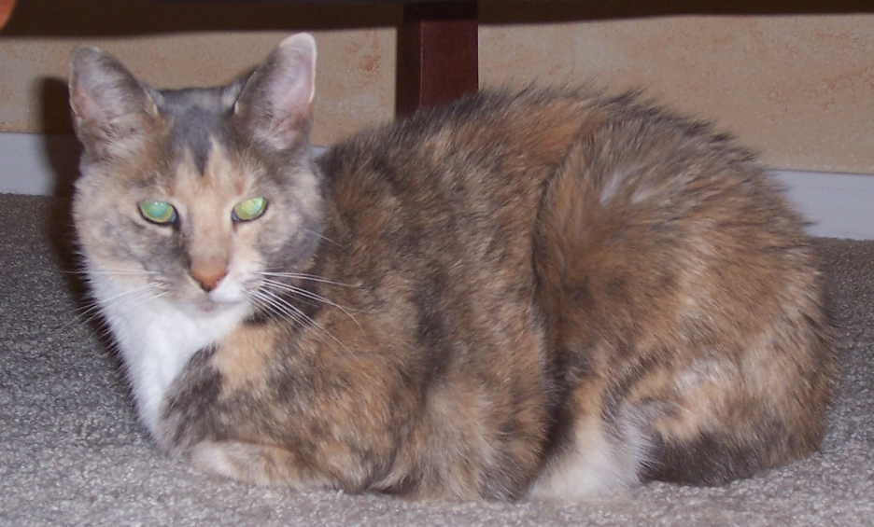
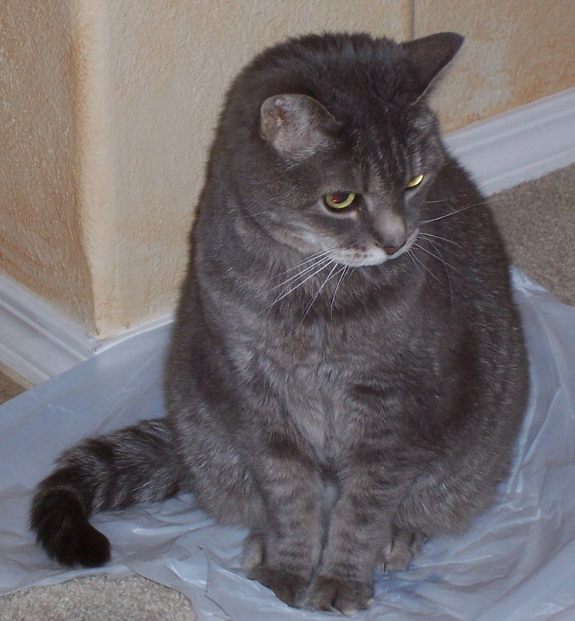

Conclusion
My cats (Eponine, Cosette, Puti)

Slide 62
Conclusion
Thanks very much!
arossman@calpoly.edu
https://askgoodquestions.blog

