Slide 1
Teaching Introductory Statistics: Ask Good Questions
Allan J. Rossman
Department of Statistics
Cal Poly – San Luis Obispo
Email: arossman@calpoly.edu
Blog: https://askgoodquestions.blog
(These slides are under “Presentations”)

Slide 2
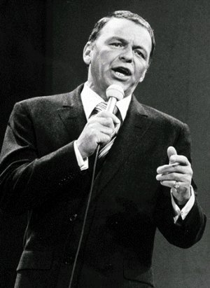
Frank Sinatra
What’s the secret to being a successful singer?
  “Sing Good Songs”
2

Slide 3
My similarly succinct suggestion
What’s the secret to being an effective teacher?
  “Ask Good Questions”
3

Slide 4
The end?
I’m tempted to stop there!
Take-home message
  Ask Good Questions
Quiz at end of presentation
  Ask Good Questions
If we bump into each other ten years from now, I’ll be overjoyed if you think
  Ask Good Questions

Slide 5
What kinds/purposes of questions?
Guide students to develop their understanding and skills
  Formative assessment
  Learning activities
Assess what students have learned
  Summative assessment
  Quiz/exam questions
5

Slide 6
Topics of questions in this presentation
Statistical thinking
Descriptive statistics
Sampling and experimentation
Probability
Simulation-based inference
Confidence intervals
Multi-variable thinking

Slide 7
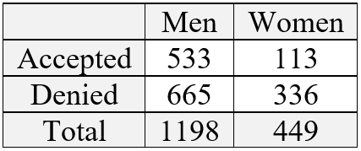
Statistical thinking
Example: Sex discrimination?
Men: 533/1198 ≈ .445 were accepted
Women: 113/449 ≈ .252 were accepted
Does this provide evidence of discrimination against women?

Slide 8
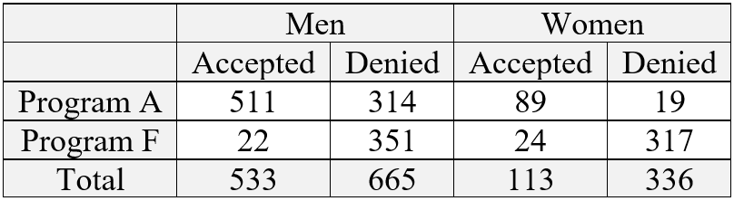
Statistical thinking
Program A
  Men: 511/825 ≈ .619; Women: 89/108 ≈ .824
Program F:
  Men: 22/373 ≈ .059; Women: 24/341 ≈ .070

Slide 9
Statistical thinking
What’s surprising about these percentages?
  Men had a much higher acceptance rate than women overall
  But women had a higher acceptance rate than men in each program
Explain how this happened, using the data
  Most men applied to the program with high acceptance rates (A)
  Most women applied to the program with low acceptance rates (F)

Slide 10
Statistical thinking
Example: Draft lottery
On December 1, 1969, the United States implemented a lottery to draft young men into the military (https://www.youtube.com/watch?v=-p5X1FjyD_g)
Each of the 366 birthdays of the year was assigned a draft number
  Those with smaller draft numbers were drafted
Find your birthday’s draft number
  Any 139s?

Slide 11
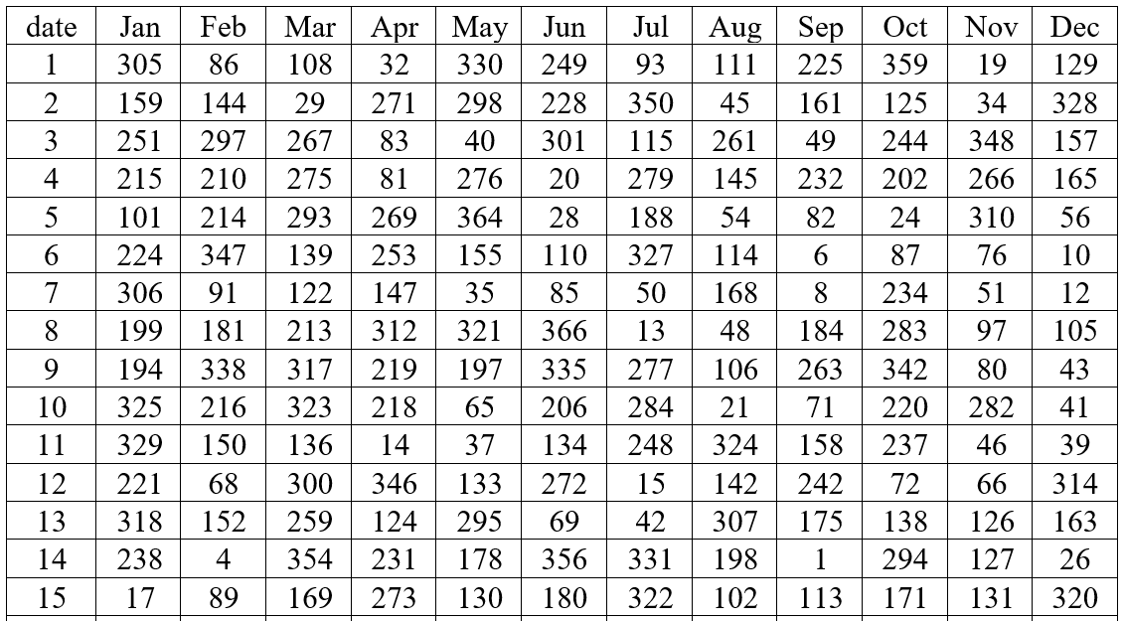
Statistical thinking

Slide 12
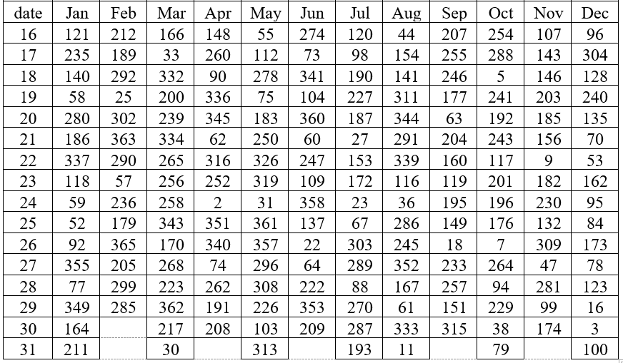
Statistical thinking

Slide 13
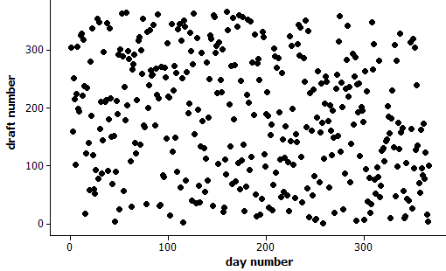
Statistical thinking
Any reason to doubt randomness?

Slide 14
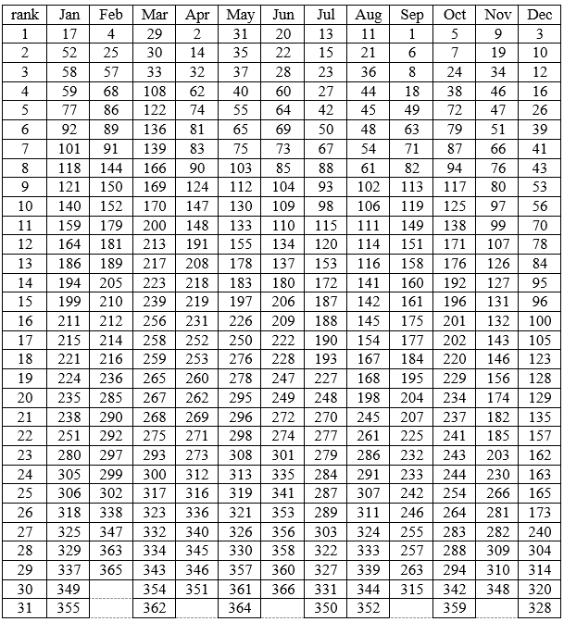
Statistical thinking
Calculate median draft number for each month
Draft numbers sorted within each month from smallest to largest

Slide 15
Statistical thinking
Calculate median draft number for each month
Jan 211 Jul 188
Feb 210 Aug 145
Mar 256 Sep 168
Apr 225 Oct 201
May 226 Nov 131.5
Jun 207.5 Dec 100
Do you see a pattern/trend?

Slide 16
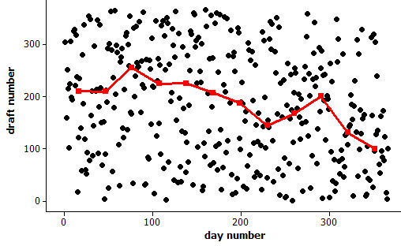
Statistical thinking
Any reason to doubt randomness?

Slide 17
Statistical thinking
How often would such an extreme outcome occur with a truly random lottery?

Slide 18
Statistical thinking
How often would such an extreme outcome occur with a truly random lottery?
What statistic might you use to determine “extreme”-ness?

Slide 19
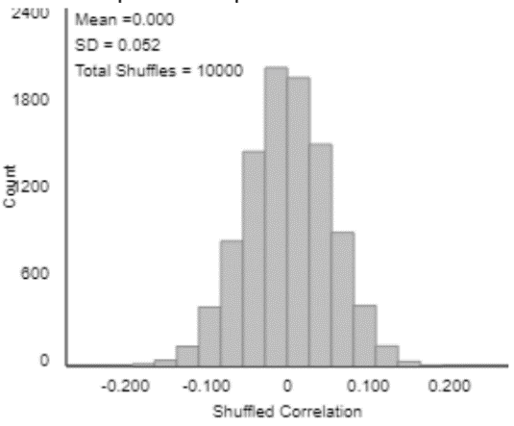
Statistical thinking
How often would such an extreme outcome occur with a truly random lottery?
What statistic might you use to assess “extreme”-ness?
  Correlation ≈ -0.226

Slide 20
Descriptive statistics
I suspect that when I moved from PA to CA, the average IQ dropped in both states!
  Is this possible?
  What would have to be true (in principle) for this to happen?
Yes, if (my IQ > average IQ in PA)
and (my IQ < average IQ in CA)

Slide 21
Descriptive statistics
Suppose that Abby records the ages of customers at The Avenue (on-campus snack bar) from 11am-2pm today, while Mary records ages of customers at McDonald’s (near freeway).
Who will have the larger standard deviation of customer ages: Abby or Mary? Explain.

Slide 22
Descriptive statistics
Example (adapted from Jay Lehmann):
Which would be larger – the mean weight of 10 randomly selected people or the mean weight of 1000 randomly selected cats? Explain briefly.
Which would be larger – the standard deviation of the weights of 1000 randomly selected people or the standard deviation of the weights of 10 randomly selected cats? Explain briefly.

Slide 23
Descriptive statistics
Many of my students think that larger sample size produces smaller SD
Do not realize that SD of the sample mean (or sample proportion) gets smaller as sample size increases
Advice: When you talk about SD, always emphasize SD of what

Slide 24
Descriptive statistics
Suppose that every student in our class scored 5 points lower on the second exam than on the first exam.
What would be the value of the correlation coefficient between (exam1 score) and (exam2 score)?
  Options: -5, -1, -0.5, 0, 0.5, 1, 5

Slide 25
Sampling and experimentation
Example: Gettysburg Address
Select a sample of 10 words from the population of 268 words in the Gettysburg Address. (Just circle 10 words.)
  Record the length (# of letters) of each word.
  Calculate average length for your sample.
  Produce graph of sample averages.
Is this a reasonable sampling method for estimating average word length in population?

Slide 26
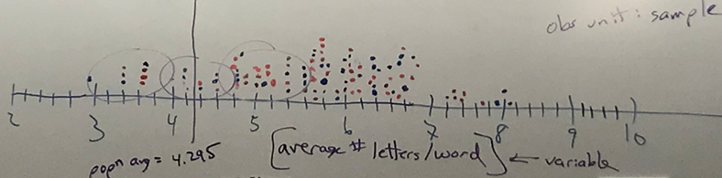
Sampling and experimentation
How does this graph indicate sampling bias?
Would closing eyes and pointing be unbiased?

Slide 27
Sampling and experimentation
Example: Mandela’s age
  Group 1: Nelson Mandela was the first president of South Africa following apartheid.
    Do you think he was older or younger than 16 years old when he died?
    Make a guess for how old he was when he died.
  Group 2: Nelson Mandela was the first president of South Africa following apartheid.
    Do you think he was older or younger than 160 years old when he died?
    Make a guess for how old he was when he died.

Slide 28
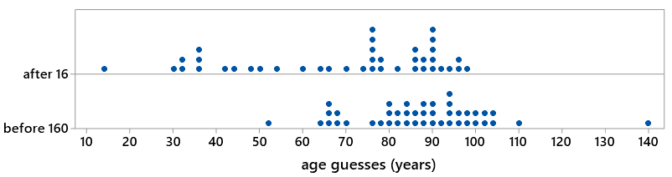
Sampling and experimentation
Example: Mandela’s age
t = -4.17; p-value ≈ .0000
Very strong evidence for anchoring effect

Slide 29
Sampling and experimentation
Random sampling and random assignment are different tools with different purposes
Random sampling
  Goal: Select representative sample
  Benefit: Generalize results
Random assignment
  Goal: Produce similar groups
  Benefit: Draw cause-effect conclusions

Slide 30
Probability
2018 General Social Survey
  47% had a pet dog
  25% had a pet cat
Does it follow that 72% (which is 47% + 25%) had a pet dog or a pet cat?
  What would be required for this to happen?
No!
  Would require that no households have both

Slide 31
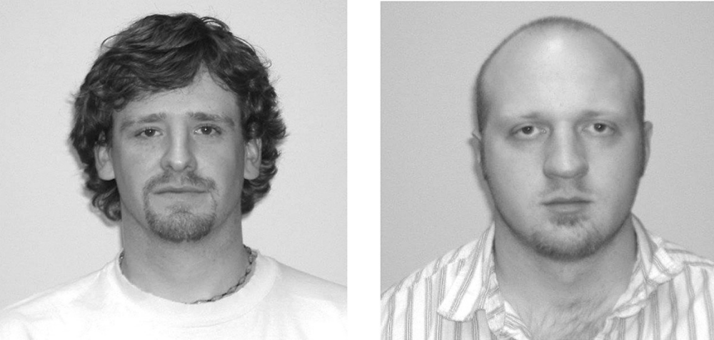
Simulation-based inference
Example: Facial prototyping
Do people tend to associate names with faces?
Who is on the left: Bob or Tim?

Slide 32
Simulation-based inference
Example: Facial prototyping (cont)
36 of 46 students put Tim on the left
  What are two possible explanations for our observed sample result?
  Which explanation can we investigate/model? How?
  How often would such an extreme sample result occur by chance alone (if there were no facial prototyping)?
  Have students flip coins to investigate

Slide 33
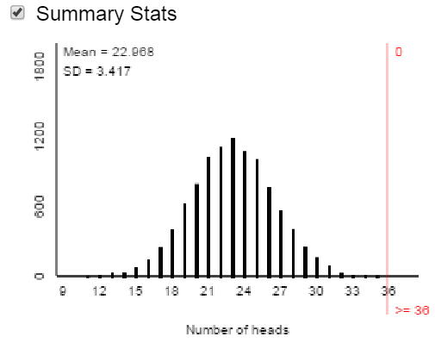
Simulation-based inference
Facial prototyping: 10,000 simulated samples of 46 students
Very strong evidence: people have a genuine tendency to put Tim on left

Slide 34
Confidence intervals
What does 95% confidence mean?
Simulation:
www.rossmanchance.com/applets
(Simulating confidence intervals)

Slide 35
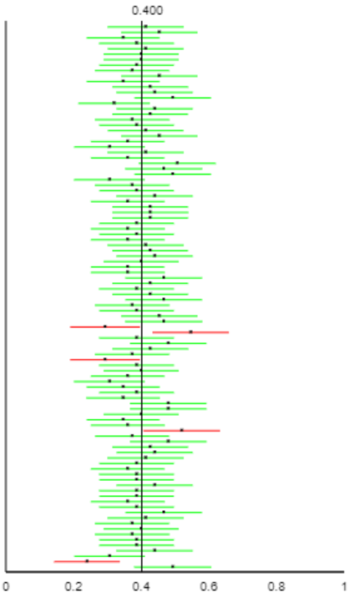
Confidence intervals
What does 95% confidence mean?
Simulation:

Slide 36
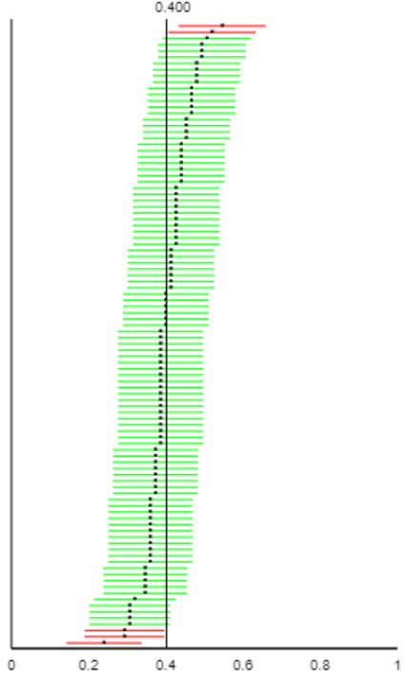
Confidence intervals
What does 95% confidence mean?
Simulation:

Slide 37
Confidence intervals
What would change (two things) if the confidence level was increased or decreased?
Predict,
then test

Slide 38
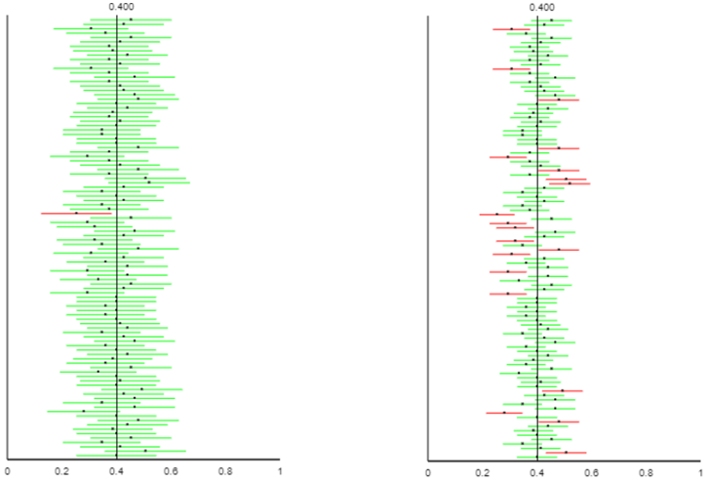
Confidence intervals
What would change (two things) if the confidence level was increased or decreased?
Predict,
then test
99% (left)
80% (right)

Slide 39
Confidence intervals
What would change if the sample size was increased?
Predict,
then test

Slide 40
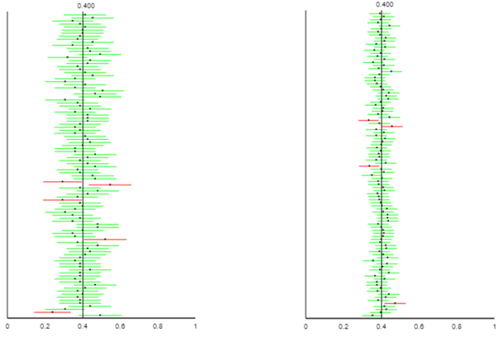
Confidence intervals
What would change if the sample size was increased?
Predict,
then test
Smaller n (left)
Larger n (right)

Slide 41
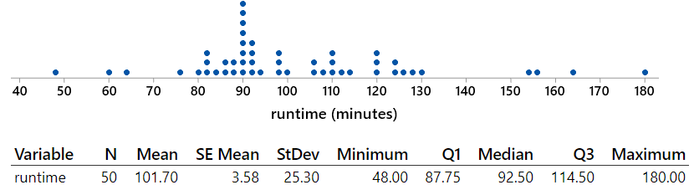
Confidence intervals
Random sample of 50 movies in “thriller” category from IMDb database

Slide 42
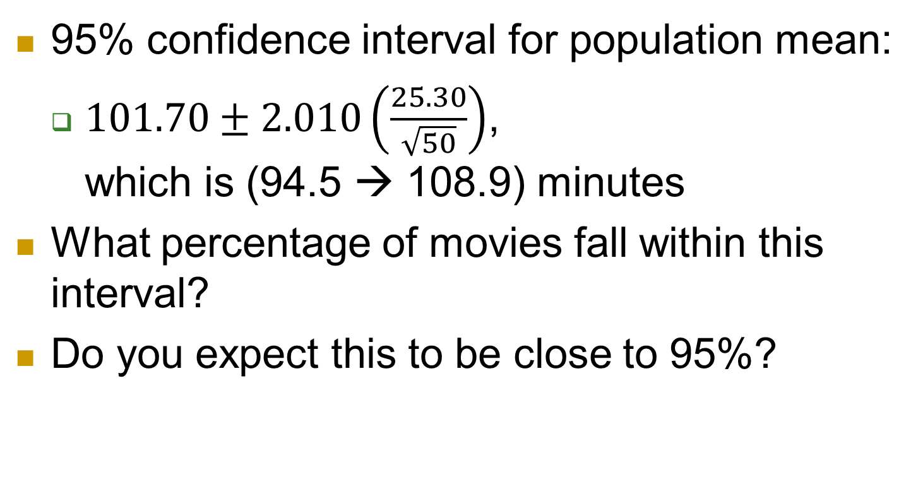
Confidence intervals
95% confidence interval for population mean:
  $101.70±2.010\left(\frac{25.30}{\sqrt{50}}\right)$, which is (94.5 → 108.9) minutes
What percentage of movies fall within this interval?
Do you expect this to be close to 95%?

Slide 43
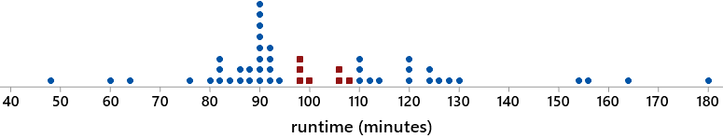
Confidence intervals
7 of 50 movies (14%) fall within this interval
CI estimates popn mean, not individual values
Many students misunderstand this
  Much more important than confidence level

Slide 44
Intervals and tests
Survey of 47,000 U.S. households in 2006 found that 32.4% had a pet cat
Does this provide very strong evidence that the population proportion with a cat is different from one-third?
Does this provide strong evidence that the population proportion with a cat is very different from one-third?

Slide 45
Intervals and tests
Does this provide very strong evidence that the population proportion with a cat is different from one-third?
  Yes! Test stat z ≈ -4.29, p-value ≈ .00002
Does this provide strong evidence that the population proportion with a cat is very different from one-third?
  No! 99.9% CI: (.317 → .331)

Slide 46
Intervals and tests
Hypothesis test and confidence interval give consistent results
  Value one-third is rejected, does not appear in CI
Statistical significance is different from practical importance
  Especially relevant with large sample sizes

Slide 47
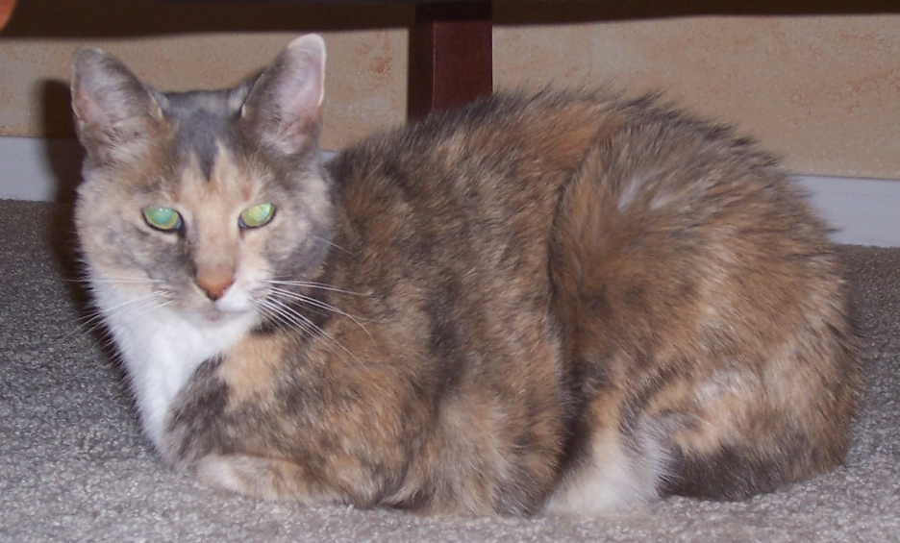
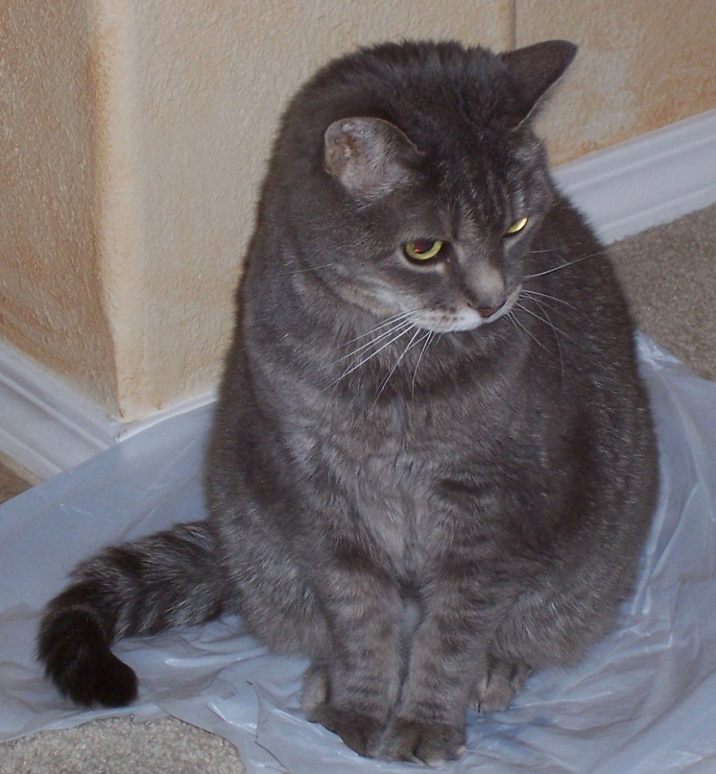
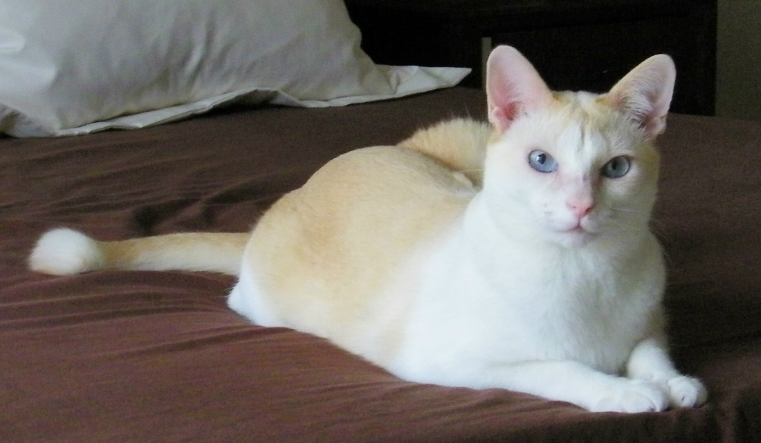
My cats

Slide 48
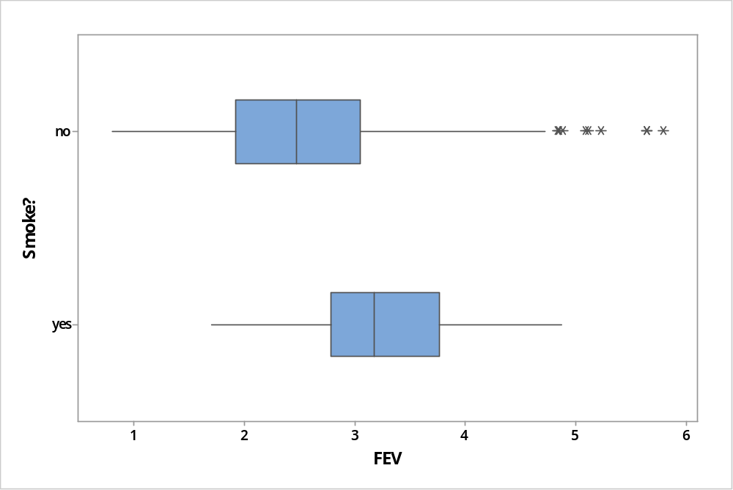
Multivariable thinking
Example: Lung capacity and smoking
t = 7.15
p-value ≈ .0000
What’s going on here???

Slide 49
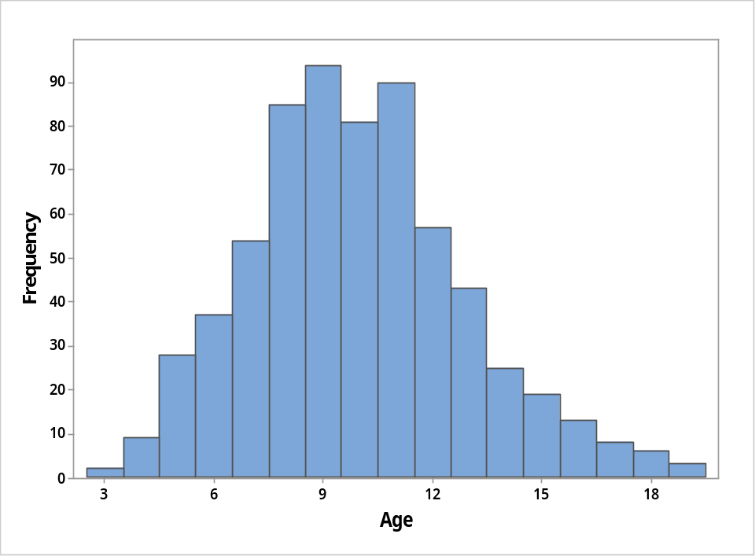
Multivariable thinking
Confounding variable
These data are from children aged 3 – 19
How does age explain why smokers have significantly larger lung capacities than non-smokers?

Slide 50
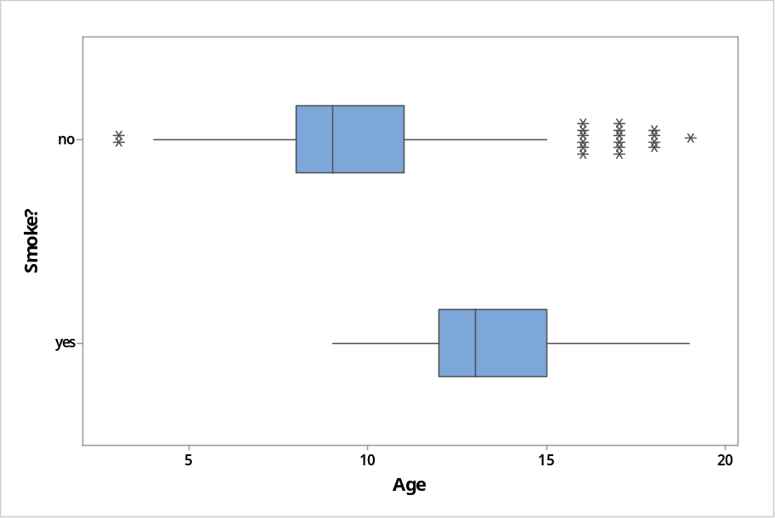
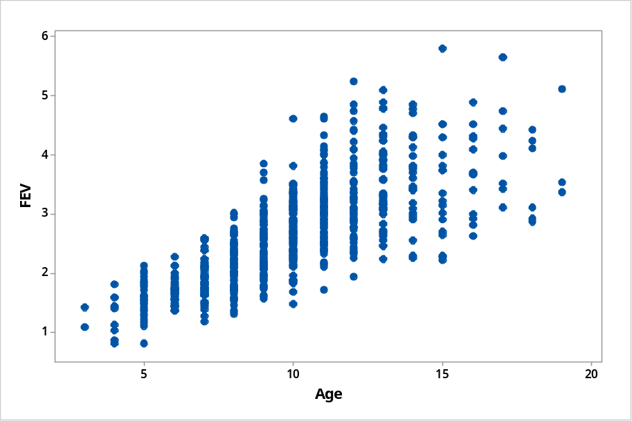
Multivariable thinking
Age is associated with both smoking status and lung capacity

Slide 51
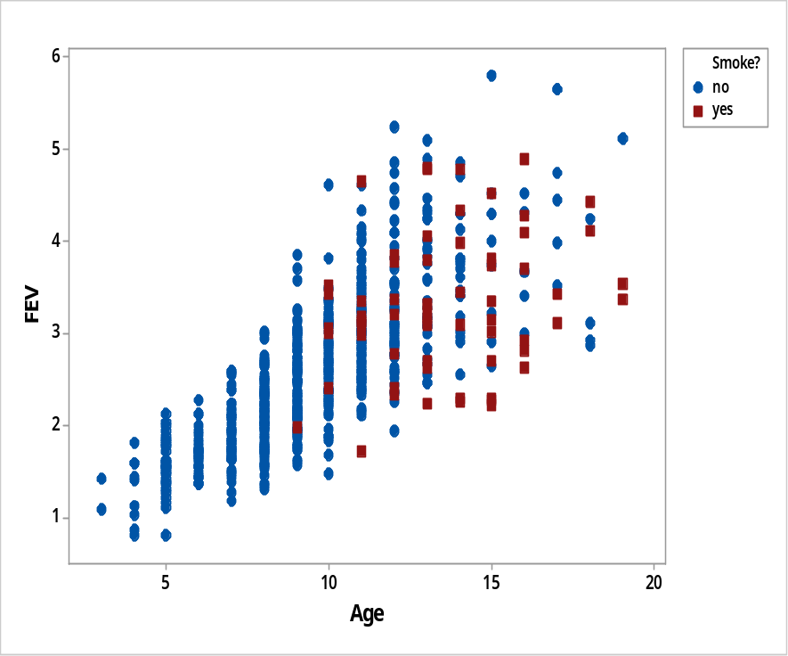
Multivariable thinking
Look at all three variables together

Slide 52
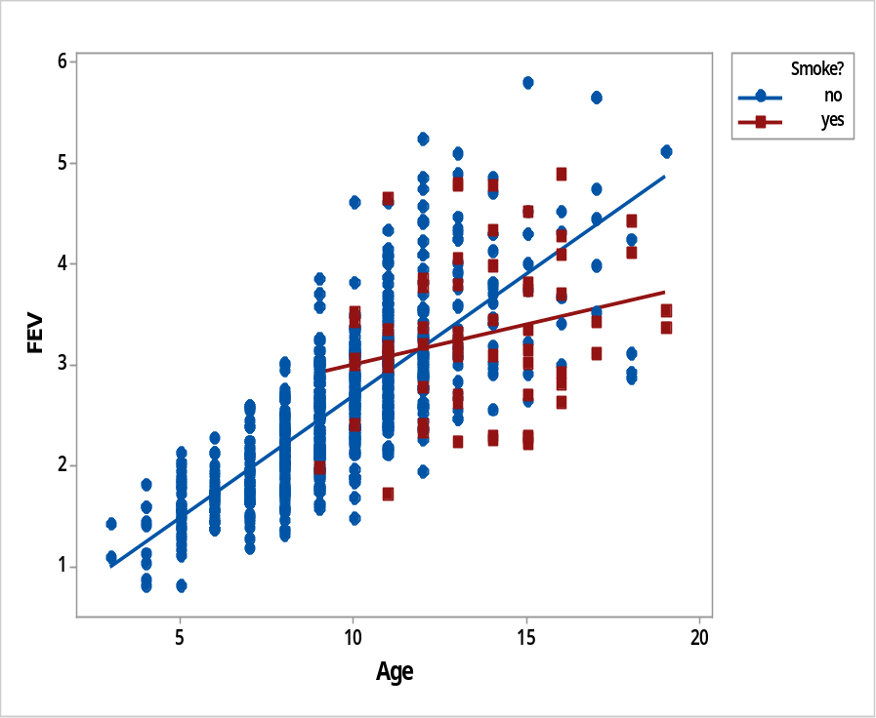
Multivariable thinking
Look at all three variables together

Slide 53
Multivariable thinking (cont)
After controlling for age, smokers have smaller lung capacity than non-smokers (12 or older)
Rate of increase in lung capacity per year of age is smaller for smokers than for non-smokers

Slide 54
“Ask Good Questions” blog
Ideas, examples, activities, assessments and advice for teaching introductory statistics
Three goals
  Practical, for direct use with students
  Thought-provoking, for discussion with peers
  Casual writing style, fun to read
One post/essay per week (87 so far)
  Published on Mondays at 11am ET, 8am PT
askgoodquestions.blog

Slide 55
Some final questions for you
Have you ever attended a presentation titled
  Ask Bad Questions?
Have you ever attended a presentation titled
  Don’t Ask Questions?
Of course not! So, …
  Why am I wasting your time with such obvious advice as “Ask Good Questions”??
55

Slide 56
Yeah, why am I wasting your time?
I respectfully suggest that the next time you (or I) feel compelled to invest our valuable time, thought, energy, and creativity on …
  Preparing crystal-clear lectures
  Writing lucid paragraphs of exposition
  Crafting beautiful presentations
56

Slide 57
What should we do?
57

Slide 58

What should we do?
58
Resist this temptation!

Slide 59
So, what do I suggest instead?
Instead we should invest these precious commodities (time, thought, energy, creativity) on
  Developing engaging classroom activities
  Preparing thought-provoking assignments
  Crafting effective assessment items
In other words, we should be sure to …
59

Slide 60
What’s the take-home message?
Ask Good Questions!
Thanks very much!
https://askgoodquestions.blog
arossman@calpoly.edu
60

